Slide 1
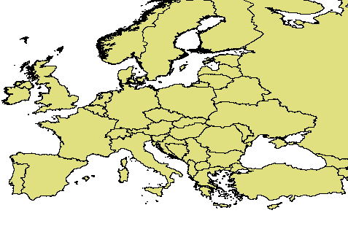

Current SDI development topics
in Central Europe
with respect to Spatial Planning
and Geoinformation Policies
Jiří Hiess
KGI UPOL
University Palackeho, Olomouc, cathedra of geoinformatics (CZ)
hiess2@gmail.com
Notes:
1

Slide 2
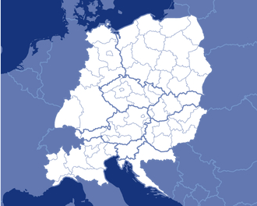
2013: Central Europe in EU 28

Slide 3
What are barriers and challenges of spatial planning and regional development?
What are current approaches to overcome these?
Infrastructure: state-of-play
Data > Geo-Data > GIS > SDI > INSPIRE (2007)…
Spatial Data Infrastructures > SDSI (+ Services, Sambura 2011)…
Networks and clouds of (geo)information
Shared complex geospatial infrastructure
Information for planning & decision making process:
PSI Directive (from 2003) + Free Data + Open Source =>
new environment, potential for deeper democratization &
better competitiveness
How do specialised disciplines (spatial planning,
geoinformatics, cartography) and their theory,
research, and practice reflect this amount of facts,
ideas, achievements, mistakes, experience?
UNDERESTIMATED!
Notes:
European countries join Geographical Information Systems into shared complex geospatial infrastructure nowadays, including large amount of geoinformation.

Slide 4
Examples the new data sources and inputs in planning processes require much more than pure existence, access to disposable, repositories and latest technology only!

Slide 5
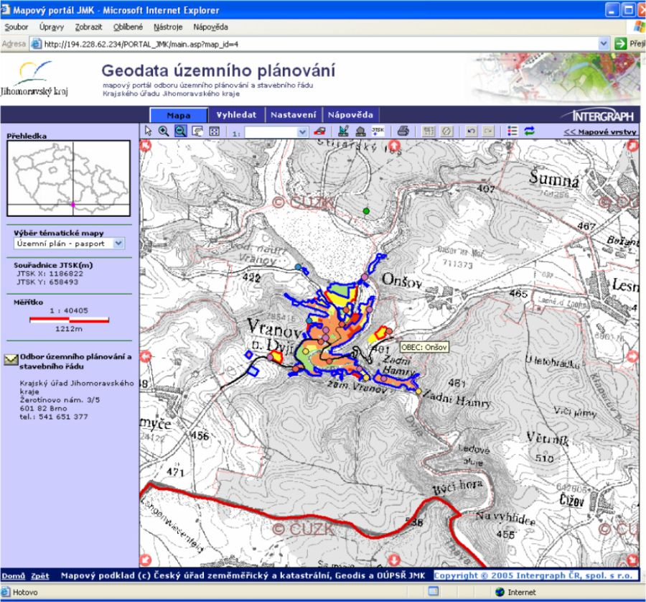
COMPLEX, PUBLIC, ACCESSIBLE SPI (spatial planing information)
1 : 40.000
the red bold line represents CZ/AT state border, coloured polygons show Urban Plan zones of Vranov nad Dyji - a village which gave name to the VRANOV dam; its lake fills a 30 km long river valley, the river DYJE flows from here through the bi-lateral National park Podyji-Thayatal and represents the natural state border.

Slide 6
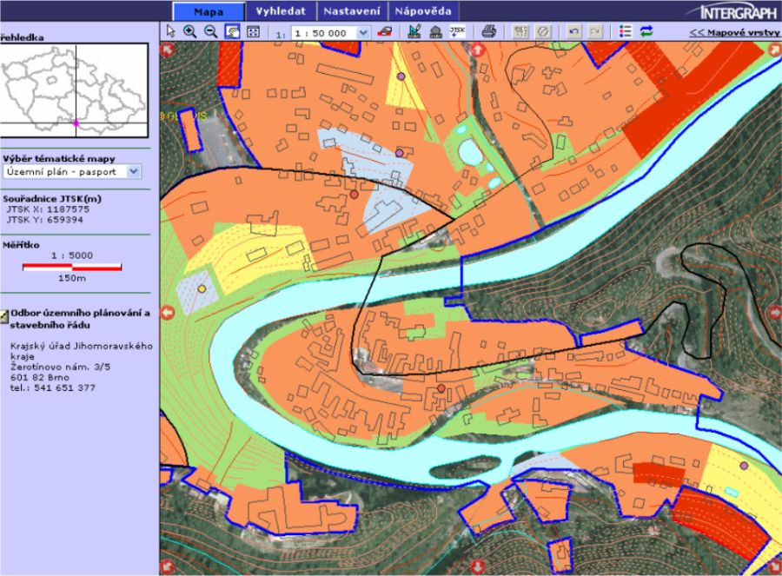
Disposable accuracy provides large scale DETAIL, BUT (!) the public administration often forget (is qualified enough ?) to generalize, work in alternatives, make new deeper and smart analysis, argue in wise decision making
1 : 5.000
generalized
urban plan of Vranov nad Dyji, intelligent geodata above orthophoto and
cadastral map (refernce GMVS components). This geoportal provides basic OWS + export of selected datasets to external customers (e.g. contractor, urban designer, architect, enterpreneur, citizen, tourist). This portal was launched in 2006 and is continuously developed.

Slide 7
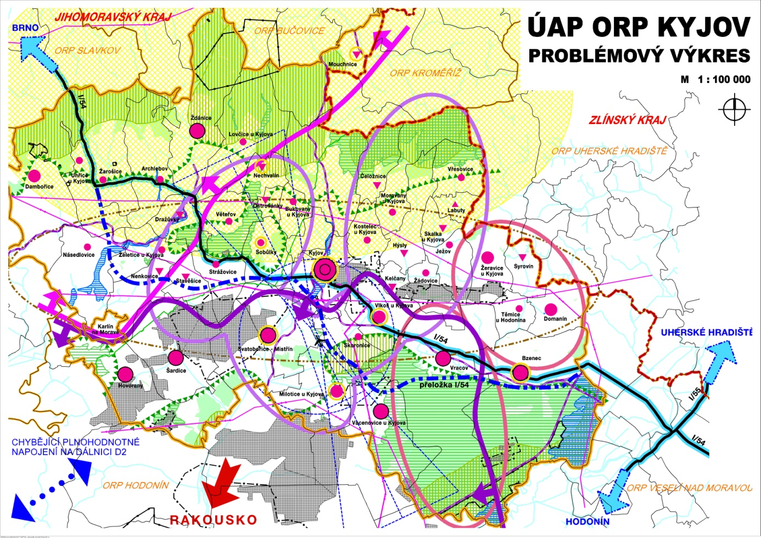
Currently: digital analytical planning backgrounds example: conflict of dumping prices, weak experience of staff, barriers to collect (or effectively protect?) corporate and infrastructural data

Slide 8
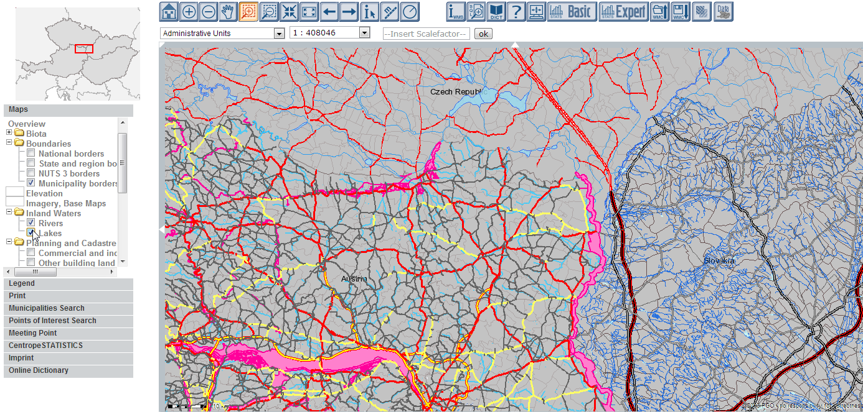

Slide 9
Visualisation,
harmonisation,
standardisation,
accessibility
data quality
catalogization
… in progress

Slide 10
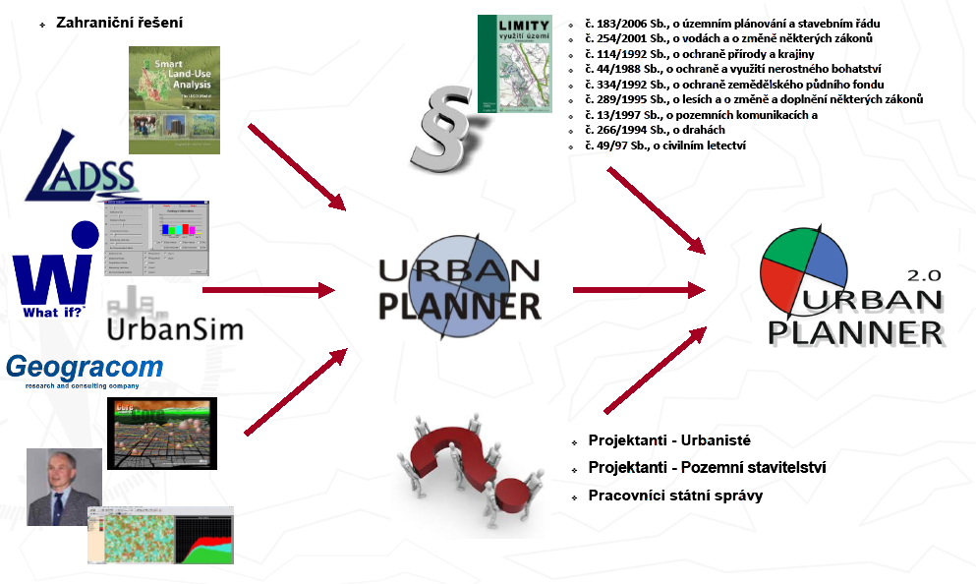
New GIT applications > less need of human resource mass,
a higher qualification of HR is expected (this example was developed at UPOL)

Slide 11
INSPIREd GI Policies
EU Directive was excellent impuls
Annexes II + III relevant to spat. planning!
30000 pages of implementing RULES!
The concept of European SDI
…ELF - European Loc. Framework,
GMES, GNSS, … USAGE!

Slide 12
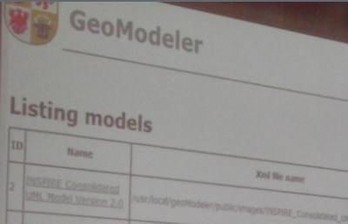
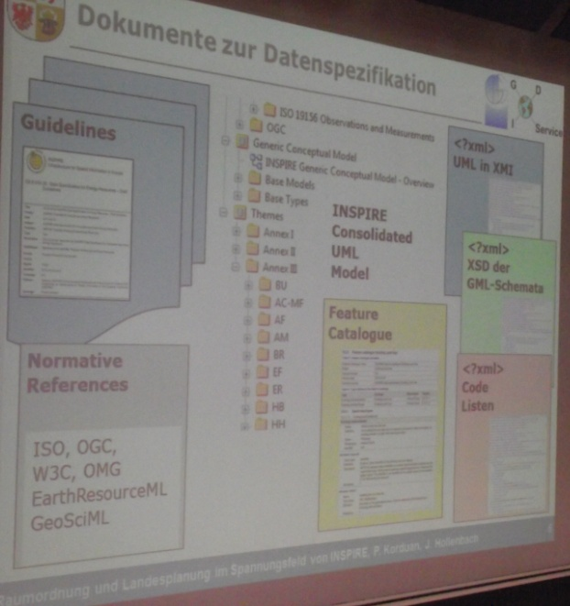
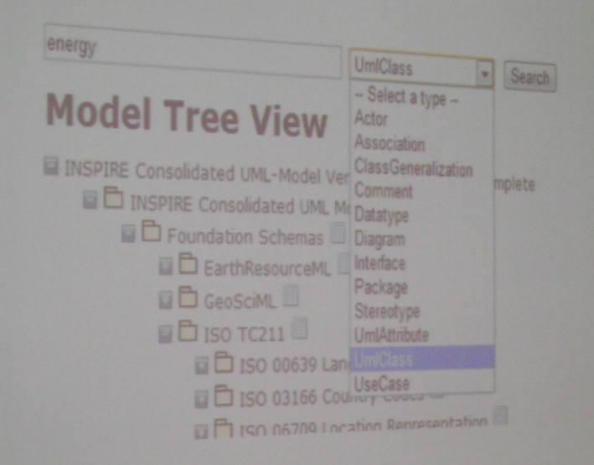
From INSPIRE rules to
planning practice :
GeoModeler app.
(J. Hollenbach, P. Korduant, DE, 2013)

Slide 13
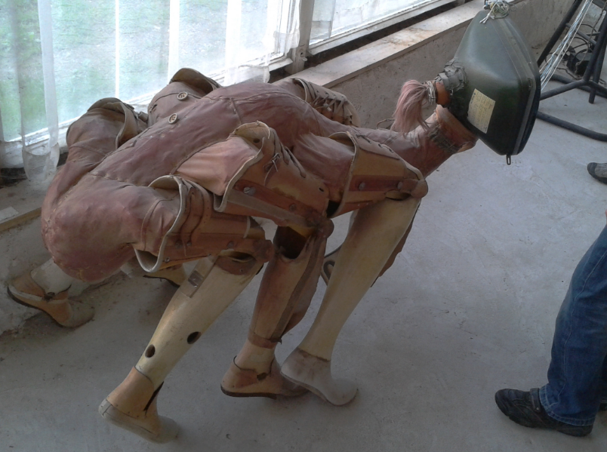
HR goal: surreal androanimaloid ?
Does technology determinate the progress? Is ICT omnipotent ?

Slide 14
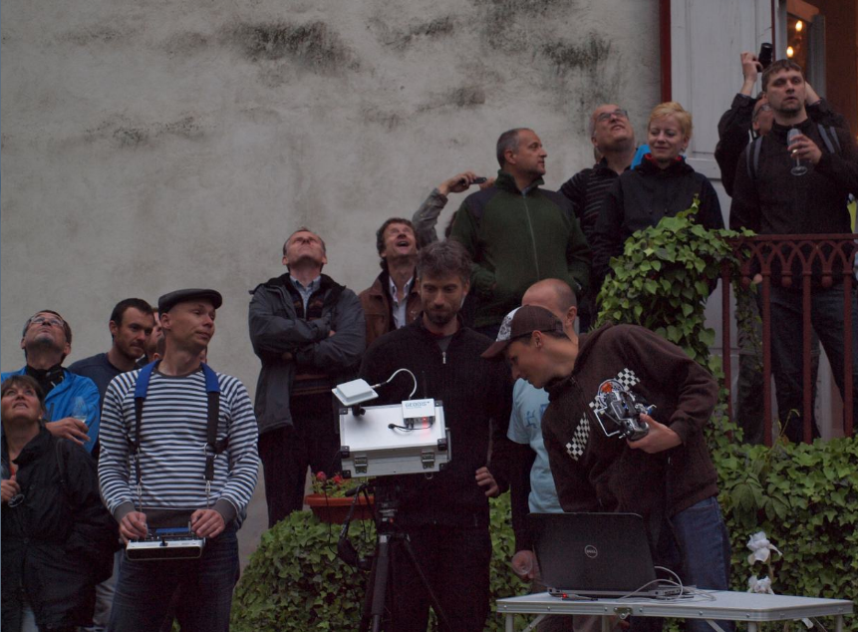
Surprise:
What has happen upstairs?

Slide 15
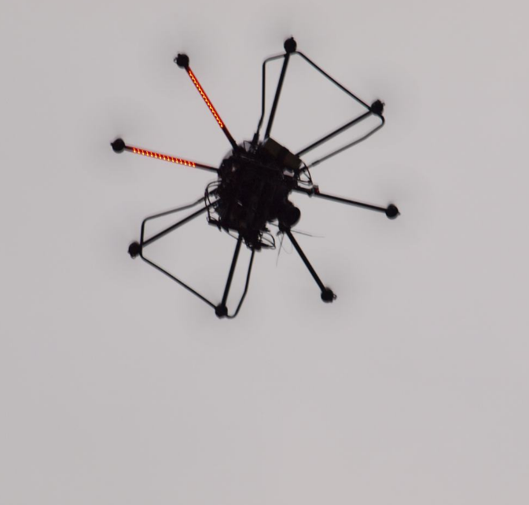
UAV octoptera live demonstration
for spatial planners at UP-GIS 2013

Slide 16
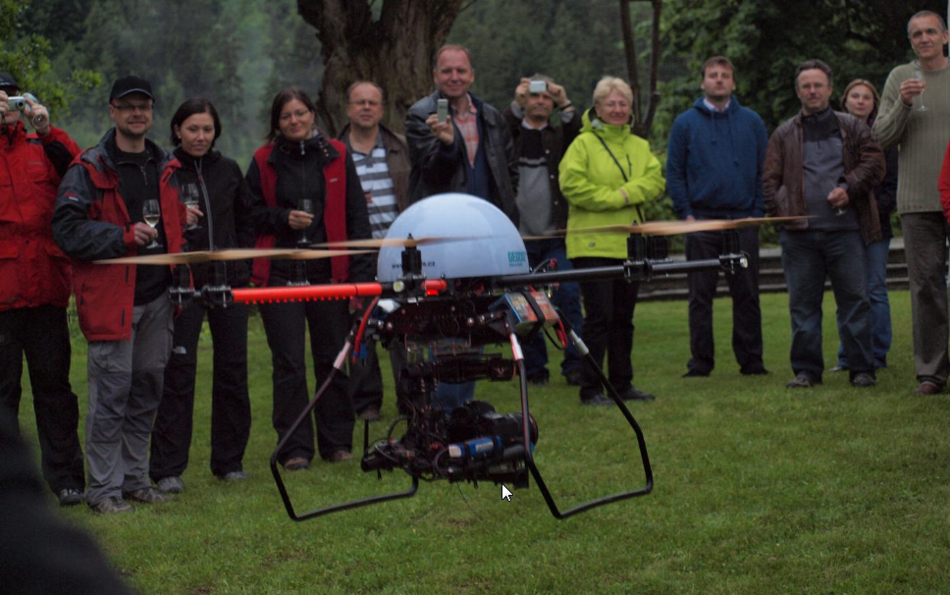
UAV as accessible source of immediate spatial (planning) data
and operational part of complex information
for territorial planning and management

Slide 17
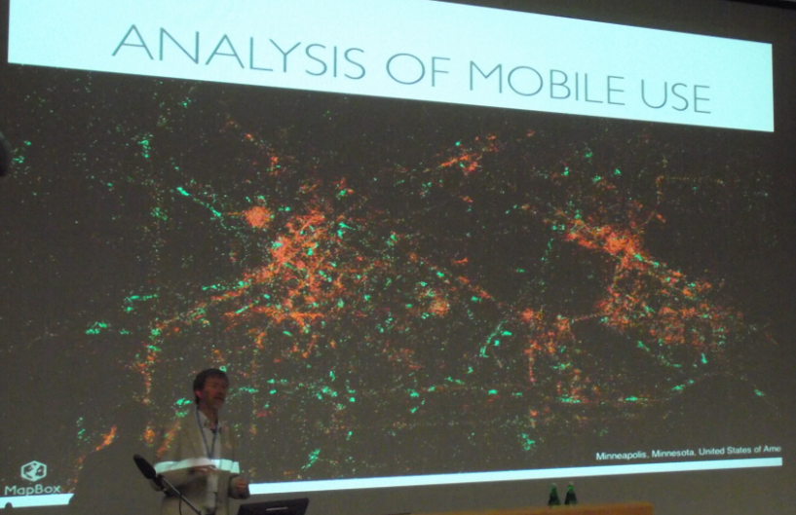
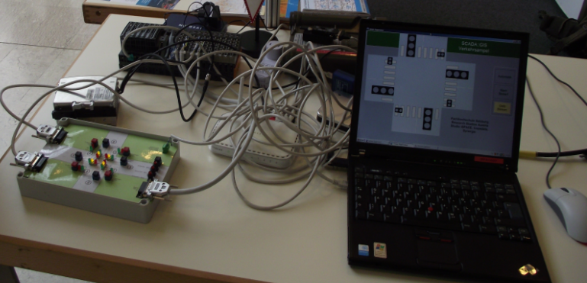
Many from ICT dreams become realistic guidelines for our future
(F. Harvey at AGIT 2013, Salzburg)

Slide 18
Achievements Some dreams became reality in last decade!
From islands of GIS > to interconnected nodes of distributed SDSI (btw. in planning, DSS, e.g. CentropeMAP)
Mass professional Geodata production (from digitalization > quality, collaboration, GNSS)
OWS progress:
  WMS as standard,
  WFS? < licensing, pricing!
  CWS – principle changes in data production
  WPS – from tests and pilots to routine practice
Return of investment, efficiency, competitiveness:
SDSI + Digital Planning/DSS = comparative advantage
Progress „engines“: Academic (UMN), Commercial (GoogleEarth), Volunteers (OpenStreetMap) < more creative people than institutions!
European specifics
  Multilinguality, Unifying & integration process ~ European diversity
Well indicated problems = future opportunities!

Slide 19
From the SPA-CE.net Declaration 2013:
Better spatial planning for better life
(the Network of Spatial Research and Planning Institutes in Central, Eastern and South Eastern Europe)
…To guarantee sustainability of the development and continuity of accumulated knowledge and information in public spatial research institutes, and their accessibility for broad public, professionals and decision makers…

Slide 20
Challenges (i) What to do next at the edge of Spatial planning and GIS?
New interconnected superstructures represent much more than GIS composed from GISs. They involve new specialised segments, new copmrehensive quality, are based on multidimensional relations, not flat linear organization. They generate new demand, requirements, expectations, tasks > PLANNING & DSS PROCESSES MORE FLEXIBLE AND COLLABORATIVE
To adapt the ubiquity of information networks and modelling limits, the world of simulations and concepts must be wise, and effective > DEEPLY ANALYSE, WORK IN ALTERNATIVES, MORE SIMULATIONS, MODELS
Geoportals and simple 3D modelling cannot be enough > Current spatial planning above large geo-databases with history requires ambitious solutions with TEMPORALITY, GI ENCAPSULATION, ON-LINE DYNAMICS!

Slide 21
Challenges (ii)
Geoinformation technologies (GIT) are integrative tool > simplify the process of geodata production from heterogenous providers through evaluations, analysis, and harmonization up to new synthetic geoinformation;
Physical and virtual worlds merge, the space/time experience, increasing mobility, and modes of interactivity represent the new opportunities more than risks! > Spatial planning has to define up-to date demands both to GI research and GI industry.
INSPIRE implementation brought not only added values, it invoked new investments too > experts must define OWN requirements; INSPIRE will expire in several years!
In ongoing interdisciplinary competition enforce the new tasks into programs, plans, politically approved Geoinformation Policies

Slide 22
Challenges (iii)
To develop, implement, and sucessfully sell the advanced GI-encapsulated products > even in spatial planning and decision sphere we have to change barriers in our brains, eliminate brakes in existing organizational structures, create new collaborative enviroment, access rules...
Internationally shared professional LLL in well fitted geomatic courses for postgraduated practitioners > Professionally conducted and certified Life-long learing is the key to Human Resources improvement.
GI knowledge - of expert users, of live population, special skills, understandability, GI intelligence – all that represents much more than „googling“, it exceeds the still traditional borders of educational systém > knowledge in brains combined with new competencies are important for the better effectivity of GI use, including planning.

Slide 23
Conclusion:
Cooperative Planning
Technology + Geointelligence
INFRASTRUCTURE + KNOWLEDGE !
Synergies in the integrating European Spatial Data and Services Infrastructure
Innovations jave to bring comparative advantage, remarkable competiteveness!

Slide 24



Do we have common interests, goals?
Be proactive!
INVITATIONS:
05/2014 - UP-GIS conference, 20th anniversary
spatial planning progress based on GI achievements, Cross-border Cooperation,
main topic in 2014: Borders…
(http://www.upgis.cz)
06/2014 - StatGeo conference in Olomouc
international Workshop on Practical Aspects of Geochemical Exploration and Mapping with Logratio Techniques (http://statgis.upol.cz)

Slide 25
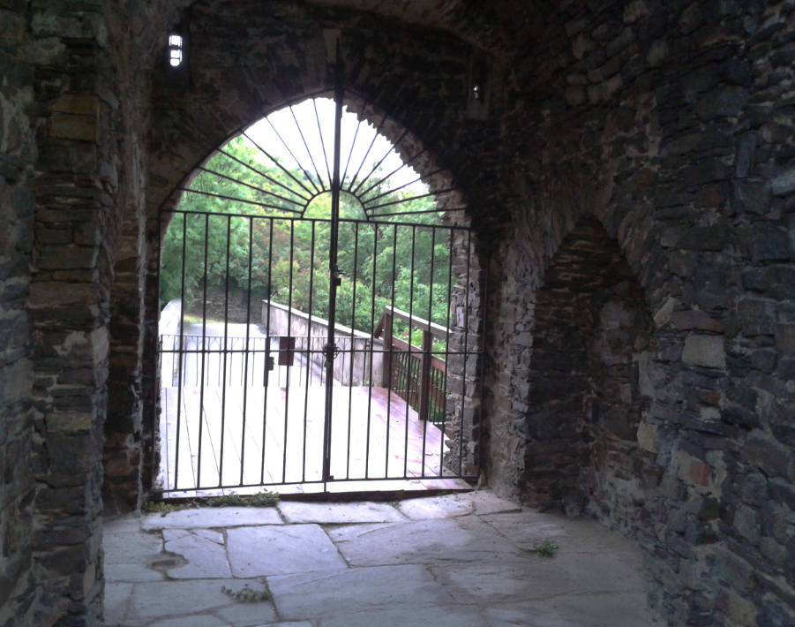
Barriers? Problems? = Only camouflaged opportunities!
Thanks for your attention!
Comments? Questions?
hiess2@gmail.com
Notes:
25

