Slide 1




November 18-21, 2013

Slide 2
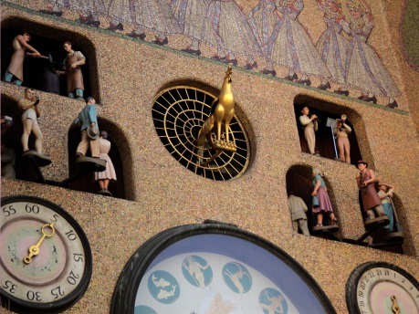
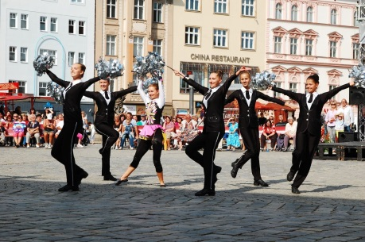
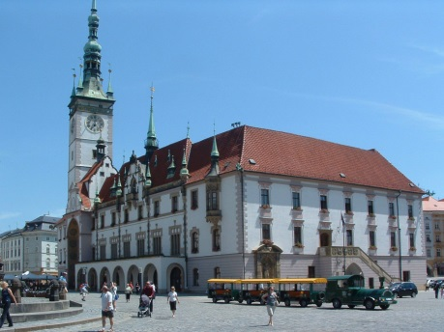
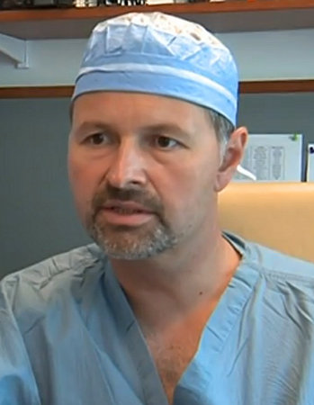
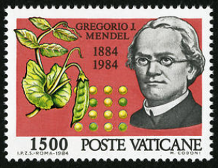
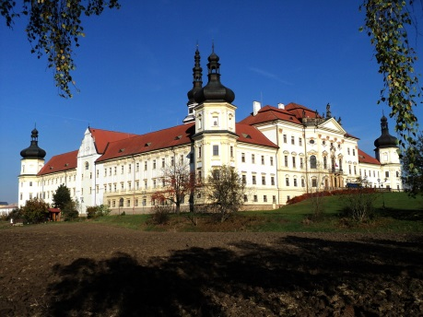
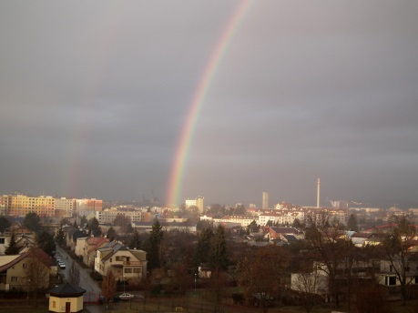
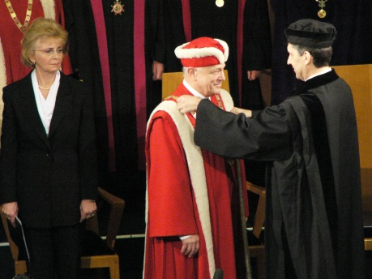
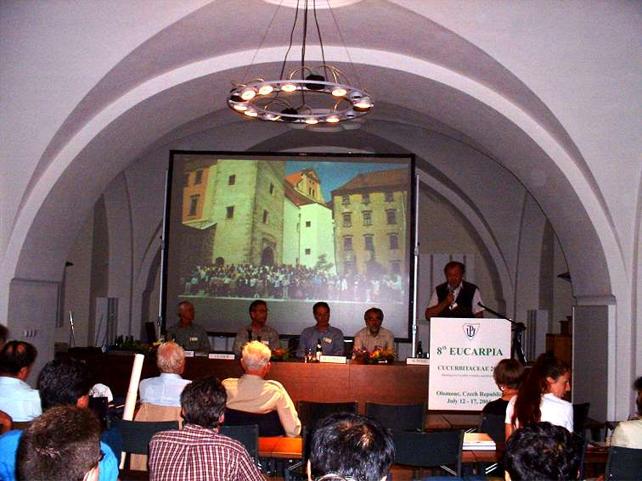
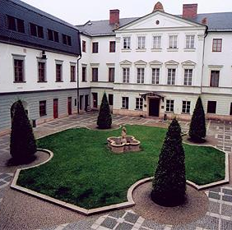
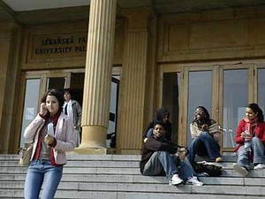
Palacký University Olomouc
est. 1573
23,000 students
2,500 employees
Sts. Cyril and Methodius Faculty of Theology
Faculty of Medicine and Dentistry
Philosophical Faculty
Faculty of Science
Faculty of Education
Faculty of Physical Culture
Faculty of Law
Faculty of Health Sciences

Slide 3

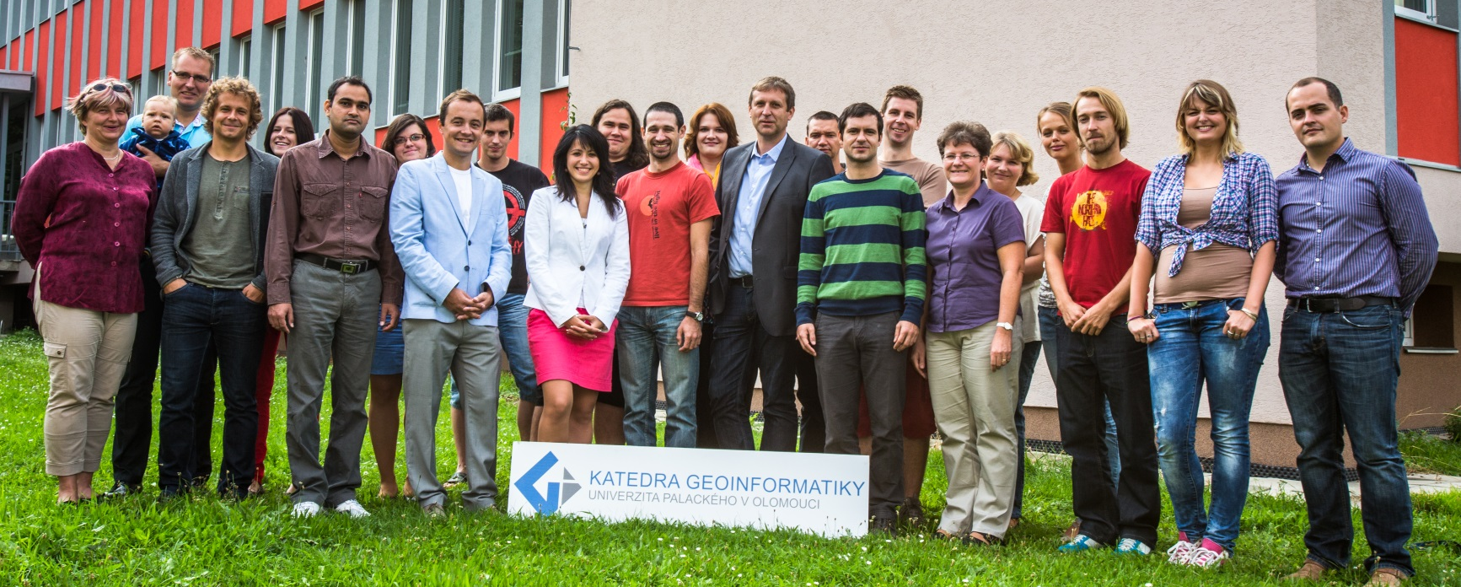
est. 2001
22 in staff
  9 academic staff
  11 research staff
  2 administration staff
166 students
  Bc 64%
  MSc 27%
  PhD 9%

Slide 4
Academic staff
prof. dr. Vít Voženílek – thematic and atlas cartography
assoc. prof. dr. Jiří Dvorský – software engineering
assoc. prof. dr. Vilém Pechanec – GIS in environment
dr. Jaroslav Burian – GIS in human geography
dr. Jan Brus – GISc, spatial analysis
dr. Zdena Dobešová – database systems
dr. Jakub Miřijovský – Earth remote sensing, GNSS
dr. Jana Svobodová – GIS in physical geography
dr. Pavel Tuček – matematics, spatial statistics
dr. Alena Vondráková – digital cartography

Slide 5

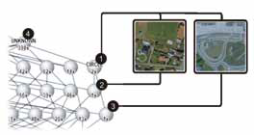
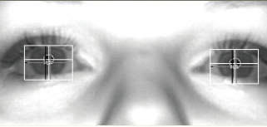
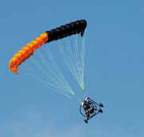
RESEARCH STREAMS
Spatial modelling of geographical phenomena in GIS
modelling of natural phenomena
modelling of urbanization processes
geostatistics in transport
environmental statistics
analysis of surveys
Digital cartography
production of thematic atlases
synthetic map-making and map-use
usability evaluation of map reading
geovisualization on web
visualisation of uncertainity
Remote monitoring of landscape
small format landscape photography in visible and near infrared spectrum
continuous monitoring of abiotic factors using sensor networks, telemetry stations and single- or multifunction data loggers,
identification and analysis of landscape structure with the use of GIT
creation and analysis of records

Slide 6
PhD study Geoinformatics & Cartography
Vít Voženílek – Palacký University, Olomouc
Jiří Dvorský – Palacký University, Olomouc
Jan Andres – Palacký University, Olomouc
Radomír Halaš – Palacký University, Olomouc
Lenka Motyčková – Palacký University, Olomouc
Jana Talašová – Palacký University, Olomouc
Ján Tuček – Technical University in Zvolen (Slovakia)
Milan Konečný – Masaryk University, Brno
Jaroslav Hofierka – University of Prešov in Prešov (Slovakia)
Bohuslav Veverka – Czech Technical University
Václav Snášel – Technical University of Ostrava
Jaromír Kolejka – Masaryk University, Brno
Ján Feranec – Slovak Academy of Science, Bratislava (Slovakia)
Jakub Langhammer – Charles University in Prague
Jiří Horák – Technical University of Ostrava
Jan Kolář – Charles University in Prague
Jaromír Kaňok
Lukáš Marek
Vít Pászto
Aleš Vávra
Alžběta Brychtová
Rostislav Nétek
Stanislav Popelka
Justyna Pastwa
Jan Caha
Vendula Hejlová
Lenka Zajíčková
Jitka Doležalová
Zbyněk Janoška
Pavel Samec
Jana Měřičková

Slide 7
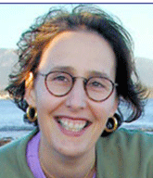
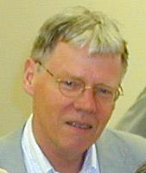
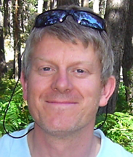
prof. Sara Irina Fabrikant
University of Zurich
prof. Ferjan Ormeling
Utrecht University
prof. Jonathan Raper
City University London

Slide 8


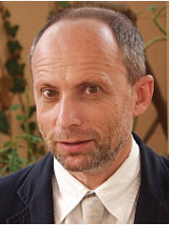
prof. Menno-Jan Kraak
University of Twente
prof. Terje MIDTBØ
Trondheim University
prof. Itzhak Benenson
Tel Aviv University

Slide 9
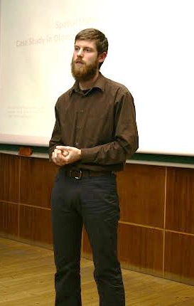
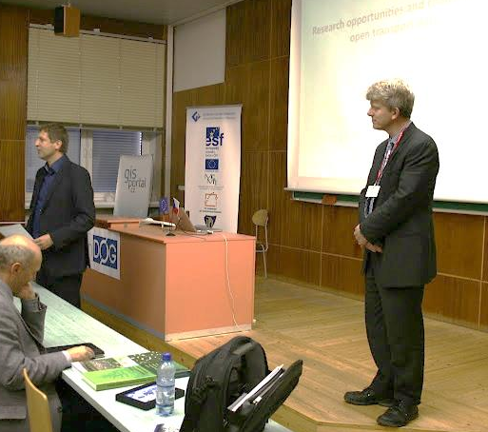
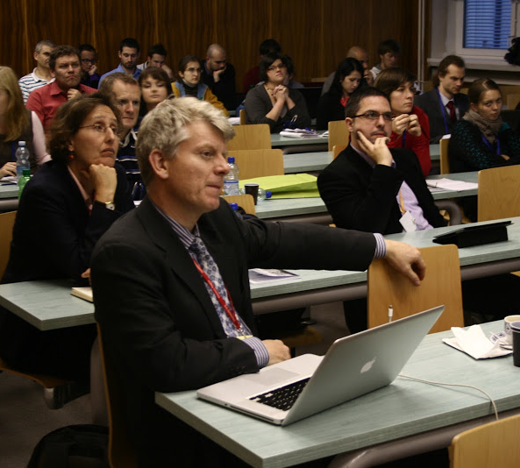
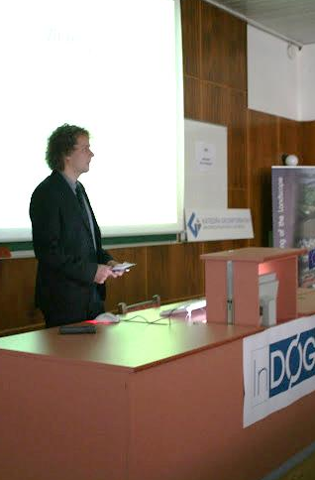
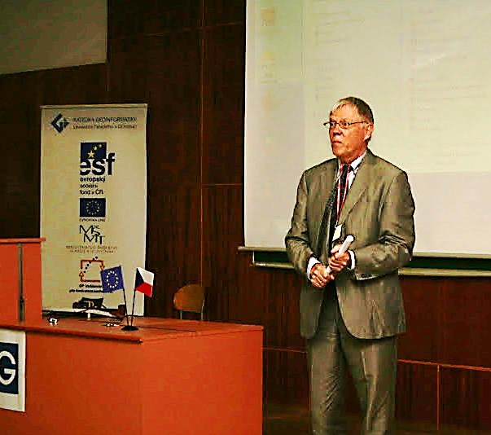
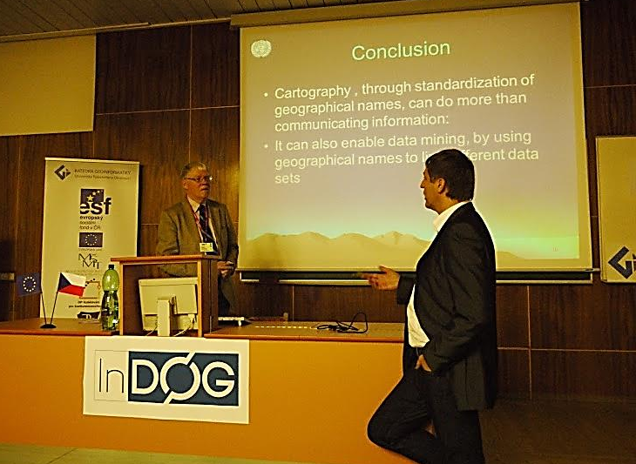

Slide 10
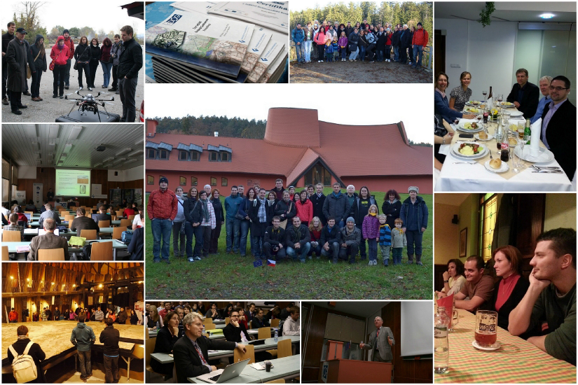

Slide 11
Monday 18.11. (KGI)
Čas | Blok | Název příspěvku
16:00 | Registrace
16:30 - 18:00 | Road Show | Zkušenosti se zahraničními stážemi Studenti KGI
18:00 - 18:30 | Cofee break
18:30 - 20:30 | Road Show | Zkušenosti se zahraničními stážemi Studenti KGI
Tuesday 19.11. (Hotel Flora)
Čas | Blok | Název příspěvku
8:00 - 8:30 | Registrace
8:30 - 10:00 | Přednáškový blok anglický | Úvodní slovo StatGIS Team Vít Voženílek
 |  | SmartGrid projects - Maps of Cooperation Mircea Ardelean
 |  | City Center Delimitation - Olomouc case study Jaroslav Burian
 |  | On Shape Metrics in Landscape Analyses Vít Pászto
 |  | Analysing the spatio-temporal pattern of farmland change using landscape metrics Qiming Zhou
10:00 - 10:30 | Cofee break
10:30 - 12:00 | Přednáškový blok anglický | A Brief History of Big Data Mapping Francis Harvey
 |  | Querying on Fuzzy Surfaces with Vague Queries Jan Caha
 |  | The occurence classification of Norway spruce (Picea abies /L./ Karst.) decline Pavel Samec
12:00 - 13:00 | Oběd
13:00 - 14:30 | Přednáškový blok anglický | Current GIS challenge: getting better in technological skills, but still remaining geographer Vít Voženílek
 |  | Geodata for administration and management of public transport in the Czech Republic Lenka Zajíčková
 |  | Comparison of current SDI development topics in Central Europe with respect to spatial planning and Geoinformation policies Jiří Hiess
 |  | Health Datasets in Spatial Analyses: What We Want, What We Get and What We Can Use Lukáš Marek
 |  | Zóny ohrožení lesů v České republice Pavel Samec
Wednesday 20.11. (Hotel Flora)
Čas | Blok | Název příspěvku
9:00 - 10:30 | Přednáškový blok anglický | Towards a real-time landslide early warning strategy in Hong Kong Qiming Zhou
 |  | Satellite generated brightness temperature (AMSR-E BT) influenced by landsurface Mukesh Boori
 |  | Morphological analysis of the fluvial forms in the Morava River Jakub Miřijovský
 |  | Combining Remote Sensing and Landscape Metrics for Urban Development to monitor Urban Spatial Variation Maik Netzband
10:30 - 11:00 | Cofee break
11:00 - 12:15 | Přednáškový blok anglický | The Next Age of Discovery and a Future in the Post-GIS World Francis Harvey
 |  | The spatial impact of high voltage transmission lines over the European landscape Mircea Ardelean
 |  | Spatial and temporal analysis of extreme hydrological events in Lower Silesian Voivodeship (1994-2011) Justyna Pastwa
 |  | Remote Sensing Data for the Mapping of Urban Poverty and Slum Area Maik Netzband
12:15 - 13:15 | Oběd
13:15 - 15:00 | Přednáškový blok český | Restrikce měřící škály geodat pomocí genetických algoritmů Jiří Dvorský
 |  | Srovnání klasických, fuzzy a posibilistických prahových hodnot v prostorových dotazech (Comparison of Crisp, Fuzzy and Possibilistic threshold in Spatial Queries) Jan Caha
 |  | Chaotický fraktál nebo fraktální chaos...? Aplikace v geovědách Vít Pászto
 |  | Fuzzy logika pro řízení světelné signalizace křižovatky Lenka Zajíčková
 |  | Urbanisticko krajinárska štúdia Vinice – MČ Bratislava Rača Juraj Furdík
15:00 - 15:30 | Cofee break
15:30 - 17:00 | Přednáškový blok český | Konceptualizace specializované edukace graduovaných uživatelů geoinformací v celoživotním vzdělávání se zřetelem na prostorové plánovače v ČR Jiří Hiess
 |  | Hodnocení přesnosti výstupů z UAV fotogrammetrie Jakub Miřijovský
 |  | Prostorová analýza výskytu kampylobakteriózy v České Republice Lukáš Marek
 |  | Aktuální stav vývoje extenze Urban Planner Jaroslav Burian
 |  | Sociální data jako zdroj pro studium percepce prostoru Vít Voženílek
17:00 - 18:00 | Workshop | Tvarové metriky a jejich použití v geoinformatice Vít Pászto, Lukáš Marek
18:00 | Social event
Thursday 21.11. (Hotel Flora)
Čas | Blok | Název příspěvku
9:00 - 10:30 | Workshop | Jak rychle publikovat mapu na webu Martin Mikloš
 |  | Vektorové formáty pro webovové mapy I Ondřej Růžička
10:30 - 11:00 | Cofee break
11:00 - 12:30 | Workshop | Vektorové formáty pro webovové mapy II Ondřej Růžička
 |  | ArcGIS - tipy&triky&vychytávky (co moc nefunguje ale jde to obejít) Jaroslav Burian
12:30 - 14:00 | Ukončení konference, oběd

Slide 12

Francis HARVEY
University of Minnesota
Dept. of Geography, Environment and Society
Specialties
Central and Eastern Europe
Local governments
Geographic Information Science (GIS)
History of geographic thought
Society and technology
Publications
Integrating Geodata Infrastructures from the Ground Up.
Public Safety and GIS: What should certification accomplish?
Developing geographic information infrastructures for local government: The role of trust.
Boundary objects and the social construction of GIS technology.
Research Activities
Local Government Geographic Information Sharing: Examine issues impeding and improving information sharing among US local governments, ongoing
Developing the Polish Cadastral Infrastructure: Study of cadastral related government activities in Poland with an emphasis on post-socialist transitional and EU accession issues, ongoing
Collaborative Research: Graduate Ethics Education for Future Geospatial Technology Professionals: Research and teaching on issues related to GI professional ethics

Slide 13
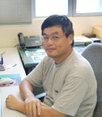

Qiming ZHOU
Hong Kong Baptist University
Dept. of Geography
Centre for Geo-computation
Specialties
Cartography
Geographic Information Systems
Remote Sensing and Image Interpretation Resource Management in China
Publications
Analysis of Spatio-temporal Pattern and Driving Force of Land Cover Change Using Multi-Temporal Remote Sensing Images
Gradient Analysis of Landscape Spatial and Temporal Pattern Changes in Beijing Metropolitan Area
Processing Multi-temporal Images for Detecting and Quantifying Spatial Pattern of Farmland Change in Western China
Research Activities
Change detection and land cover modelling with remote sensing
DTM-based terrain analysis
Spatial decision support systems
3-dimensional GIS
GIS and remote sensing applications

Slide 14
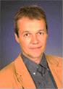
Maik NETZBAND
Ruhr-University Bochum
Institute of Geography
Palacky University Olomouc
Dept. of Geoinformatics
Specialties
Social Sciences
Earth Sciences & Environment
Information & Communication Technologies
Measurement of surface parameters in setteled areas, i.e. imperviousness, vegetation cover, surface temperature, bare soil, etc.
Publications
Synthesizing urban remote sensing through application, scale, data and case studies
Urban Land Use Changes
Monitoring Urban Change with ASTER data
Flood risks in urbanized areas – multi-sensoral approaches using remotely sensed data for risk assessment
Research Activities
Urban remote sensing
Spatial planning

Slide 15
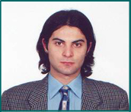
Mircea ARDELEAN
West University of Timișoara
Dept. of Geography
Specialties
digital cartography
GIS
physical geography
Publications
Geomorphological Aspects of the Human Impact in the Alpine Area of Southern Carpathians
The Use of the Digital Terrain Model in Analyzing the Natural Potential of the Muntele Mic
Proposal regarding the building of electronic atlas of Banat
Research Activities
Complex method of digital geomorphological map building of Romania using GIS
Digital geomorphological analysis and automated classification methods of landforms in mountain areas based on Digital Elevation Model and through remote sensing imagery integration
Climatic change impact over the Holocene and present day dynamics of the alpine environments in Romanian Carpathians

Slide 16

Thank you for coming….
…. enjoy StatGIS!

