Slide 1



Analysing the Spatio-temporal Pattern of Farmland Change Using Landscape Metrics
Qiming Zhou & Bo Sun
CENTRE FOR GEO-COMPUTATION STUDIES
HONG KONG

Slide 2
Spatio-temporal change
Agriculture in China’s aridzone
Trajectory analysis
Spatio-temporal modelling of changing farmland
Results and interpretation
Conclusions

Slide 3
Agriculture in China’s aridzone
Plenty land resources
High-density population in oases
Severe shortage of water resources
  <200mm annual rainfall
  Glacier retreatment due to global warming
  High variation in supply
Government policy impacts

Slide 4
Study area
Centered at Yuli County, Xinjiang Uygur Autonomous Region of China
A fringe area of Taklimakan Desert
The “green corridor” of Tarim Basin
Dry and harsh environment
Rapid expansion of irrigated farmland since 1990’s

Slide 5
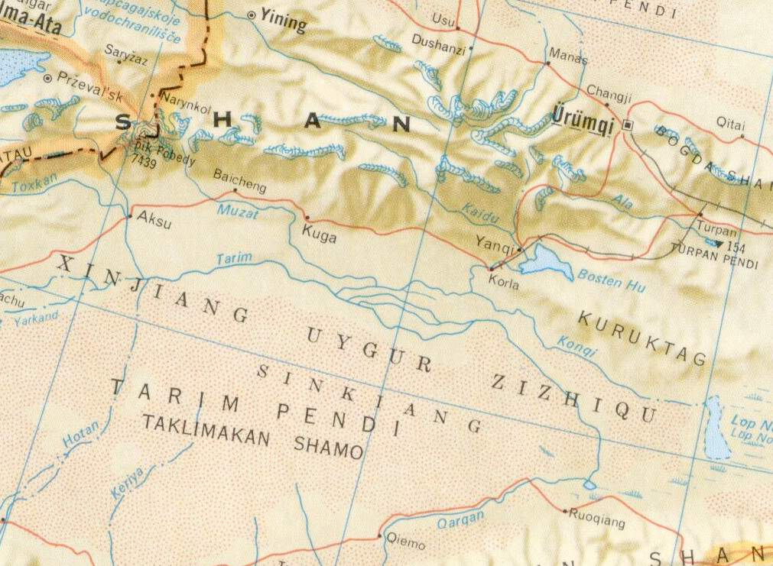
Study area
Study area

Slide 6
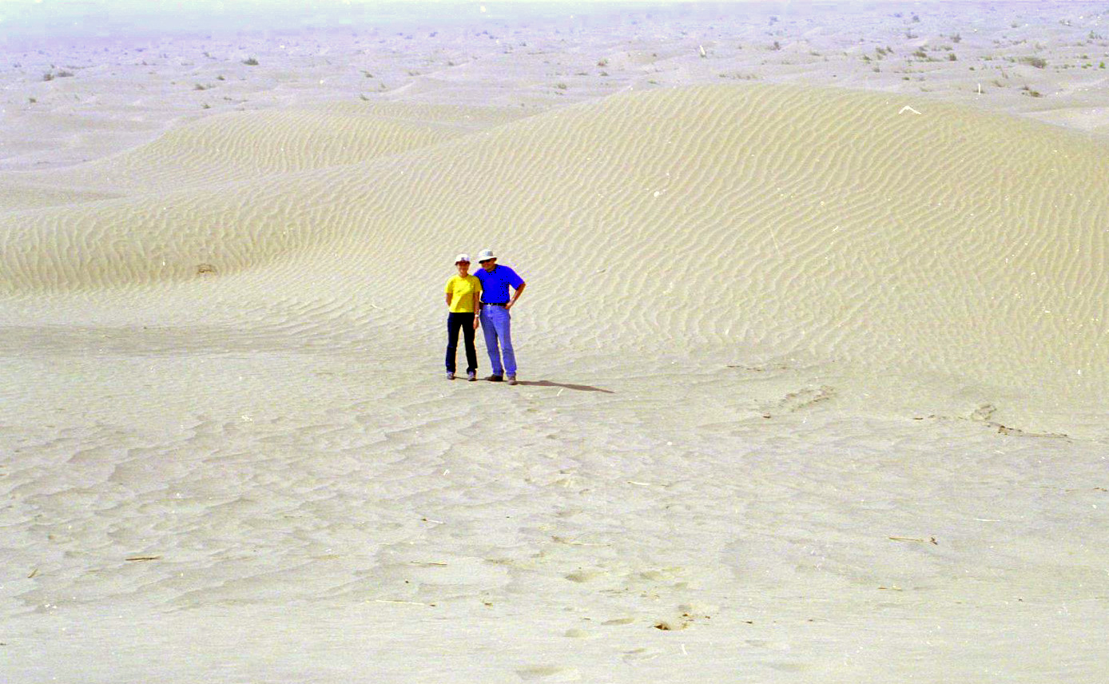
Taklimakan Desert

Slide 7
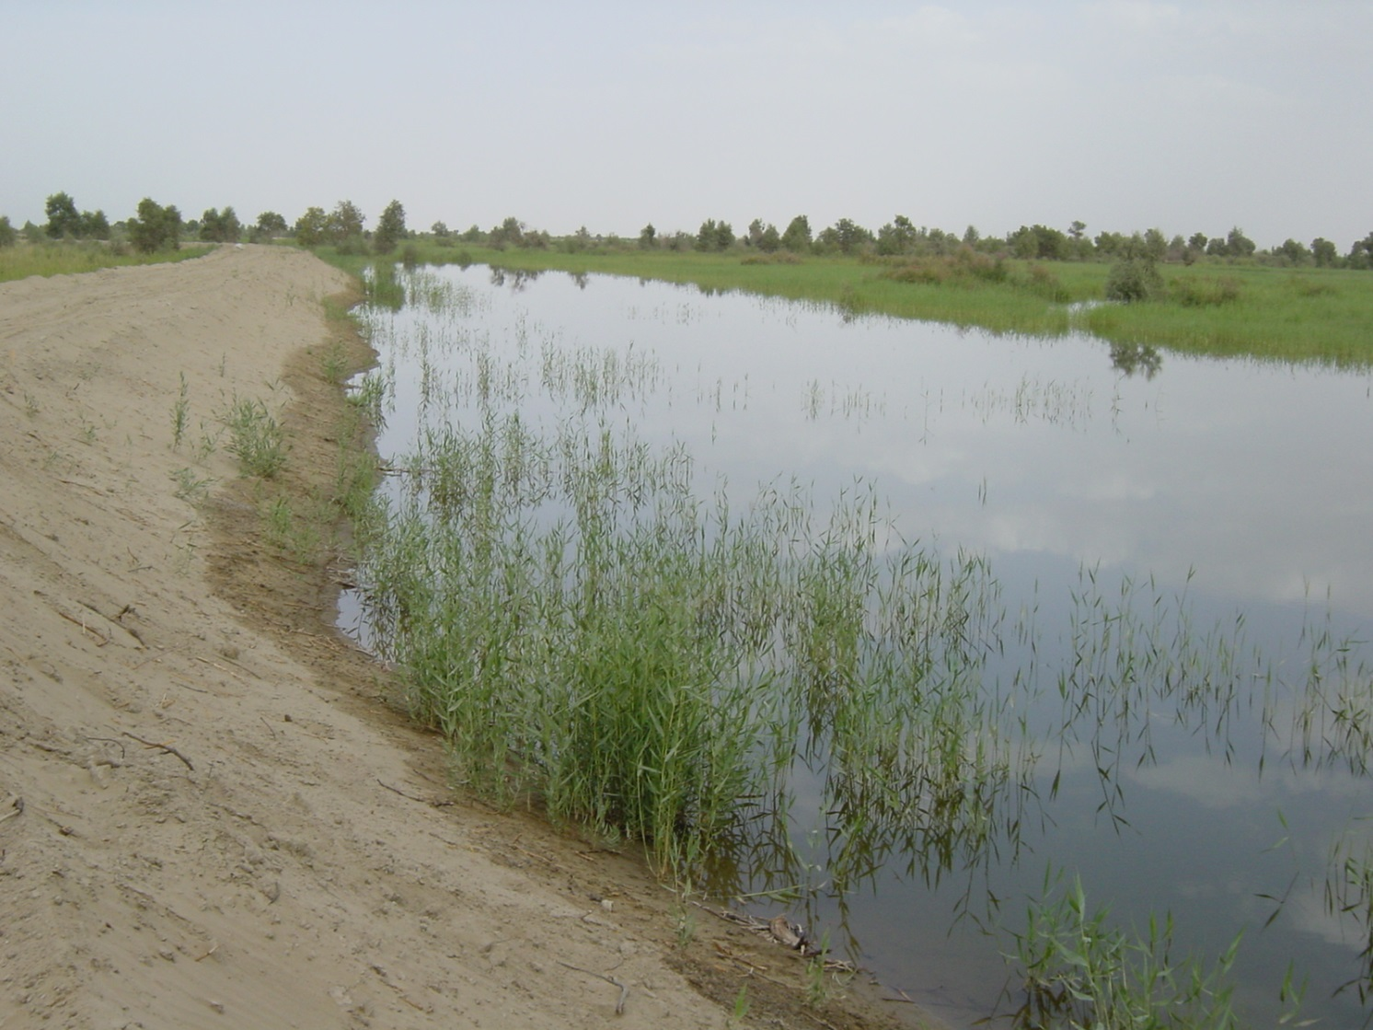
Tarim River

Slide 8
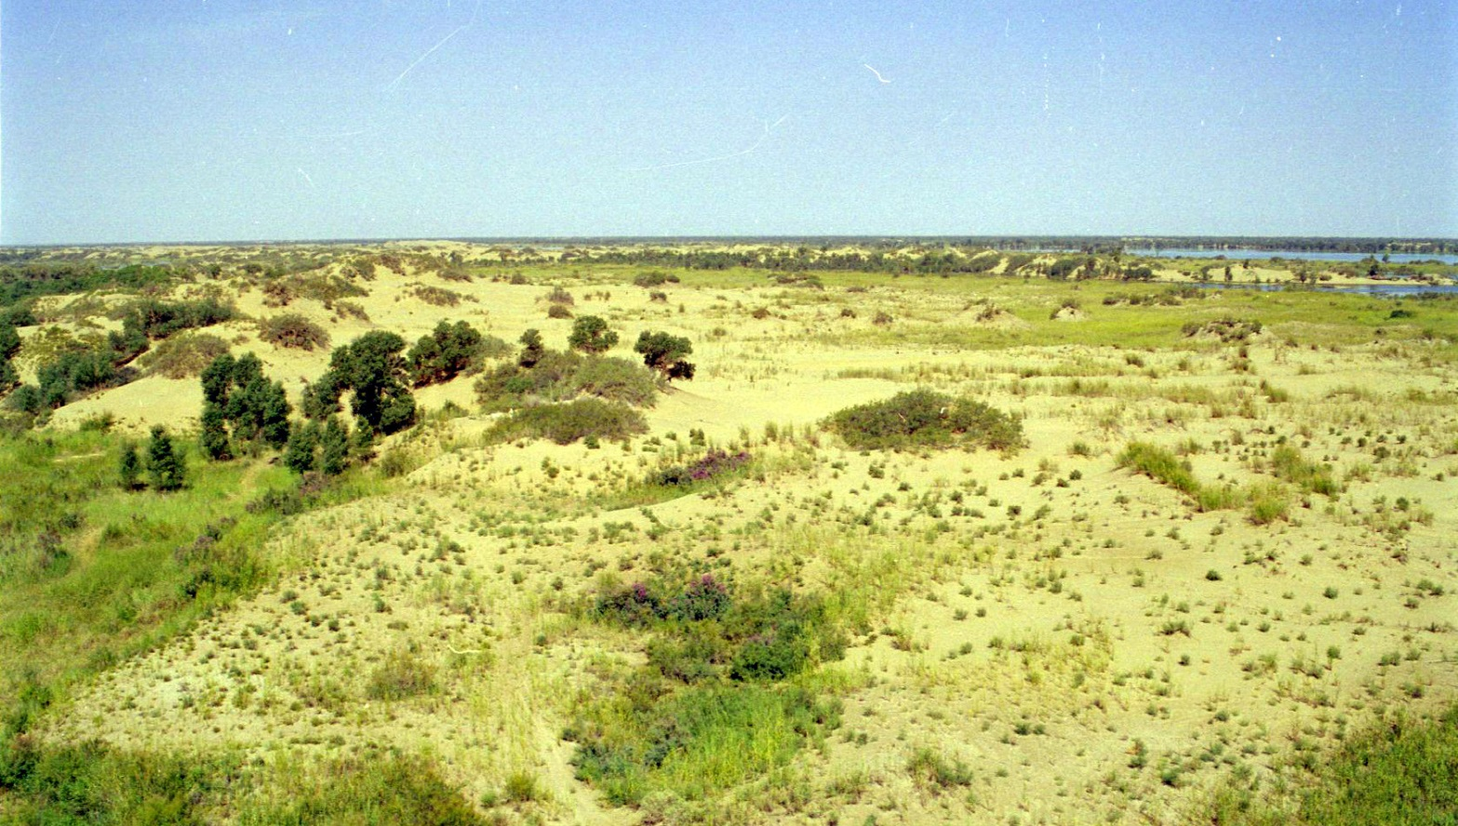
Fringe of Taklimakan Desert

Slide 9
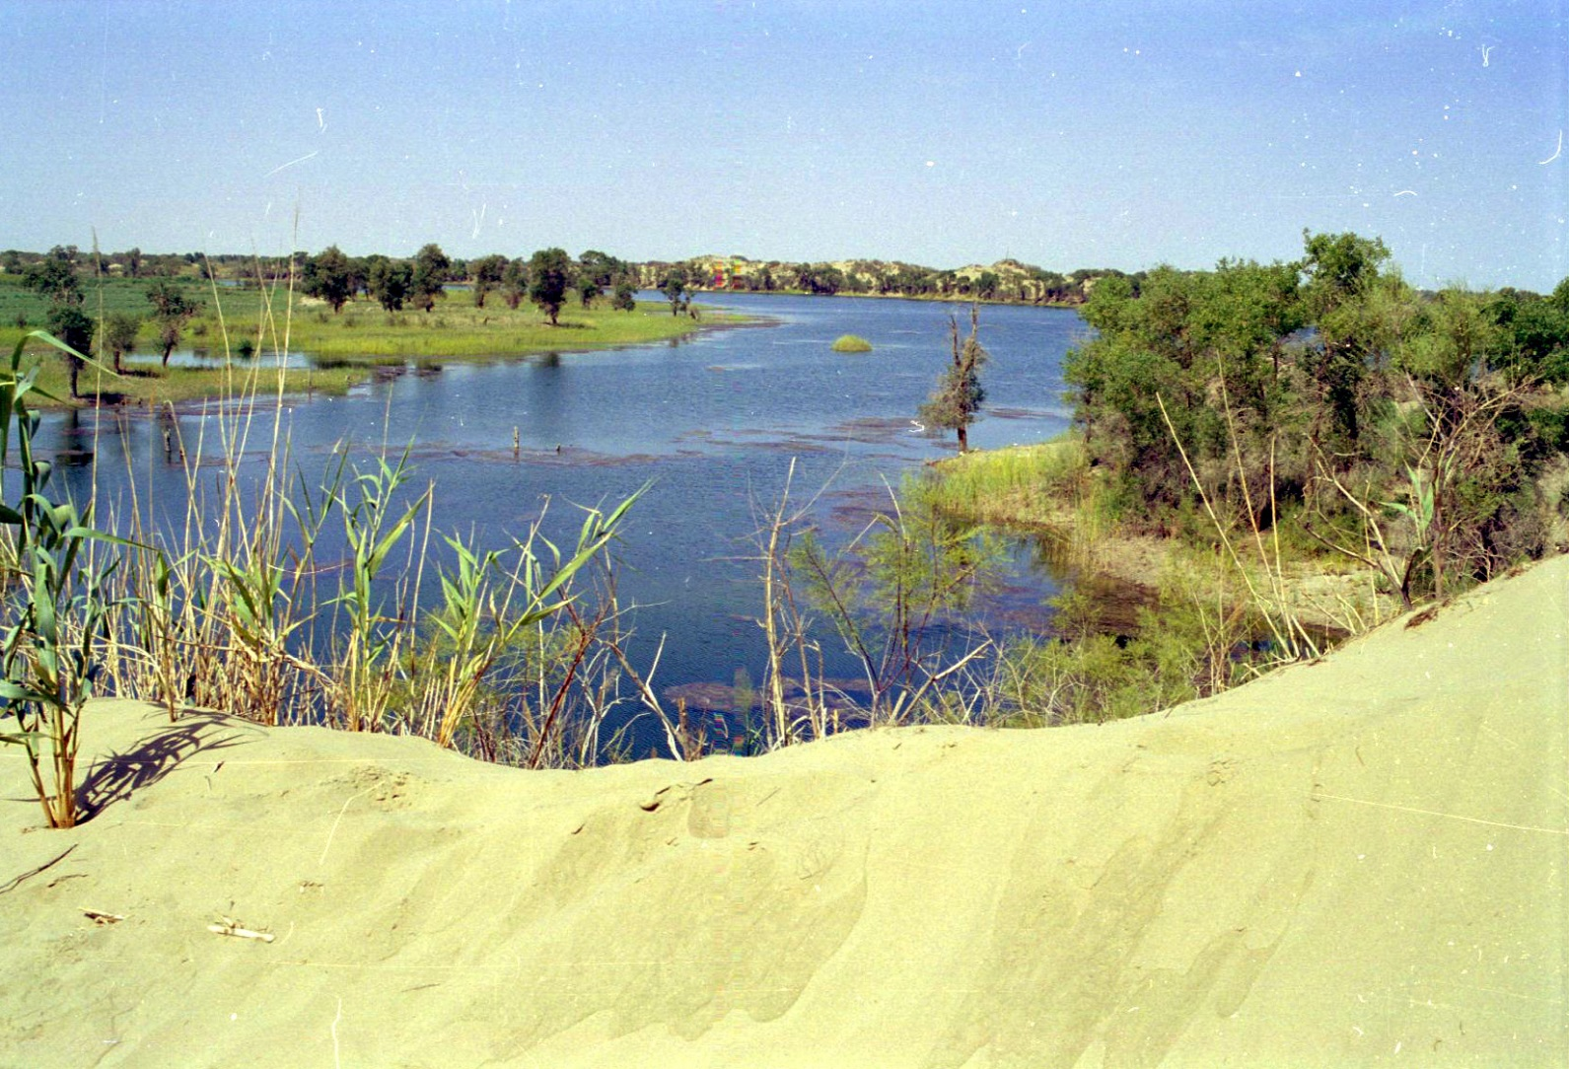
Fragile ecosystem

Slide 10
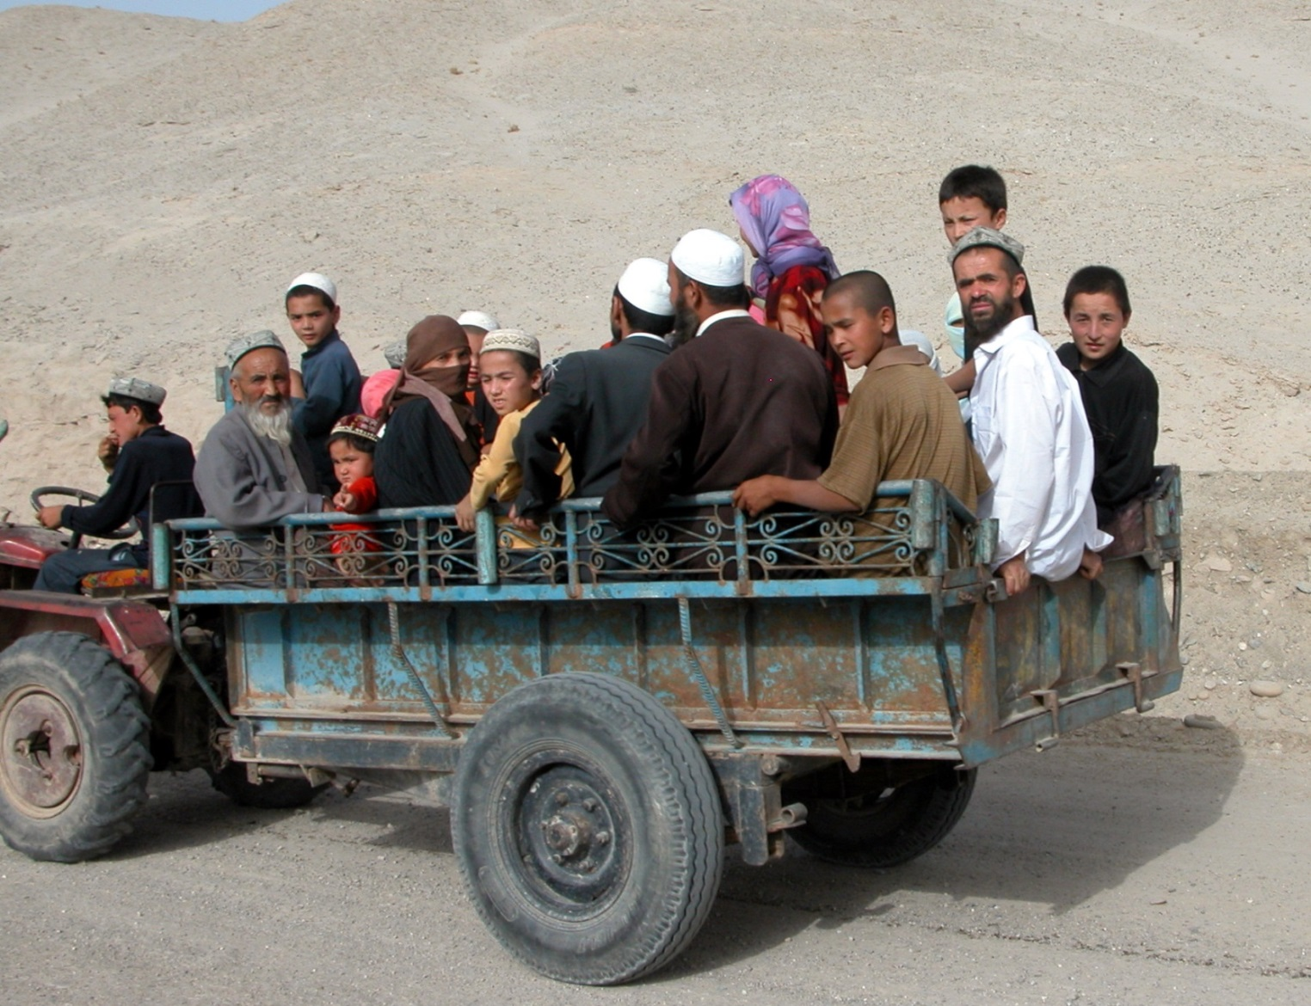
People

Slide 11
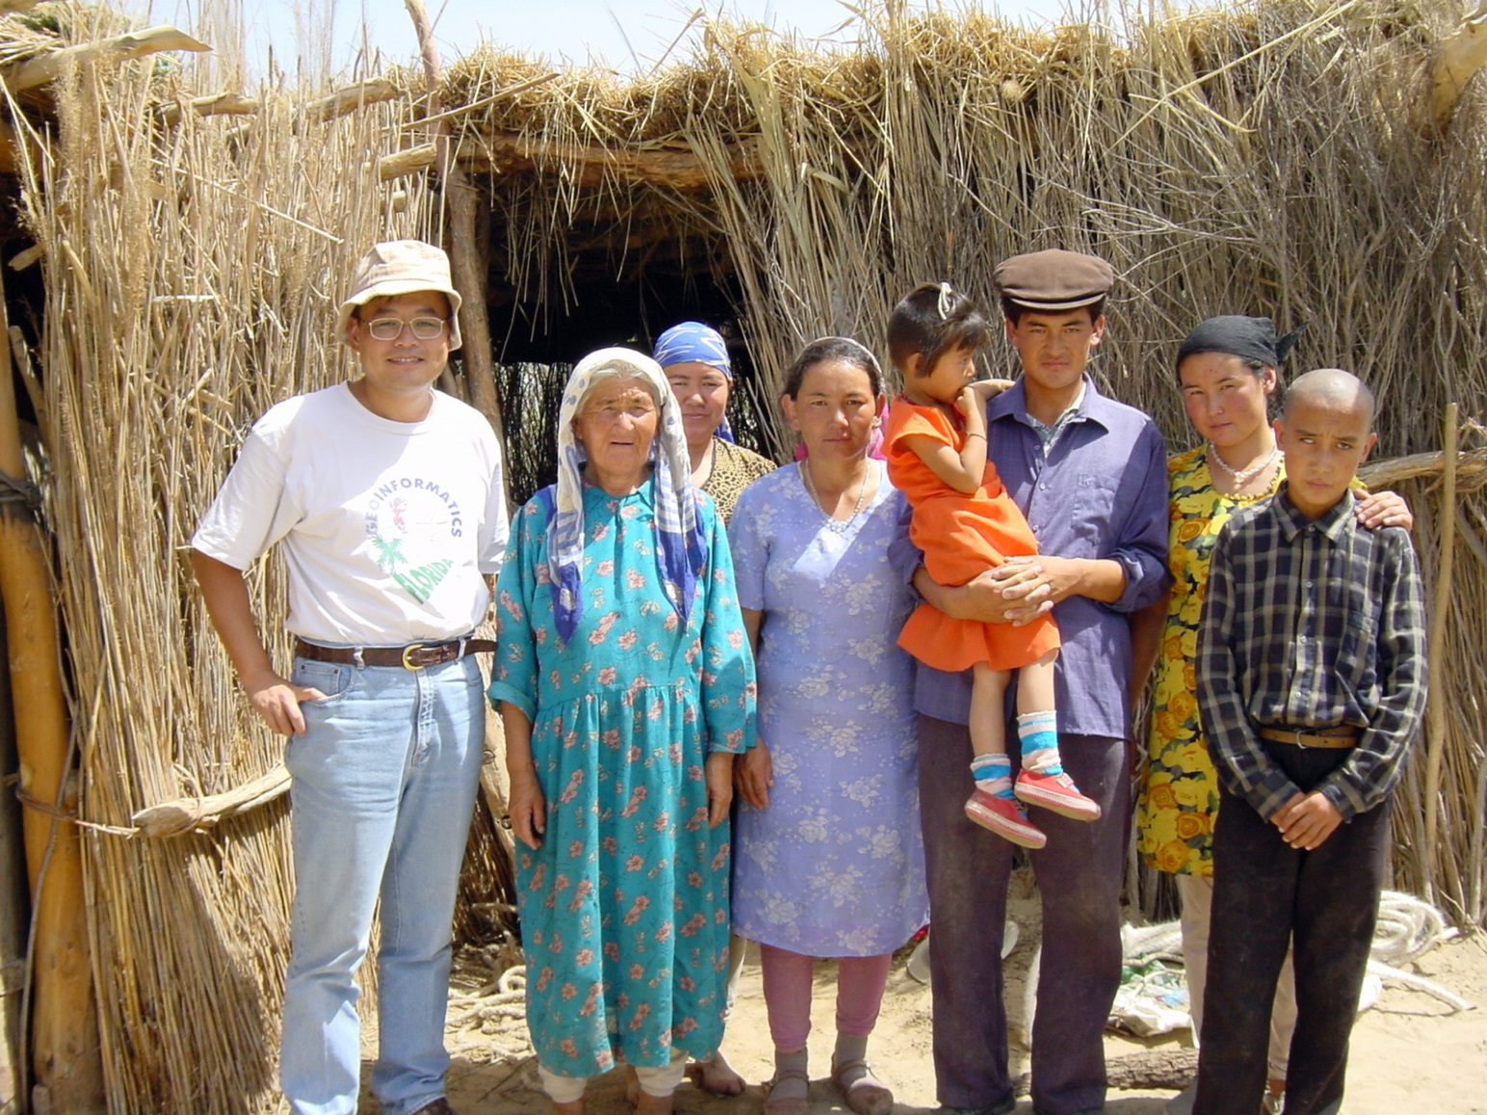
Local minorities

Slide 12

Simple elementary daily life

Slide 13
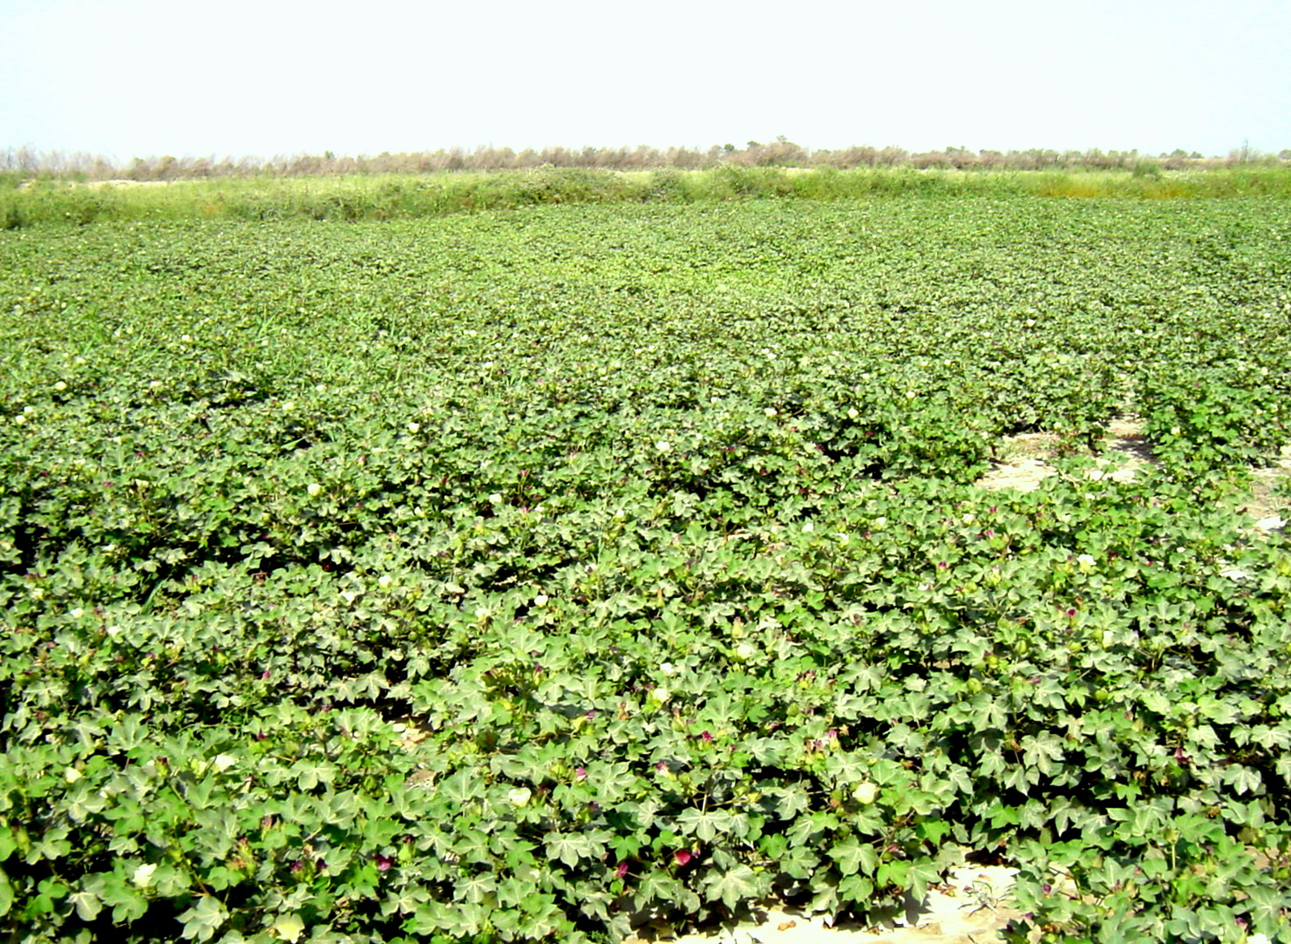
Small-scale cultivation

Slide 14
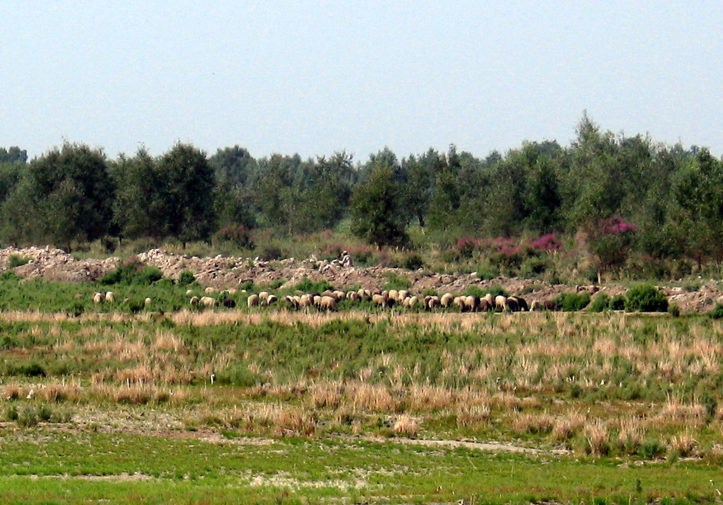
Limited animal husbandry

Slide 15
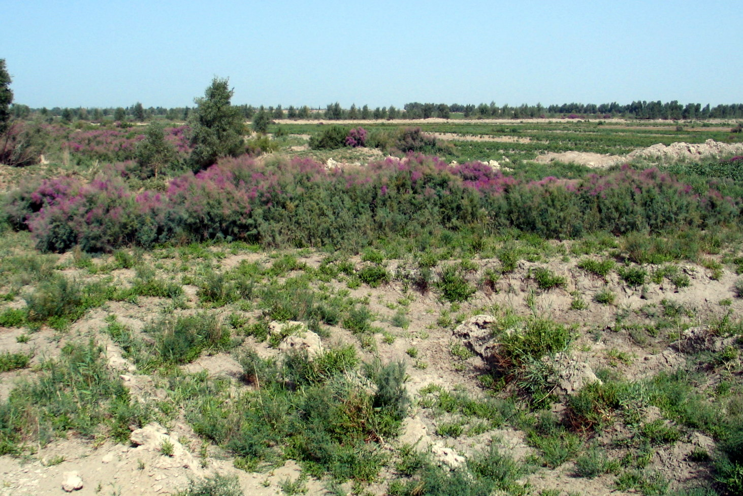
‘Unlimited’ uncultivated land

Slide 16
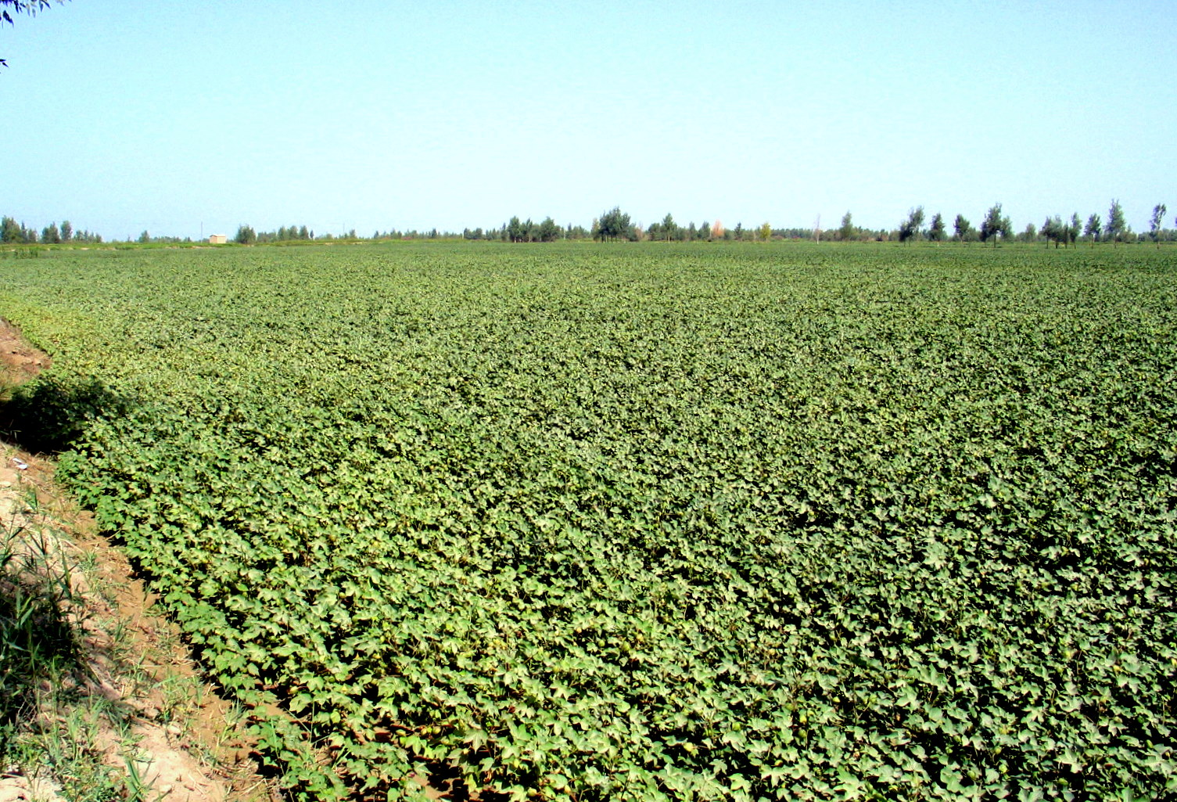
Large-scale cotton cropping

Slide 17
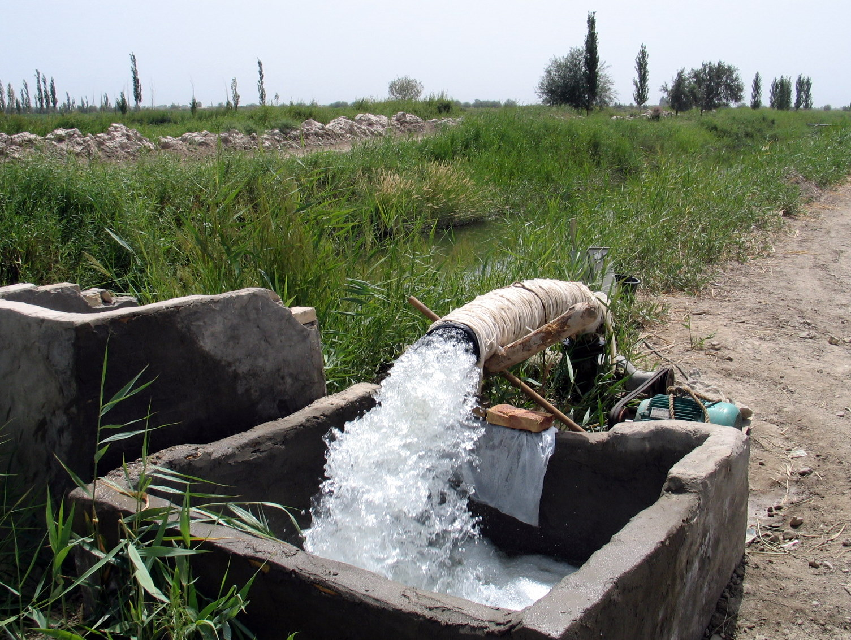
Irrigation

Slide 18
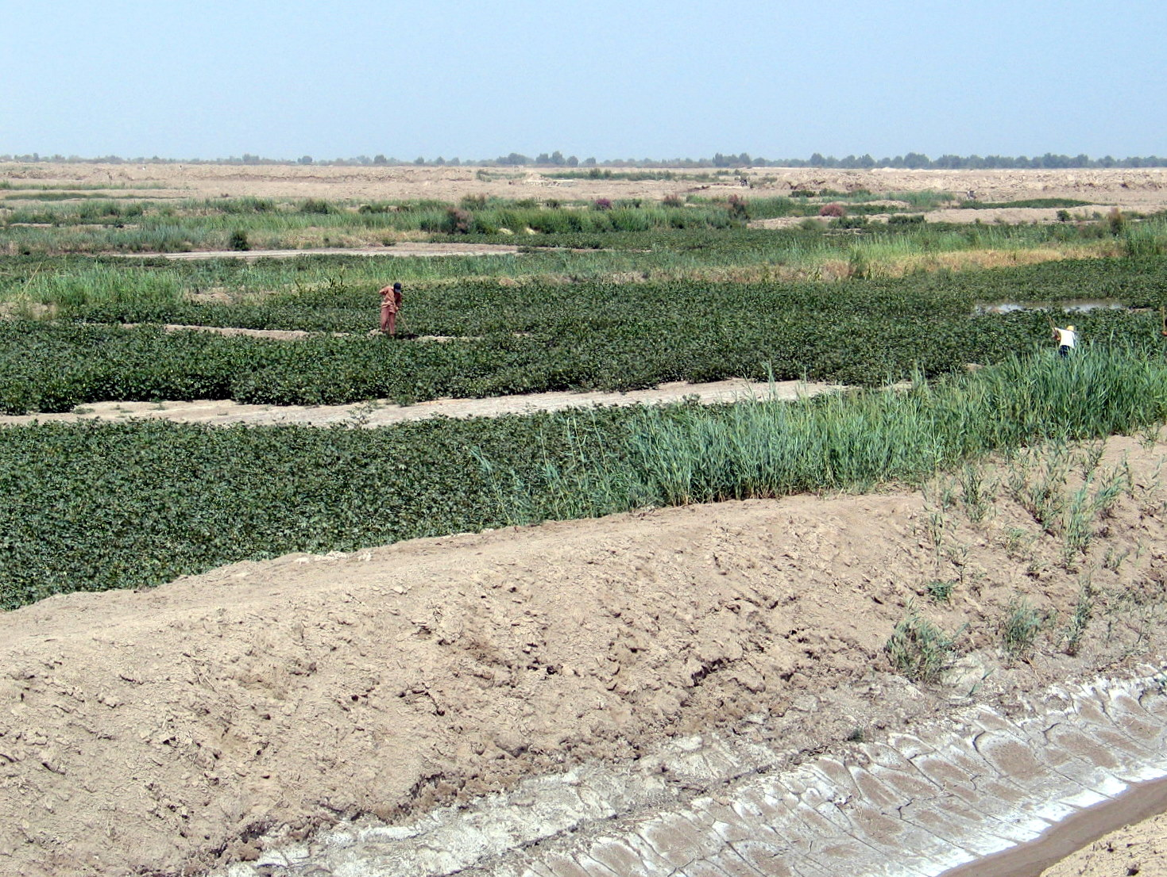
Drainage

Slide 19
Research issues
The environmental impacts due to rapid expansion of cultivated farmland.
How farmland has been changed?
  Expansion versus abandonment
What is the spatio-temporal pattern of the changes?
  To understand the driving force of such changes.

Slide 20
Image data
Satellite | Sensor | Spatial Resolution (m) | Acquisition Date
Landsat 5 | TM | 30 | 25/9/1994
Landsat 7 | ETM | 28.5* | 17/9/2000
CBERS-02 | CCD | 19.5 | 15/9/2005
BJ-1 | CCD | 32 | 10/8/2006
BJ-1 | CCD | 32 | 31/8/2007
BJ-1 | CCD | 32 | 09/9/2008
*Resampled

Slide 21
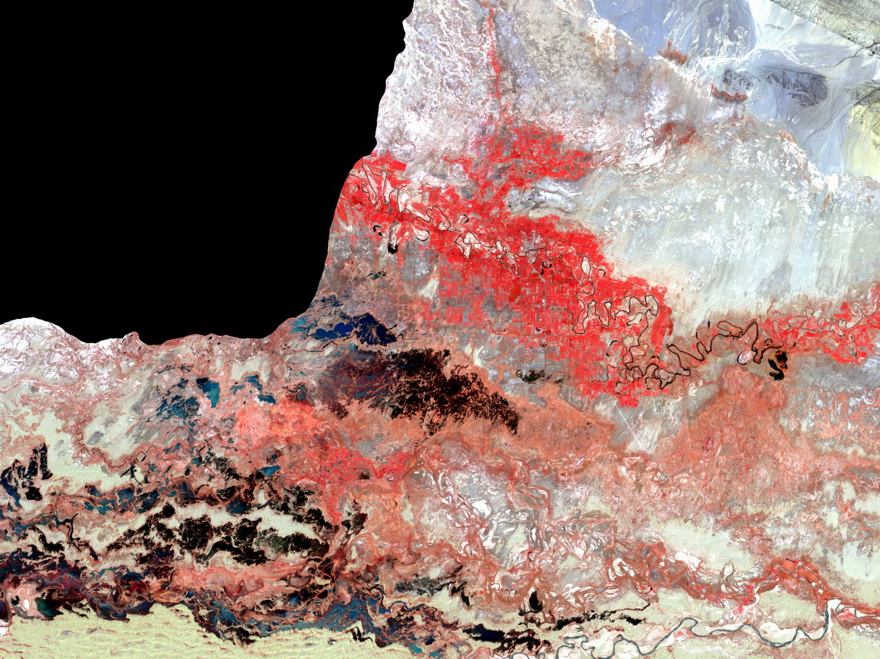
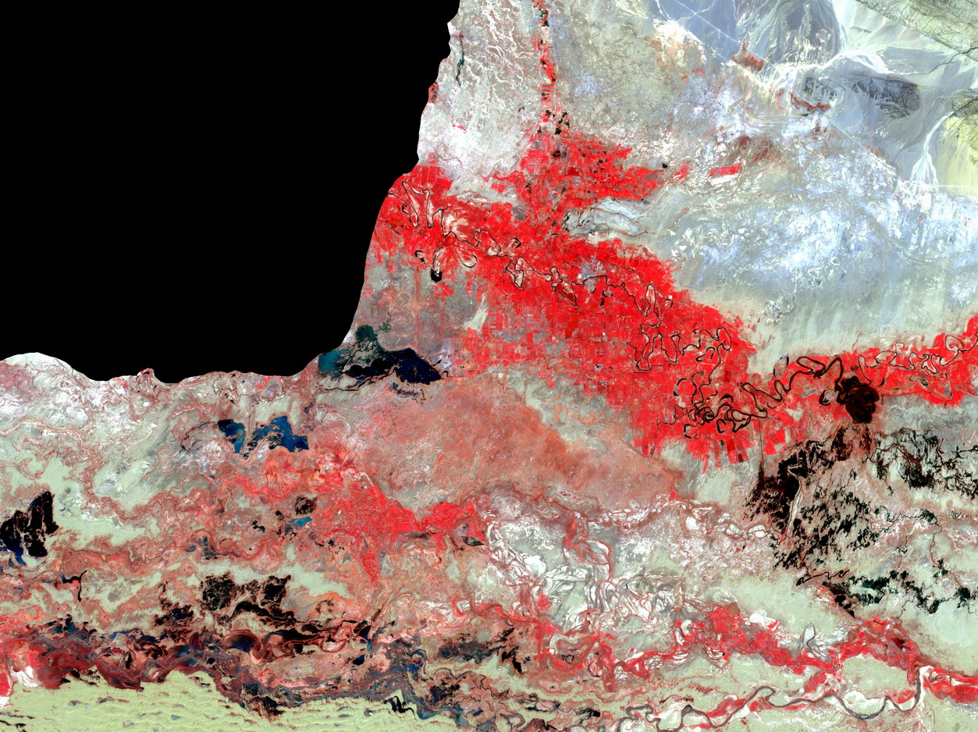
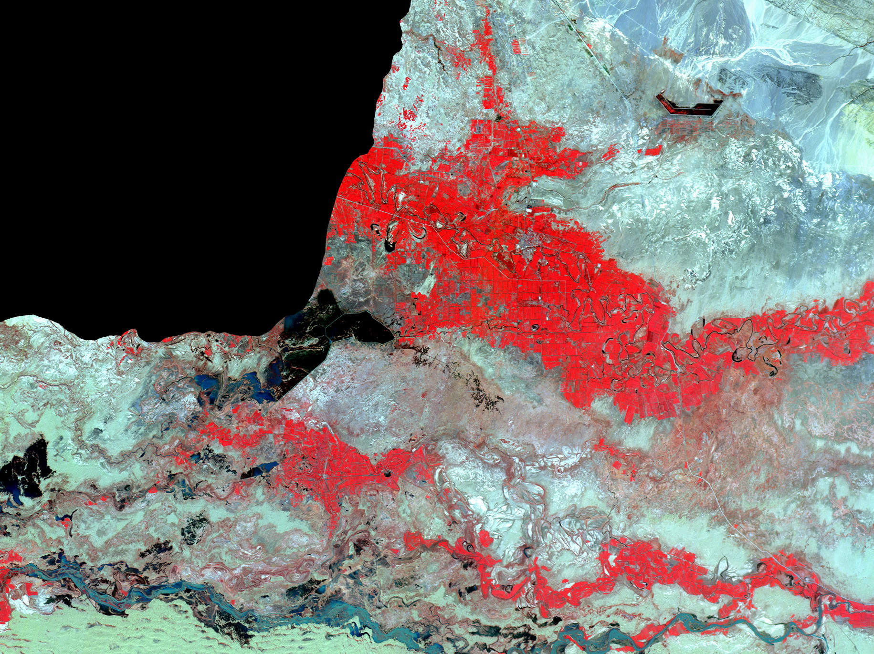
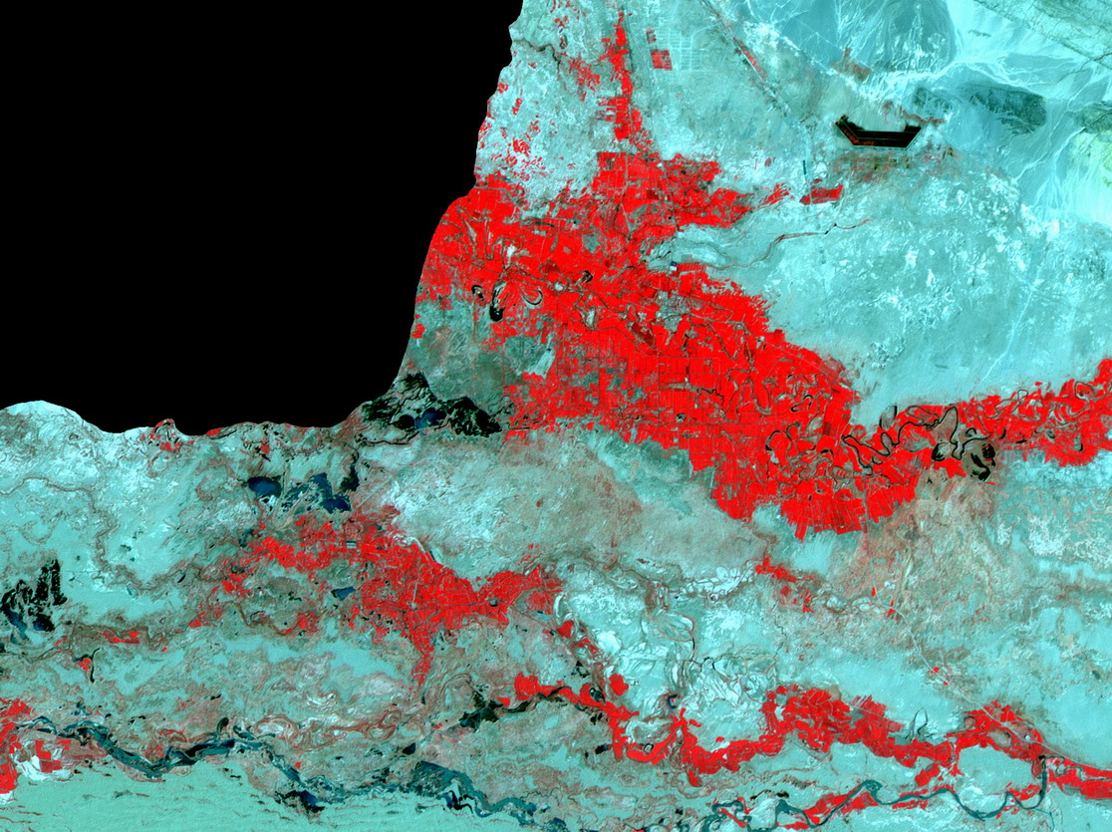
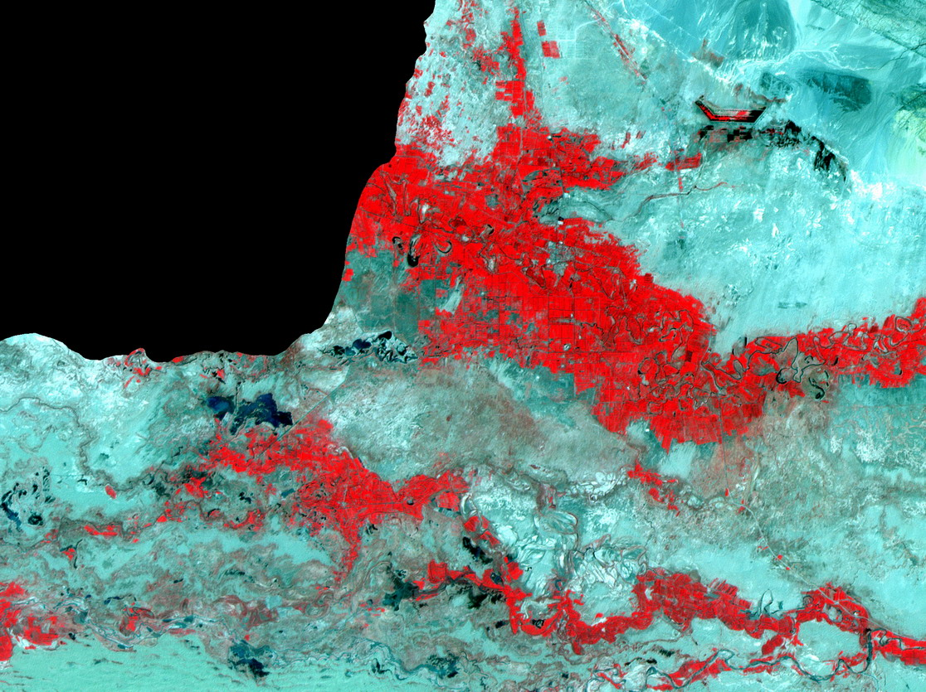
Landsat 7 ETM image (17/9/2000)
CBERS-02 CCD image (15/9/2005)
BJ-1 CCD image (31/8/2007)
BJ-1 CCD image (10/8/2006)
Landsat 5 TM image (25/9/1995)

Slide 22
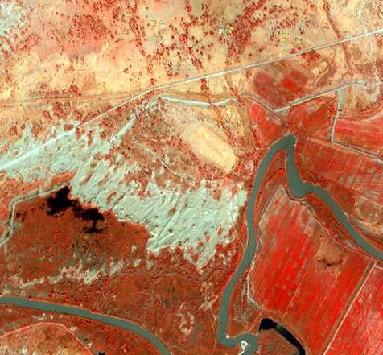
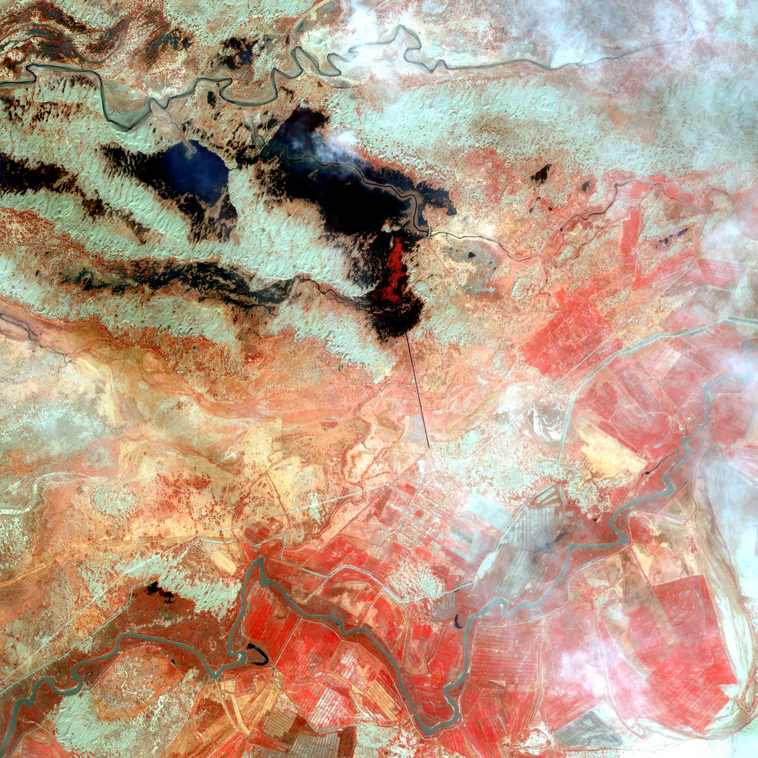
IKONOS (5/10/2000)

Slide 23
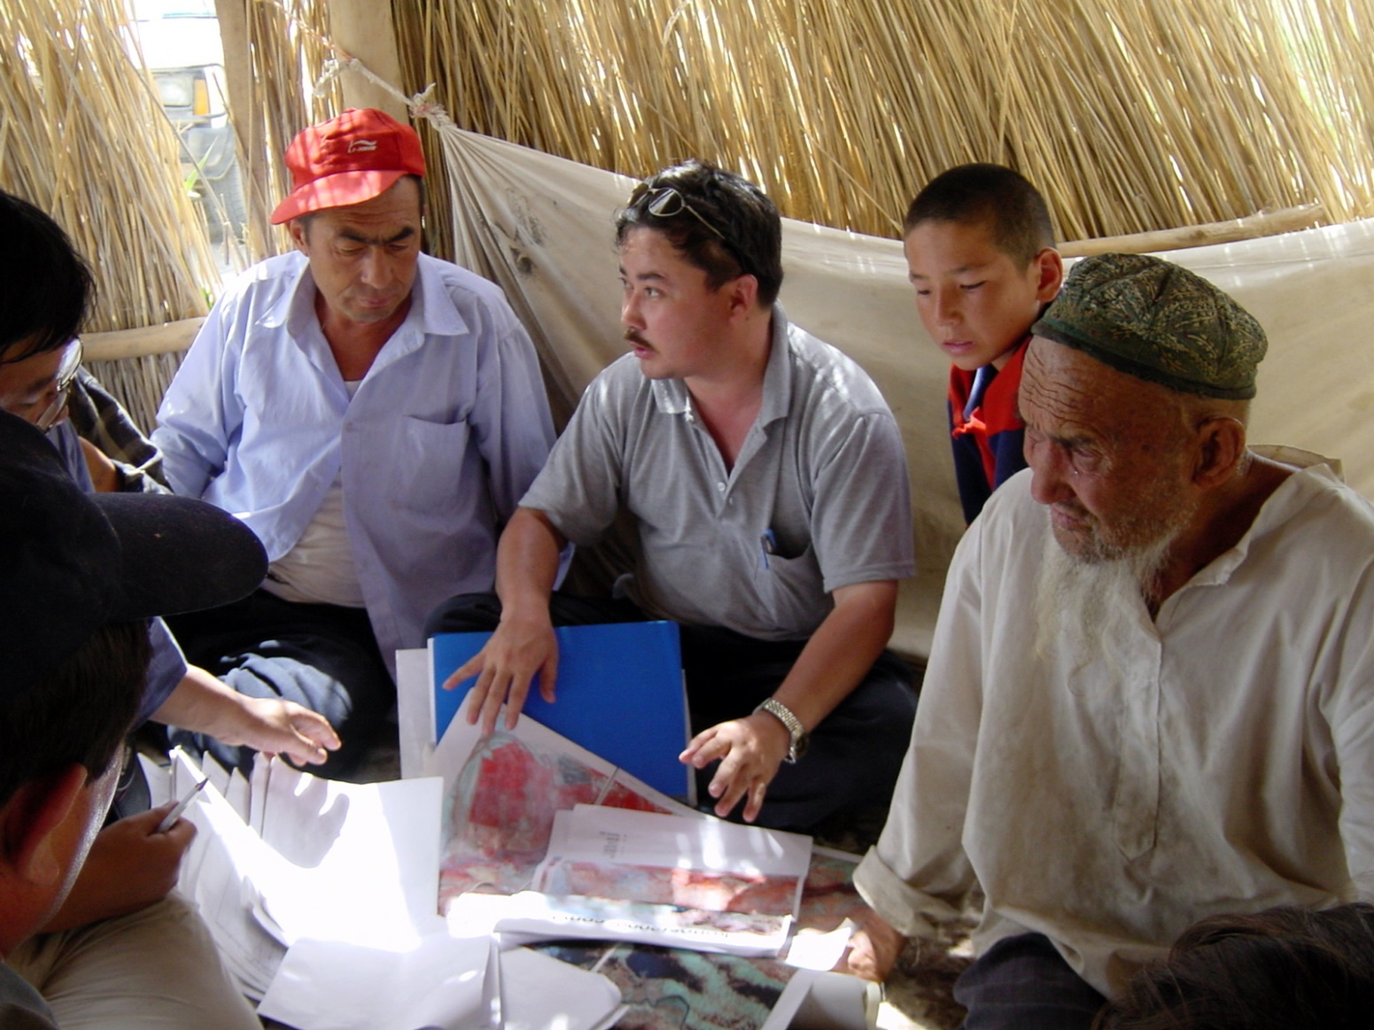
Field investigation

Slide 24
The general approach
The methodology is based on post-classification comparison approach.
Classification of multi-temporal images
Establish landuse trajectories based on classified images
Pattern analysis of landuse trajectories

Slide 25
Image classification
For the purpose of this study, only two classes are delineated:
  Farmland
  Others (non-farmland)
Supervised classification using the maximum likelihood classifier is undertaken.
Reference data sets were collected through image interpretation on higher resolution images and field investigation.
Error matrices were created for accuracy assessment.

Slide 26
Establishing change trajectories
1994
2000
2005
2006
2007
2008
Farmland
Unchanged
Cultivated
Others
Abandoned

Slide 27
Spatio-temporal pattern of the trajectories
Farmland change trajectories might show particular spatio-temporal patterns that may help us to understand the causes and driving force of the change.
Some quantitative measurements need to be established to describe such spatio-temporal patterns.
In this study we employed landscape metrics used in ecological studies.

Slide 28
Selected landscape metrics
PLAND: Percentage of Landscape
NLSI: Normalized Landscape Shape Index
AWFDI: Area Weighted Fractal Dimension Index

Slide 29
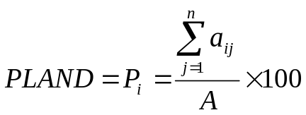
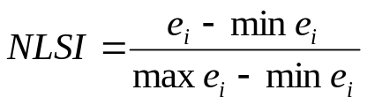
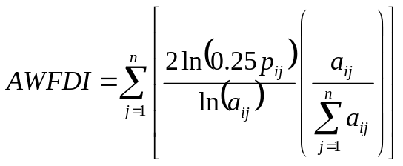
Spatial pattern indicators
Metrics | Equation | Interpretation
PLAND |  | Quantifies the proportional abundance of each patch type in the landscape.
NLSI |  | NLSI equals 0 when the landscape consists of a single square or maximally compact, and 1 when the patch type is maximally disaggregated.
AWFDI |  | Approaches 1 for shapes with very simple perimeters such as squares, and approaches 2 for shapes with highly convoluted, plane-filling perimeters.

Slide 30
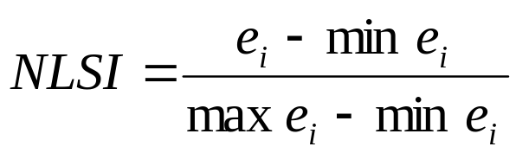
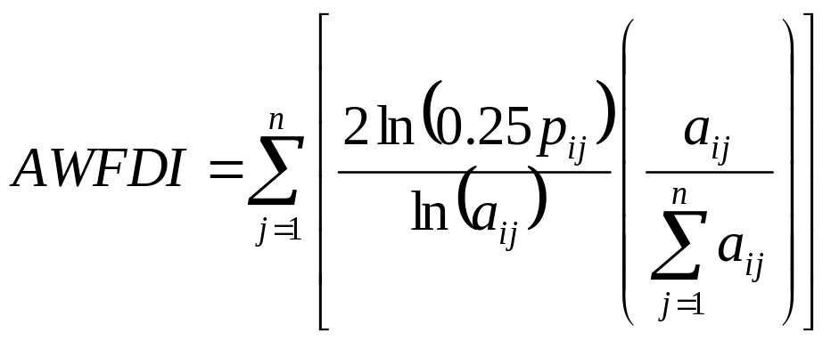
Selected pattern indicators
Adopted from the landscape metrics used in ecological studies (McGarigal et al., 2002)
total length of edge of class i in terms of number of cell surface
perimeter of patch ij
area of patch ij

Slide 31
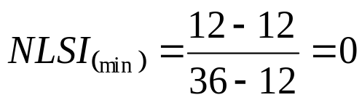
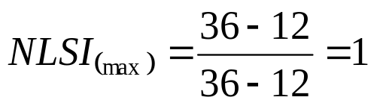
NLSI (class-level)
For area = 9:
min e_{i} = 12
max e_{i} = 36

Slide 32
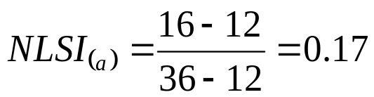



NLSI (class-level)
For area = 9:
min e_{i} = 12;
max e_{i} = 36
(a)
(b)
(c)
(d)
e_{i} = 16
e_{i} = 20
e_{i} = 24
e_{i} = 30

Slide 33

Fractal Dimension Index (class-level)
Borrowed from the fractal dimension index used in landscape ecology
Reflects the shape complexity of landscape classes (Turner et al., 2001)
a
b
The simplest boundary: FDI = 1
a
c
b
d
Complicated boundary: FDI → 2
a
c
b

Slide 34
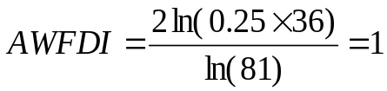
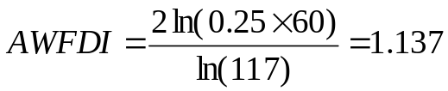
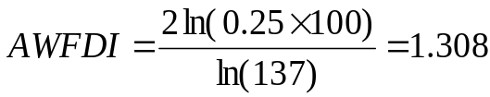
AWFDI (class-level)
9
3
1

Slide 35
Results and interpretation
Classification accuracy
Farmland area
Farmland trajectory statistics
Metrics of farmland expansion, abandonment and ephemeral farmlands
Comparison between trajectory metrics

Slide 36
Classification accuracy
Image | Overall accuracy (%) | Kappa
1994 | 93.4 | 0.914
2000 | 97.2 | 0.964
2005 | 93.0 | 0.911
2006 | 94.2 | 0.926
2007 | 87.7 | 0.837
2008 | 92.7 | 0.902

Slide 37
Farmland area
Description | Area (k ha) | Annual Growth (%)
Old farmland | 14.43 | -
Cultivated since 2000 | 11.81 | 10.5
Cultivated since 2005 | 7.08 | 4.9
Cultivated since 2006 | 1.78 | 5.3
Cultivated since 2007 | 4.62 | 13.2
Cultivated since 2008 | 6.38 | 16.1
Abandoned since 2000 | 1.19 | -
Abandoned since 2005 | 1.34 | 16.3
Abandoned since 2006 | 0.77 | 30.4
Abandoned since 2007 | 0.45 | 13.6
Abandoned since 2008 | 3.83 | 102.1
Ephemeral farmland | 9.16 | -

Slide 38
Proportion of permanent, ephemeral and abandoned farmlands
 | Farmland (k ha) | Stable (k ha) | % | Abandoned (k ha) | % | Ephemeral (k ha) | %
1994 | 20.43 | 14.43 | 70.6 | -- | -- | 6.00 | 29.4
2000 | 34.86 | 26.24 | 75.3 | 1.19 | 5.8 | 8.62 | 24.7
2005 | 42.06 | 33.32 | 79.2 | 1.34 | 3.8 | 8.74 | 20.8
2006 | 40.34 | 35.11 | 87.0 | 0.77 | 1.8 | 5.23 | 13.0
2007 | 50.64 | 39.73 | 78.5 | 0.45 | 1.1 | 10.91 | 21.5
2008 | 55.27 | 46.11 | 82.6 | 3.83 | 7.6 | 9.16 | 16.4

Slide 39
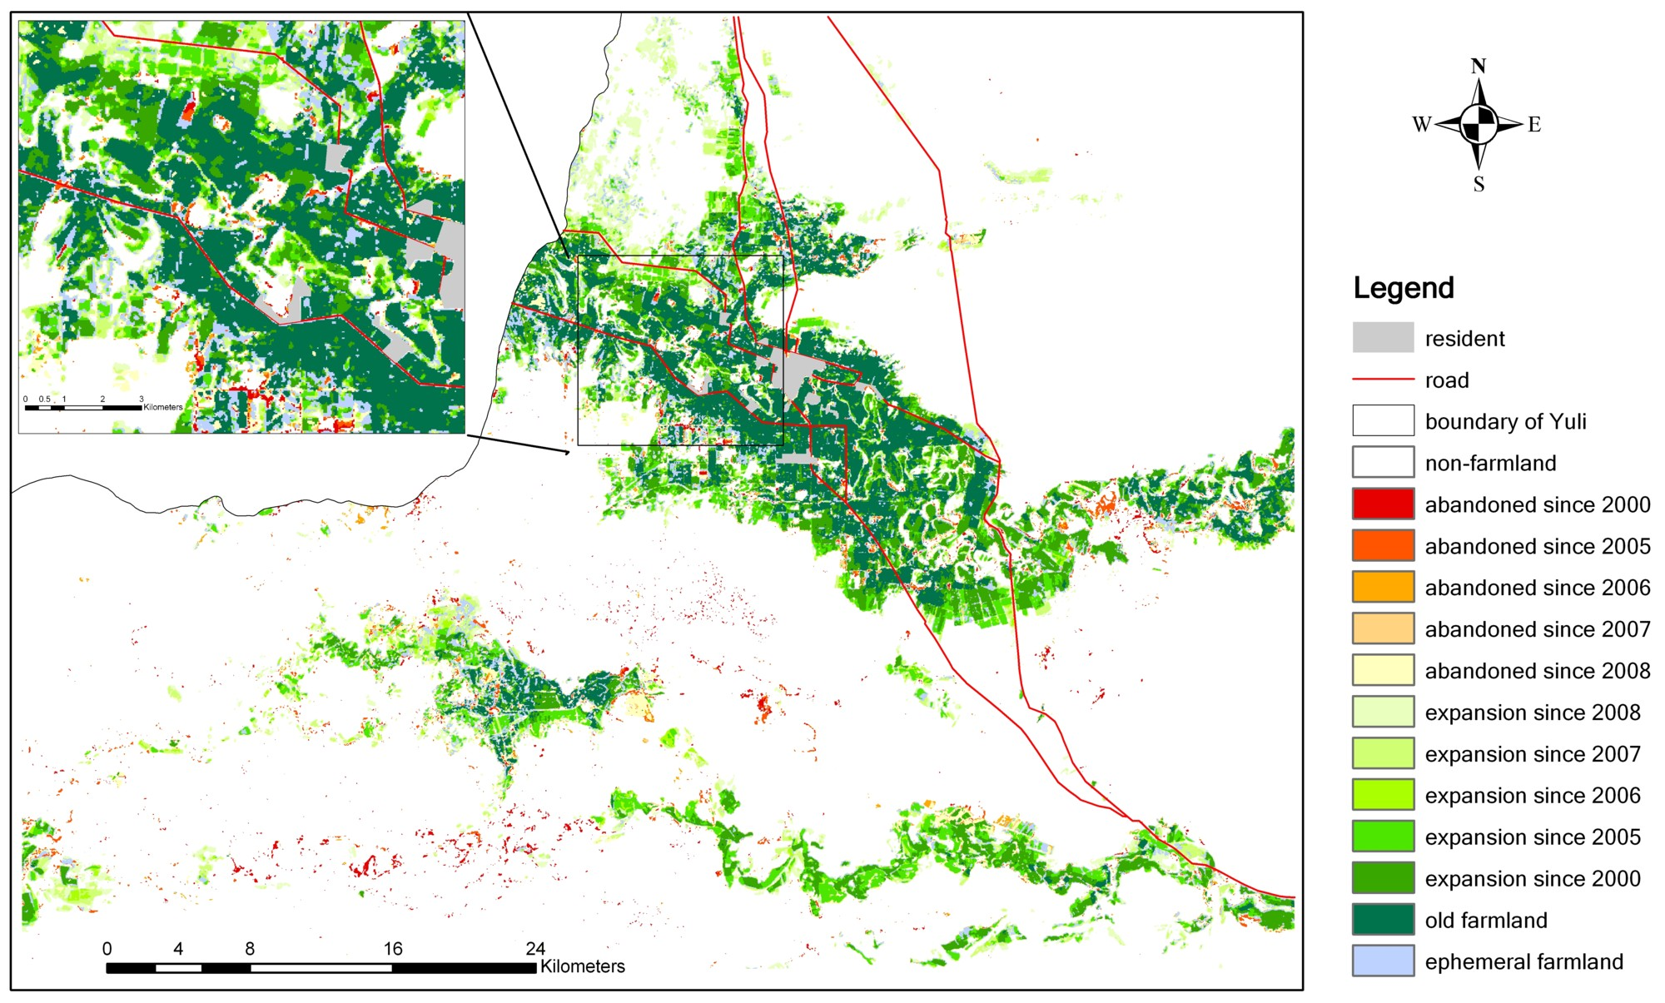
Farmland trajectories

Slide 40
Metrics of farmland trajectories
Trajectory | Change description | PLAND (%)
X-X-X-X-X-X | Old farmland | 3.79
O-X-X-X-X-X | Cultivated since 2000 | 3.10
O-O-X-X-X-X | Cultivated since 2005 | 1.86
O-O-O-X-X-X | Cultivated since 2006 | 0.47
O-O-O-O-X-X | Cultivated since 2007 | 1.21
O-O-O-O-O-X | Cultivated since 2008 | 1.67
X-O-O-O-O-O | Abandoned since 2000 | 0.31
?-X-O-O-O-O | Abandoned since 2005 | 0.35
?-?-X-O-O-O | Abandoned since 2006 | 0.20
?-?-?-X-O-O | Abandoned since 2007 | 0.12
?-?-?-?-X-O | Abandoned since 2008 | 1.01
O-X-O-X-O-X X-X-O-O-X-X … | Ephemeral farmland | 2.40

Slide 41
Metrics of stable farmland
Year | Change description | Area (kha) | PLAND (%) | NLSI | AWFDI
1994 | Stable farmland | 14.43 | 3.79 | 0.121 | 1.200
2000 |  | 26.24 | 6.89 | 0.100 | 1.210
2005 |  | 33.32 | 8.75 | 0.096 | 1.233
2006 |  | 35.11 | 9.22 | 0.093 | 1.242
2007 |  | 39.73 | 10.43 | 0.106 | 1.265
2008 |  | 46.11 | 12.10 | 0.114 | 1.285
2000 | Permanently abandoned | 1.19 | 0.31 | 0.480 | 1.086
2005 |  | 2.53 | 0.66 | 0.447 | 1.099
2006 |  | 3.30 | 0.86 | 0.447 | 1.100
2007 |  | 3.75 | 0.98 | 0.450 | 1.104
2008 |  | 7.58 | 1.99 | 0.385 | 1.134
 | Ephemeral farmland | 9.16 | 2.40 | 0.431 | 1.143

Slide 42
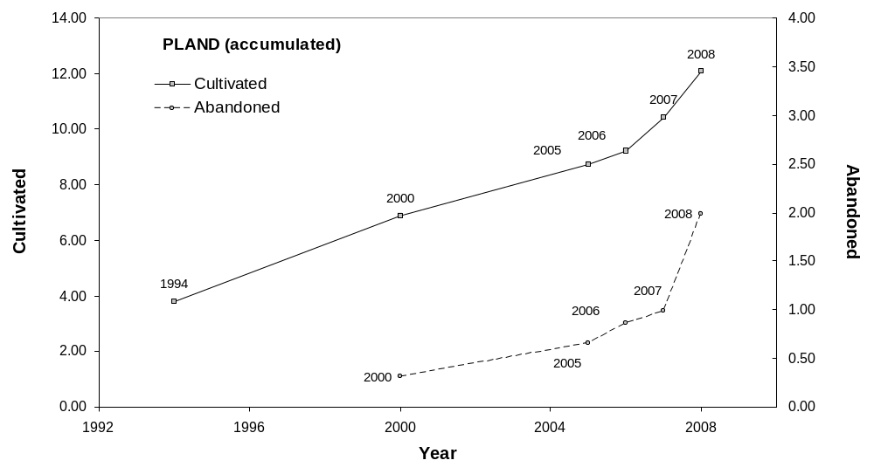
PLAND of permanent farmland expansion/abandonment

Slide 43
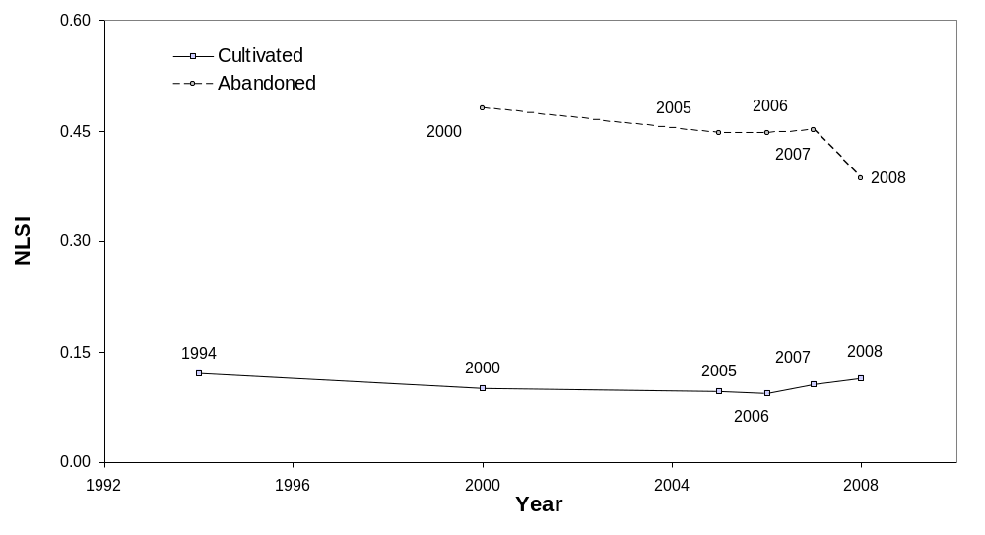
NLSI of permanent farmland expansion/abandonment

Slide 44
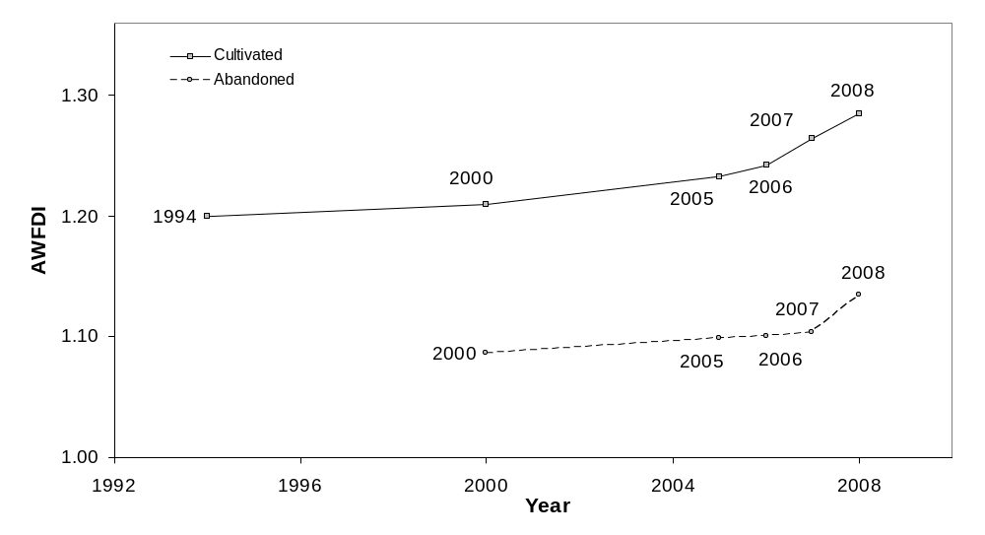
AWFDI of permanent farmland expansion/abandonment

Slide 45
Discussion: change of metrics
PLAND: rapid expansion associated with accelerated abandonment.
NLSI: tendency to greater patch aggregation – larger scale of farmland expansion and abandonment.
AWFDI: increasing edge complexity of patches when small, simple shape patches are merged together.

Slide 46
Discussion: ephemeral farmlands
The marginal farmland that has been cultivated and abandoned in succession.
Accounts for 16.4% of total farmland area.
Insufficient infrastructure and water resources.
Prone to the farmland abandonment and land degradation.

Slide 47
Conclusions
The trajectory-based approach to monitor and analyse landuse change in aridzone.
Farmland has rapidly increased in the study area.
Signs have been shown that the lack of water supply has resulted in farmland abandonment.
The spatial pattern of the farmland expansion and abandonment can be quantified by the class-level metrics.

Slide 48
Thank you for your attention!
For further contact: qiming@hkbu.edu.hk

Slide 49
References
Turner, M.G., Gardner, R.H., O'Neill, R.V. 2001 Landscape Ecology in Theory and Practice: Pattern and Process. New York: Springer.
McGarigal, K., Cushman, S. A., Neel, M. C. and Ene, E. 2002. FRAGSTATS: Spatial Pattern Analysis Program for Categorical Maps. Computer software program produced by the authors at the University of Massachusetts, Amherst. Available at the following web site: www.umass.edu/landeco/research/fragstats/fragstats.html.

