Slide 1

Geoinformatics Department, Palacky University Olomouc
1st StatGIS conference: 19.11.2013
Dr. Maik Netzband
Urban Remote Sensing and Landscape Metrics

Slide 2
Urban Remote Sensing and Geomatics
A city is characterised by its heterogeneity – in space and time
In the field of remote sensing and the applied data there are different sensors and scales selected dependent on the goal of the analysis
Unmodified and dynamically developing areas are closely intertwined in a city
In addition, a dynamic suburban and peri-urban environment with a manifold of interdependencies with the city exists
Spatial heterogeneity and a spatially limited , temporal dynamics are challenges for the monitoring and the analyse of remotely sensed data and digital Geoinformation datasets
Notes:
Die Stadt zeichnet sich aus durch ihre Heterogenität – räumlich und zeitlich
In der Fernerkundung drückt sich dies in Mischpixeln aus – unterschiedliche Skalen werden zur Auswertung gewählt
Unveränderte und sich dynamisch entwickelnde Bereiche sind in der Stadt eng miteinander verzahnt
Hinzu tritt ein oft dynamisches Umland mit engen Verflechtungen zur Stadt auf ganz unterschiedlichen Ebenen
Räumliche Heterogenität und räumlich begrenzte, temporale Dynamik bedingen hohe Anforderungen an Monitoring und Analyse mittels Fernerkundung und digitaler Geoinformation

Slide 3
Indicators for the urban environment
Natural Environment:
Soil / groundwater: degree of imperviousness, risk of contamination
Climate / air: thermal stress, circulation
Green spaces: quantity and location, biodiversity, network of green spaces
Built-up Environment:
Energy supply: Energy requirements / availability, energy consumption
Waste disposal: Quantity, collection, compost, recycling
Water management: needs, water treatment , rain water retention
Urban built-up structure: land use distribution and composition, densification and
urban land use potentials, building structure, state (quality) of buildings,
industrial plants
Mobility structure: motorised, non-motorised people in streets, public transport
Social Environment:
Housing: housing supply, demolition, empty housing
Population: age structure, marital status, ♀/♂ , proportion of foreigners, income
Socio cultural structure: socio cultural infrastructure, supply with
goods and services, green spaces, quality of neighborhood environment
Notes:
In dieser Gliederung ist die durch eine Stadt geprägte Umwelt eingeteilt in eine
„natürliche“ Umwelt
„Gebaute“ Umwelt
„Soziale“ Umwelt
In blau gekennzeichnet sind die Indikatoren, zu denen die Fernerkundung einen Beitrag leisten kann.
Dabei ist die FE - Daten und Methoden - zu verstehen als ein Werkzeug, um Forschungsgegenstände zu untersuchen.
FE ist kein Forschungsgegenstand per se.

Slide 4
Methodological Background
Vegetation-Imperviousness-Soil (V-I-S) Modell after Ridd (1995)
Imperviousness
Based on classification
100
0
Imperviousness as a kind of „paramount“ indicator for a variety of processes
CBD
Approach valid in general, but not transferable to any cities
High density
residentíal
Light
industry
Percent Soil
Percent Imperviousness
Medium density
residentíal
Heavy
industry
Low density
residentíal
Cover
crops
Row
crops
Range-
land
Bare
soil
100
0
Lawn
Forest
Desert
Vegetation
100
Percent Vegetation
0
Soil
Notes:
In diesem flächenbezogenen Modell nach Ridd sind die drei dominanten Landbedeckungen:
Versiegelung
Vegetation
Boden
In Bezug gesetzt, in denen Städte und Teile von Städten je nach ihrer Funktion, Größe und Ausprägung skaliert sind.
Modellhaft ist hier der CBD mit dem höchsten Versiegelungsgrad angegeben.
Versiegelung wird hier betrachtet als ein hochrangiger Indikator, der für eine Vielzahl von Prozessen Aussagen liefert.
(Indikator für Flächeninanspruchnahme, Versickerungsrate bzw. oberflächlichen Abfluss, Temperaturanstieg im Sommer, etc.)

Slide 5
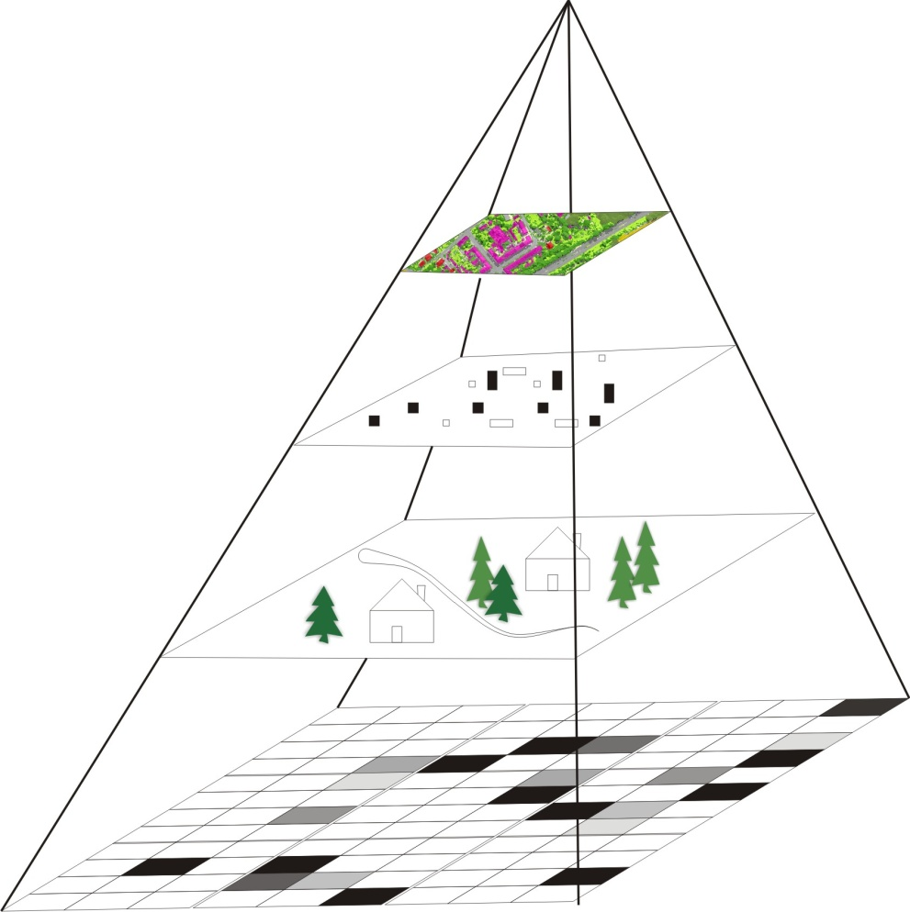
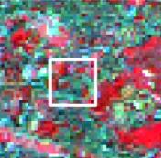
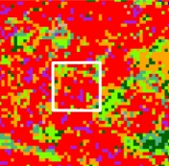
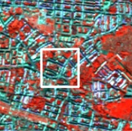
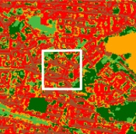
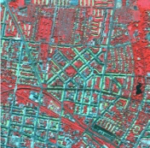
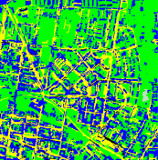
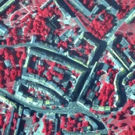
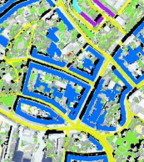
Scale-dependent analyses exemplified for urban remote sensing studies
Spatial resolution
imagery /
photography
classified
image
urban entity
= image set of
urban structures
1 : 100 000 - 1 : 50 000
20 – 30 m
urban structure
= configuration
of single elements
1 : 25 000 - 1 : 15 000
10 – 15 m
single structure
element
(house,street,garden)
Generalisation
Characterisation
1 : 10 000 - 1 : 5 000
1 – 5 m
Pixel = smallest unit
of on imagery depen-
dent on spatial
resolution. It can
contain one object or
parts of objects
1 : 1 000 - 1 : 5000
0,20 – 1 m
Modified after Puissant & Weber 2002
Notes:
TM : gesamtstädtische Flächendynamik – Suburbanisierung
Auswirkungen physischer Faktoren wie Klima und Gesundheit „städtische Wärmeinsel“
Naturgefahren – Lage und Ausdehnung von Überflutungen, Hangrutschungen, etc.
Spot: Siedlungsstruktur, Biotopstruktur
Ikonos: Versiegelungsgrad, gemischte und homogene Strukturen, Umweltqualität auf Blockebene
CIR: Zu- / Abnahme von Gebäudeflächen; Gebäudetypisierung; Verkehrswege: Fluchtwege bei Disaster

Slide 6
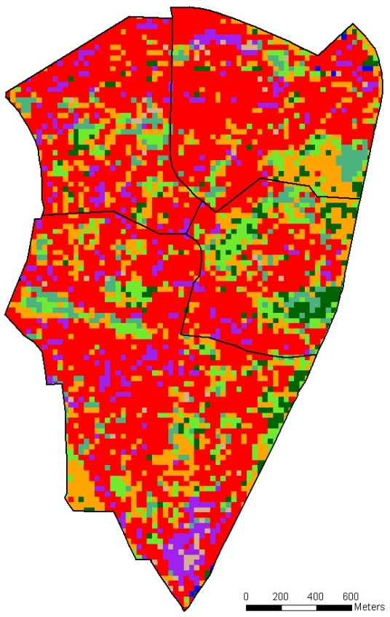
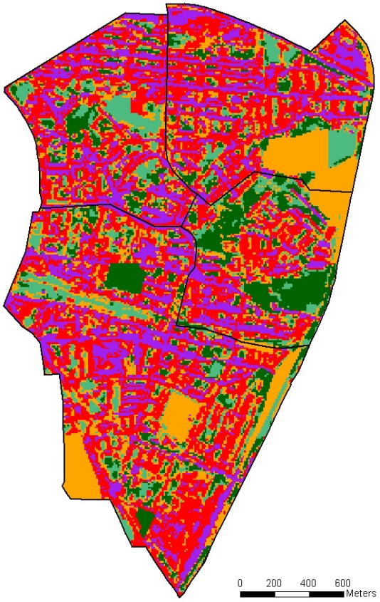
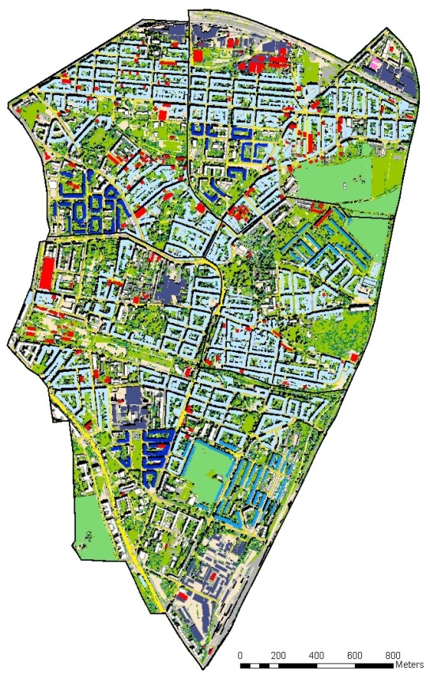
Scale-dependency: different sensors, resolutions, semantics
Four Local Districts in the City of Leipzig
Landsat-5-TM [30 m]
05-Sept-2005
Spot-5-XS [10 m]
07-Sept-2005
CIR photograph [40 cm]
21-Juni 2005
Urban structure:
Inner urban differentiation ▪ Amount, intensity, axes of infrastructure
Different building structures, densities ▪ Amount and structure of vegetation

Slide 7
Two ecological approaches to understand and manage the dynamics of urban and urbanizing ecosystems
The ecosystem approach: fluxes of energy, matter and species.
The patch dynamic approach: creation of the spatial heterogeneity within landscapes and how that influences the flow of energy, matter, etc. across the landscape.
Spatially focused approach of patch dynamics (Pickett et al. 1997): urban landscape is a mosaic of biotic and abiotic patches within a matrix of infrastructure, social institutions, cycles and order.
Spatial heterogeneity within an urban landscape has both natural and human sources.

Slide 8
Remote Sensing and Landscape Metrics
Analysed satellite image data is a very useful instrument offering the information needed:
  continuous land-cover information,
  quasi-recent to retrospective (back to the 1970’s )
  reasonable price, i.e. for monitoring purposes
Digital image processing and landscape metrics software can ‘sharpen’ information contained in the raster-based image structure:
  - texture
  - shape
  - neighbourhood
Show public decision makers the necessity of regional concerted actions and to be able to regulate the process (‘spatial map aha effect’).
Notes:
8

Slide 9
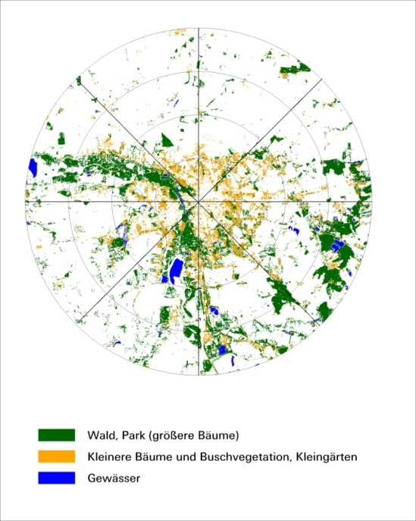
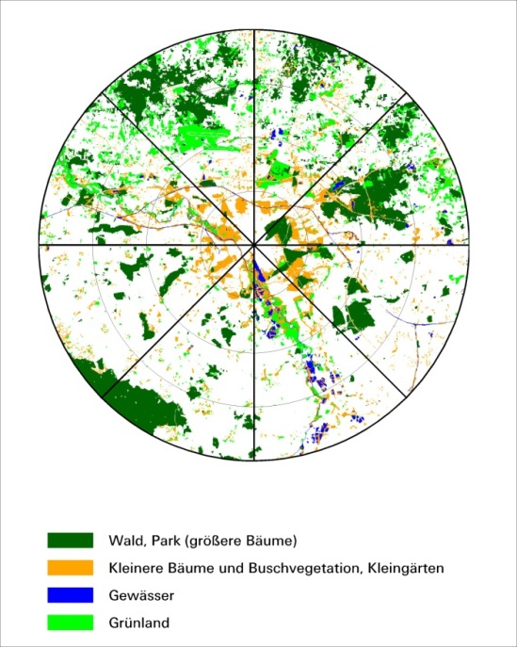
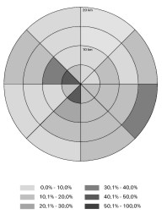
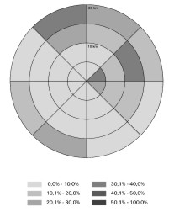
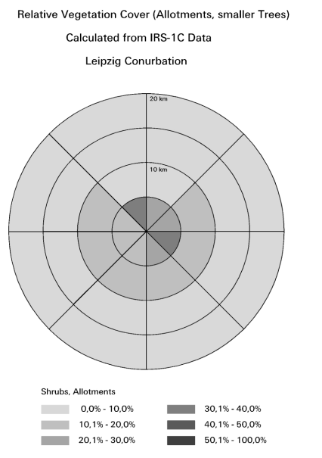
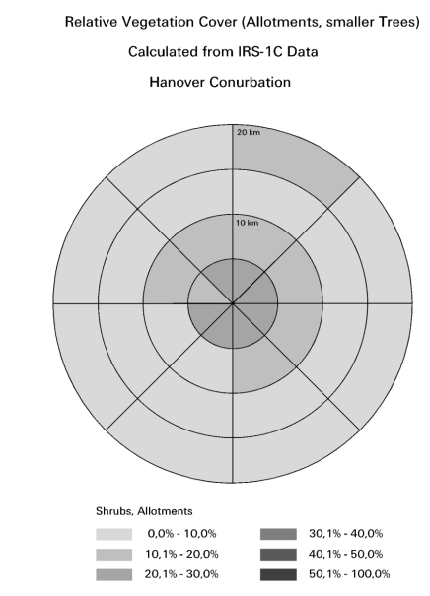
IRS 1C Satellite Image Data -Classified Vegetation Cover
Leipzig
Hanover
Trees, Forest
Allotments and Backyard Gardens

Slide 10
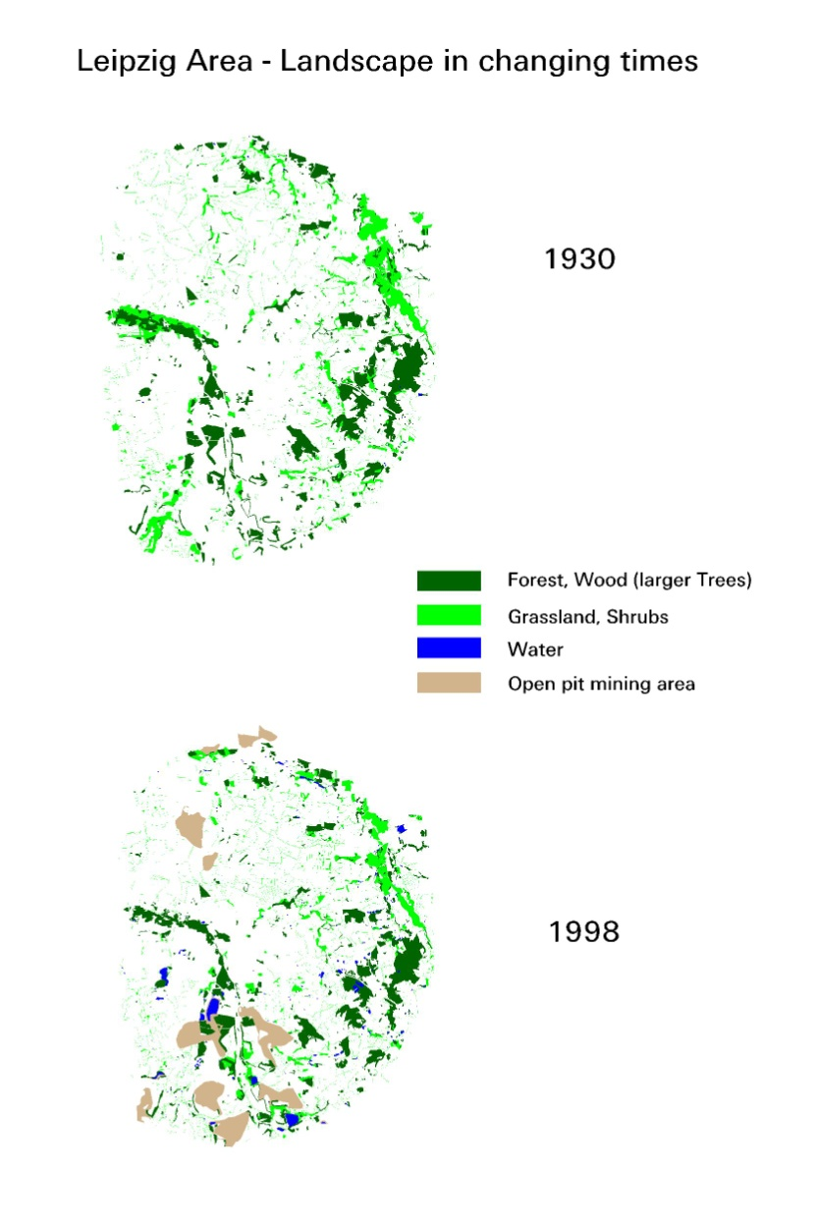
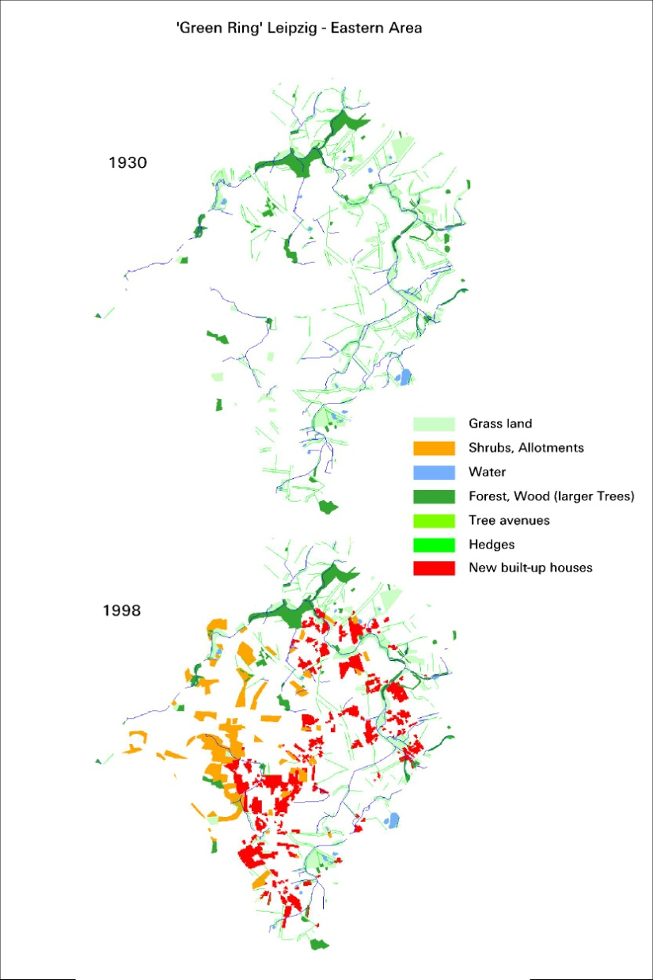
Configuration of green spaces
Netzband & Banzhaf, 2000

Slide 11
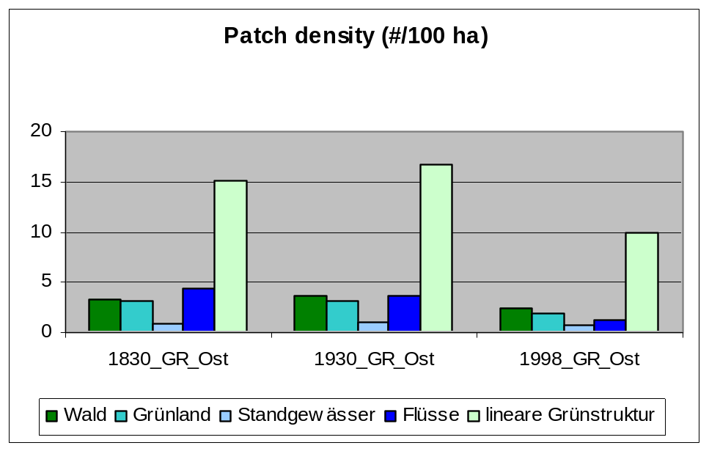
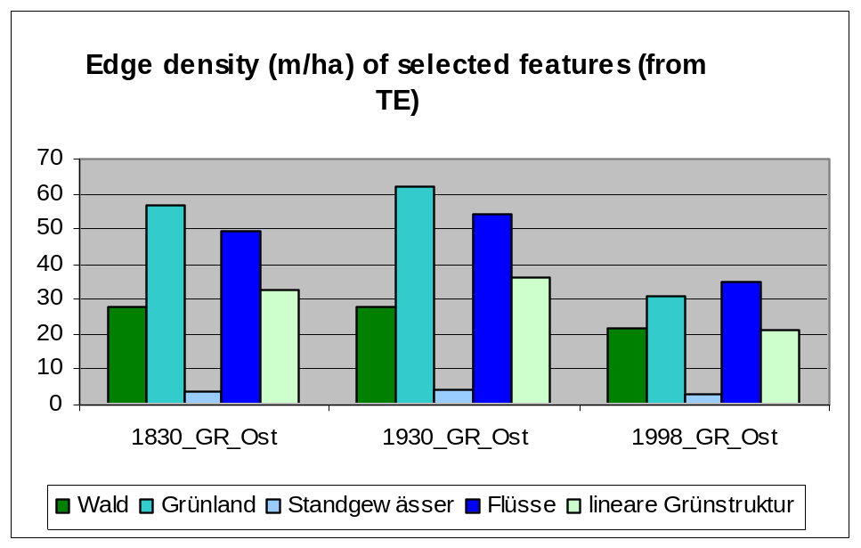
Landscape metrics for the „Green Belt“ of Leipzig
■ PD equals the number of patches of the corresponding patch type (NP) divided by total landscape area, multiplied by 10,000 and 100 (to convert to 100 hectares).
■ facilitates the comparison of landscapes at different time slots
■ strongest decrease of shrubs / smaller trees patches in the 10-15 km zone
■ ED equals the sum of the lengths of all edge segments involving the corresponding patch type, divided by the total landscape area, converted to hectares.
■ decrease of edge lengths in
the peri-urban area of the city
Netzband & Kirstein, 2001

Slide 12

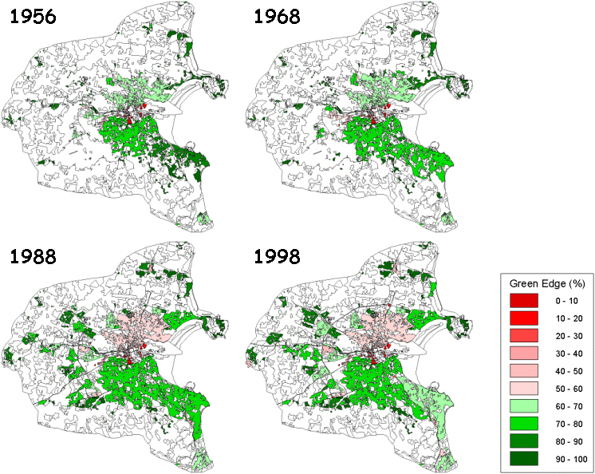
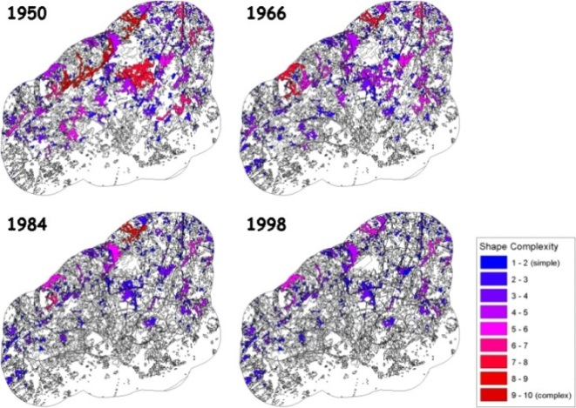
Indicators on the basis of remotely sensed data
Habitat Suitability Index (Shape Complexity
for Arable Land in Helsinki (1950-1998)
‘Green Edge Index’ for Urban Fabric
in Dublin (1956-1998) - how much of a region’s urban fabric
is adjacent to (i.e. has an edge with) vegetated areas.
Notes:
12

Slide 13
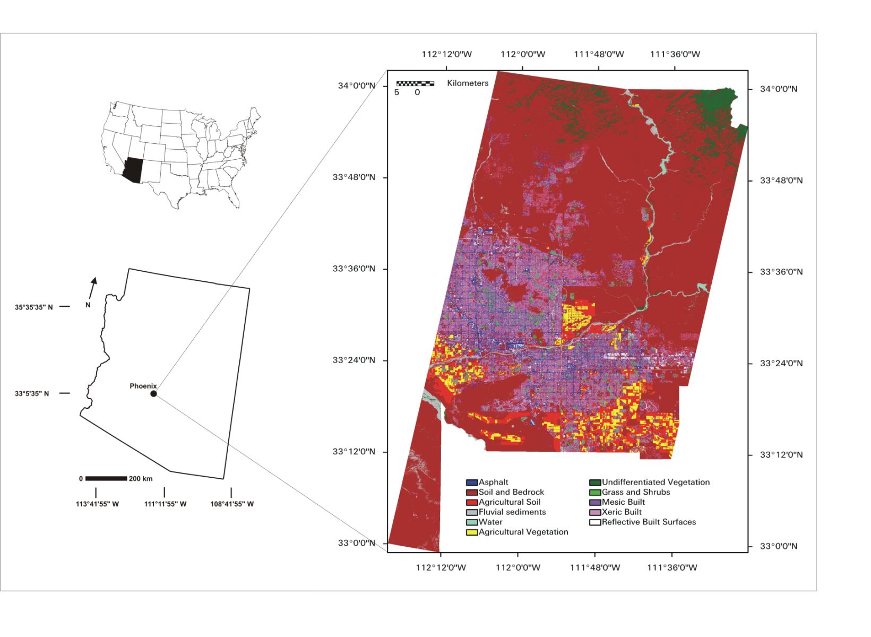
ASTER Land Cover Classification for Phoenix

Slide 14
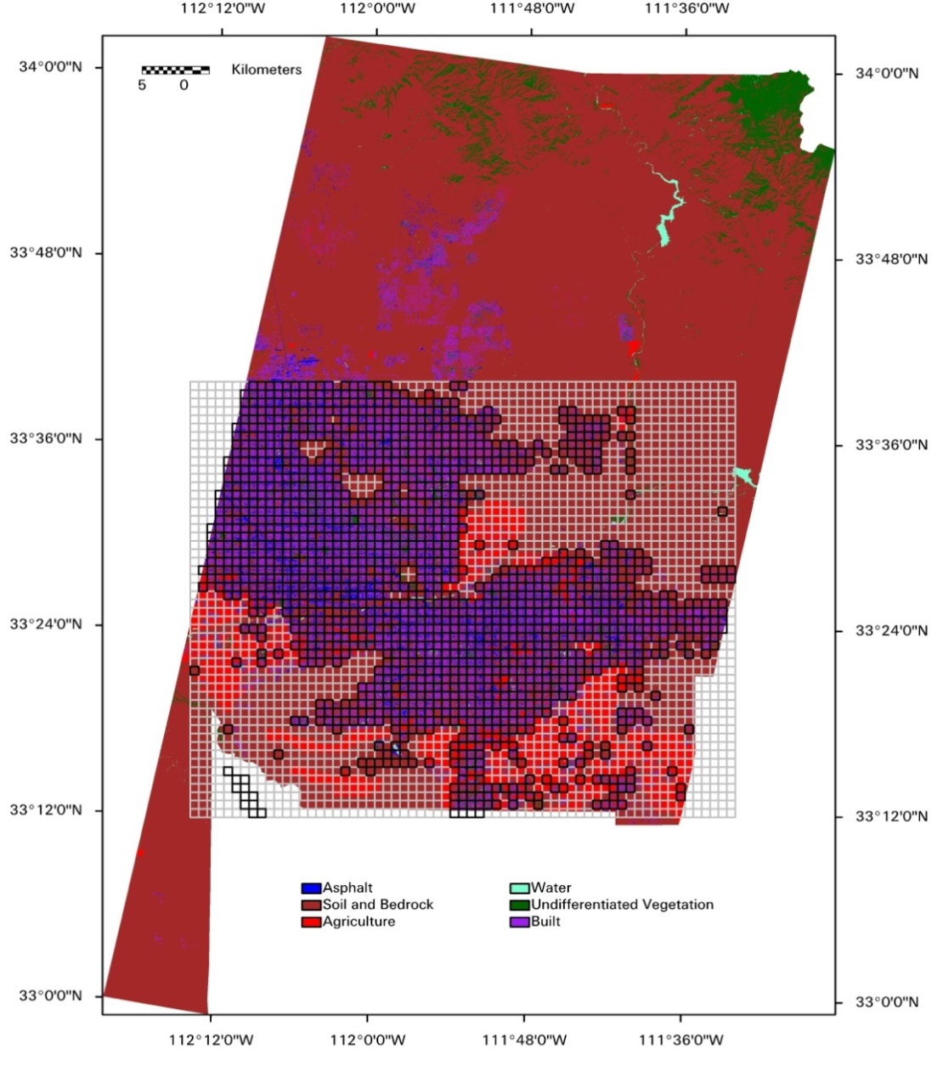
Landscape Characterization of Urban Centers
Suite of landscape metrics available (FRAGSTATS); Class Area, Edge Density, Mean Shape Index, Interspersion and Juxtaposition Index.
Metrics calculated on 1 x 1 km grid to allow comparison of results between urban centers and comparison with other datasets such as MODIS.
Stefanov and Netzband,
RSE, 2005

Slide 15
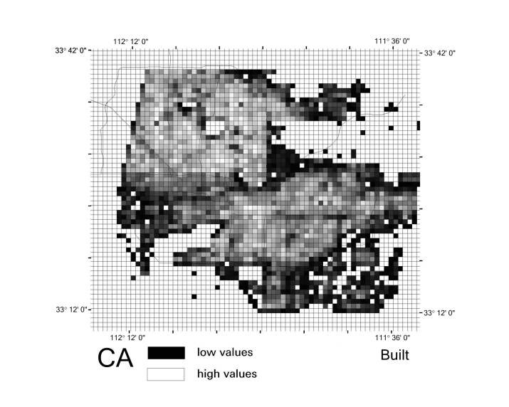
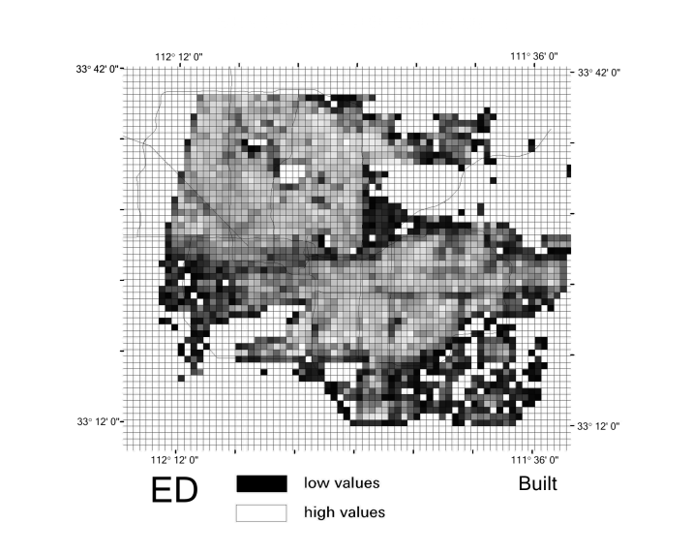
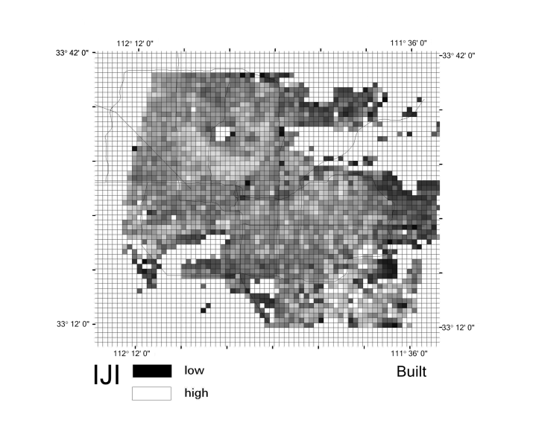
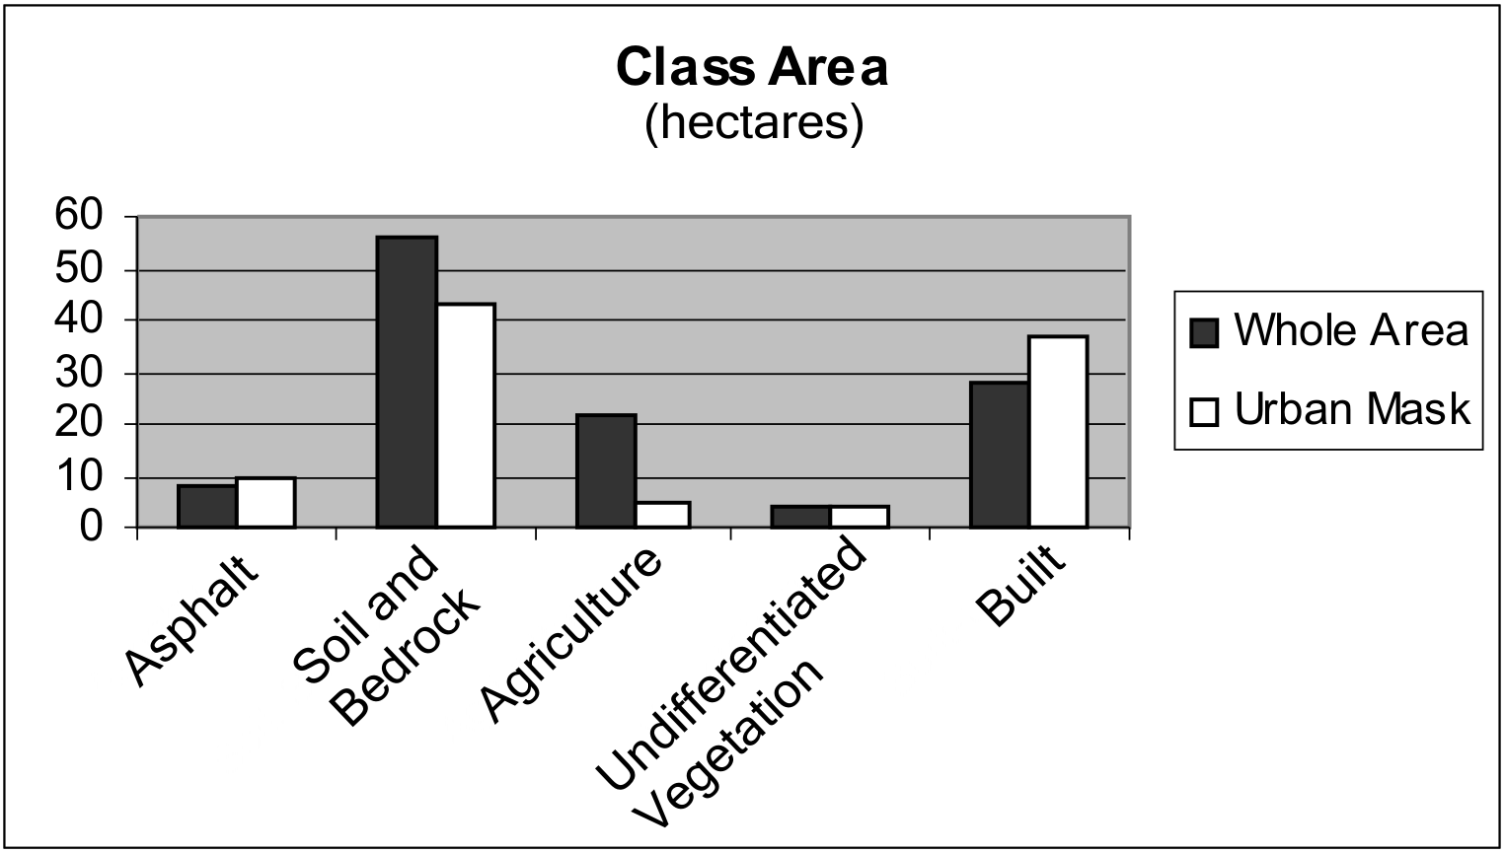
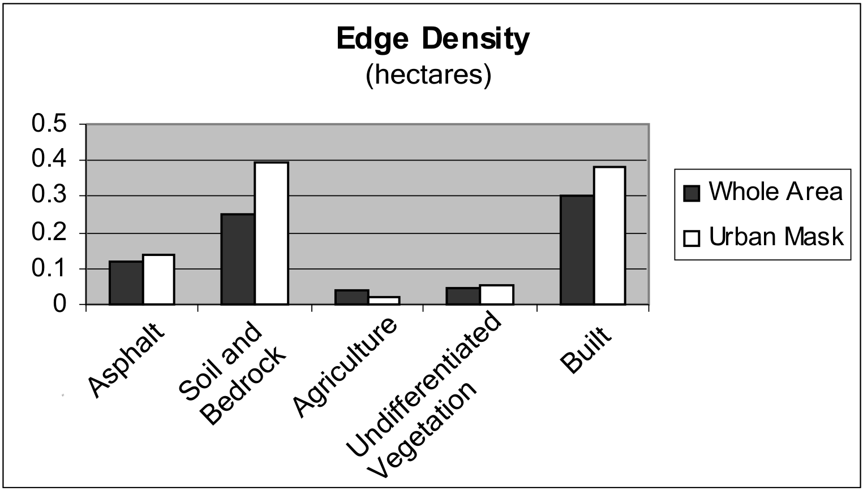
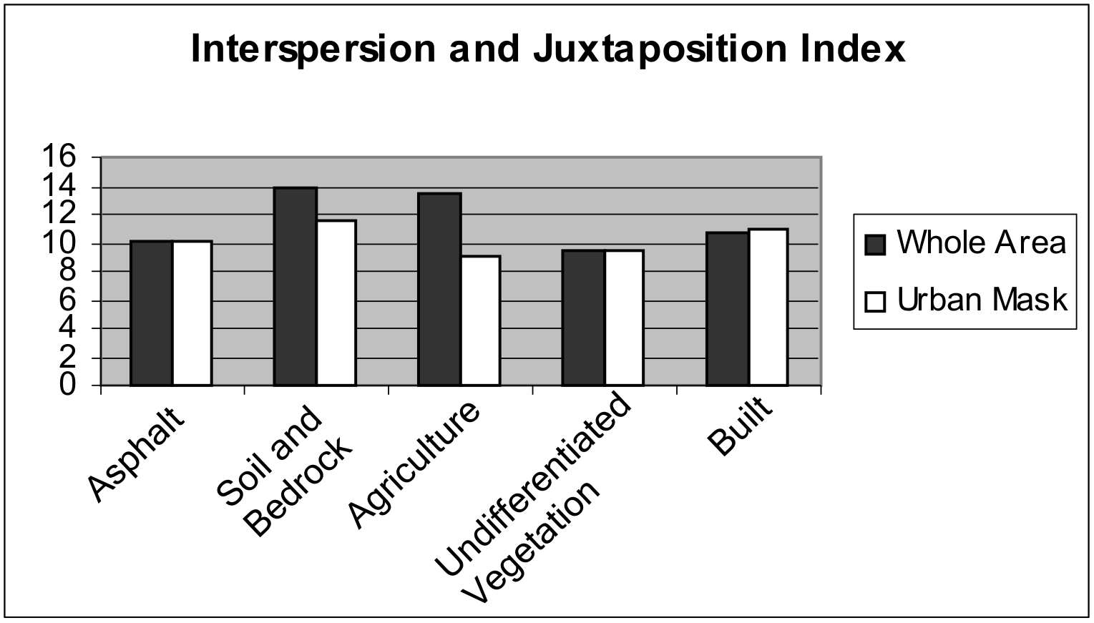
Landscape Metric Results for Phoenix
(Stefanov and Netzband, 2005)iew)

Slide 16
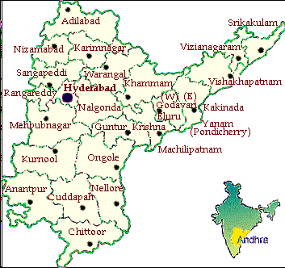
Case study Hyderabad/Secunderabad
  Capital region of Andhra Pradesh State
  It spreads over an area of 1279 km²
  Urban population:
    increased by 41.57% as against 43% of the total Andhra Pradesh state and 36% of total country.
    just 0.44 million in 1901
    after India’s independence in 1947 1.13 million,
    up-to 3.6 million by 2001.
  Climate:
    hot semi-arid moist with dry summers maximum temperature 40ºC and mild winters minimum temperature up-to 15ºC with average rainfall of about 75 cm
Andhra Pradesh
Fig. 1 Location of study area Hyderabad
Rahman et al, 2009
Notes:
16

Slide 17
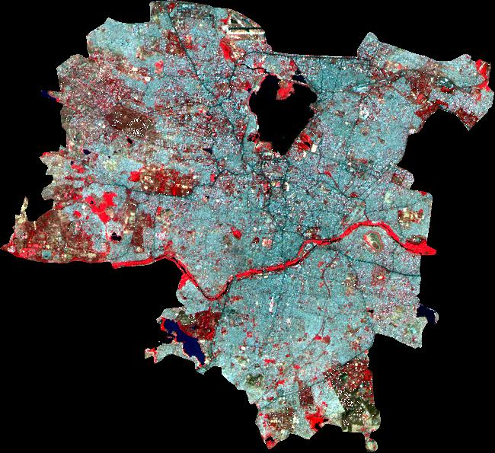
Physical expansion of Hyderabad
In the North of Hyderabad Hussain Sagar lake provides water for the growing urban population
further expansion of this twin city is mainly in the North which is the new part called Secundarabad, so the city gradually expanded to an area of 179 Km².
Notes:
17

Slide 18
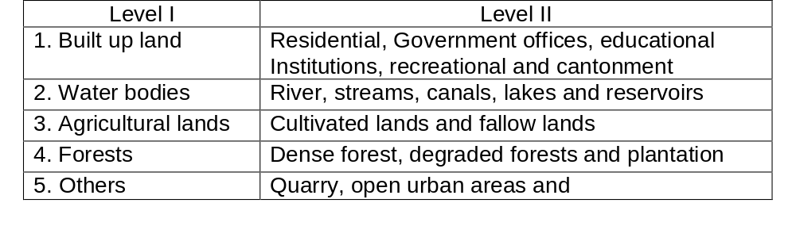
To study the urban growth...
Two basic data layer i) ward-wise map and ii) land use map.
Land use/land cover map prepared for 1971 from topographical sheet at a scale of 50,000, for 1989 and 2001 from Landsat TM and ETM+ and for 2005 IRS P6 data
NRSA 1995 classification scheme was used for major land use classes – see below...
SoI toposheet of 1971 was geo-referenced and then digitized for the six major land use classes and that was used as a base map.
Notes:
18

Slide 19
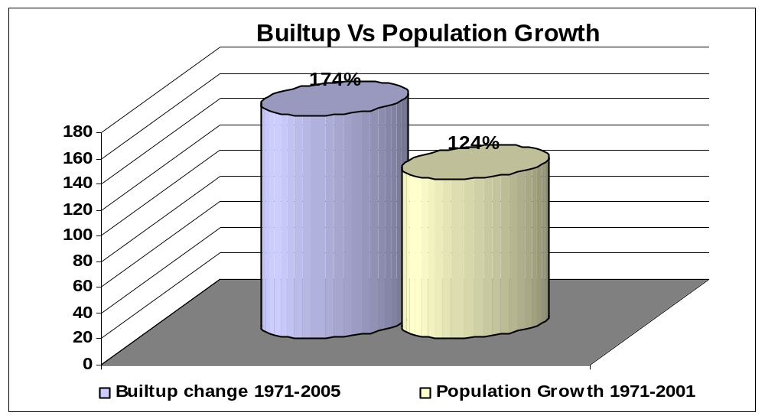
Comparing built-up vs. population of Hyderabad
  Rate of development of land in the Hyderabad-Secundrabad region is far outstripping the rate of population growth.
  Implies that the land is consumed at excessive rates and probably in unnecessary amounts as well.
  Per capita consumption of land has increased steadily over three and half decades.
Notes:
19

Slide 20
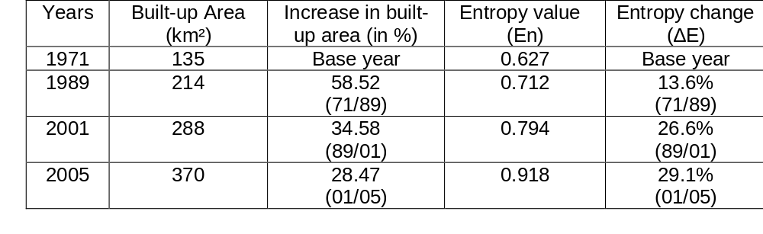
Results show that...
1971 total entropy value 0.627 and it increased to 0.918 in 2005 this means that the expansion of Hyderabad has occurred at a fast rate in the fertile fringe areas.
Compact distribution and vertical development of built up entropy value (ranges from 0 to log n) closer to 0
Distribution very dispersed closer to log n.
High value of entropy indicates the occurrence of urban growth in that particular region.
Notes:
20

Slide 21
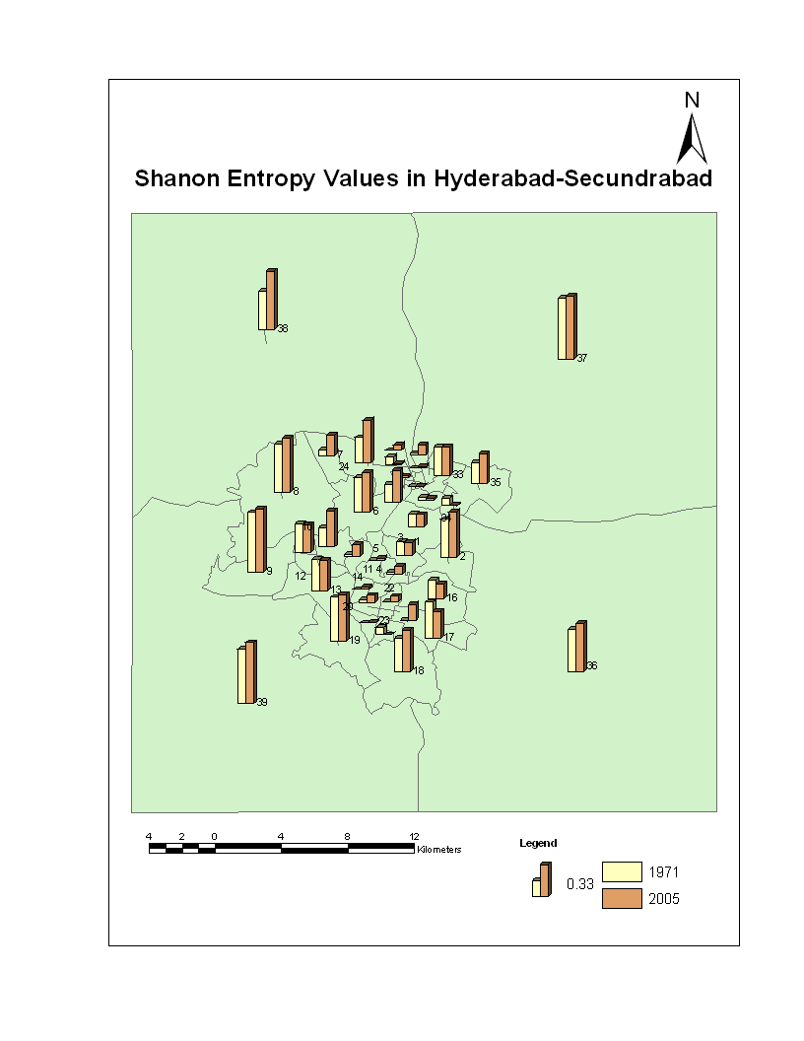
Results also show...
Built up area increased almost in all wards of the city but areas in the north-west of the city (7-11) maximum increase in the built-up area
The four zones NW of Hyderabad highest growth rates, entropy value increased from 0.409 in 1971 to 0.66 in 2005
Reason: new township has come up i.e. Hi-Tech city, a hub of computer software.
Notes:
21

Slide 22
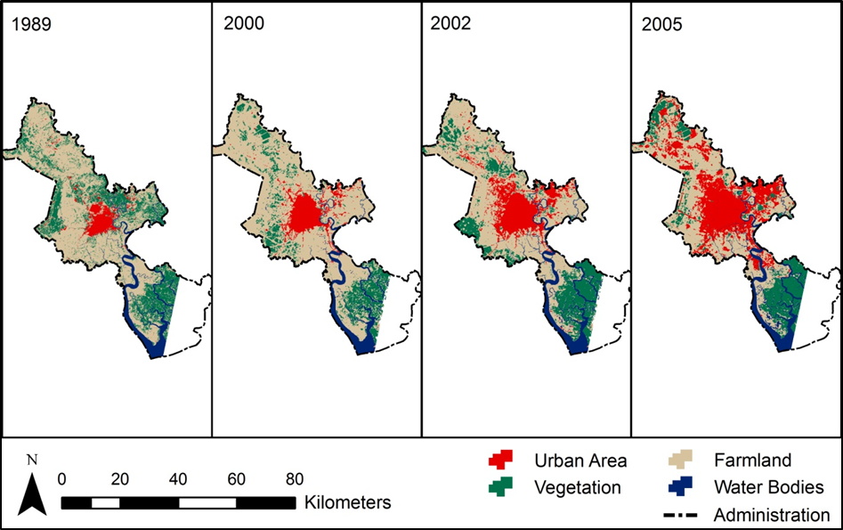
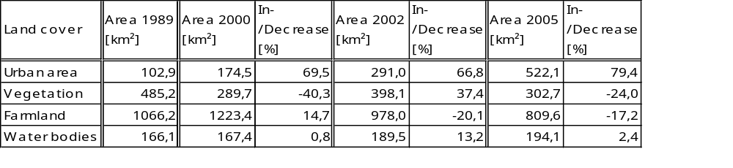
Change in land coverage for the period 1989 - 2005

Slide 23
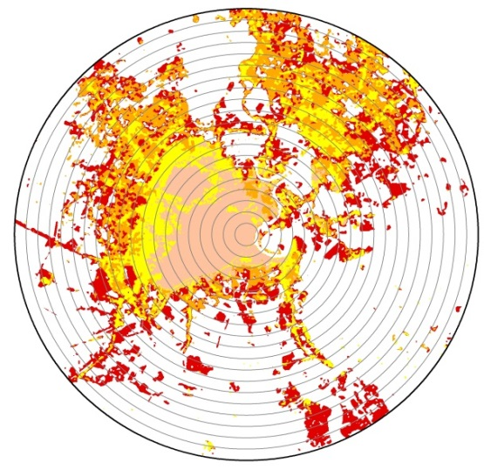
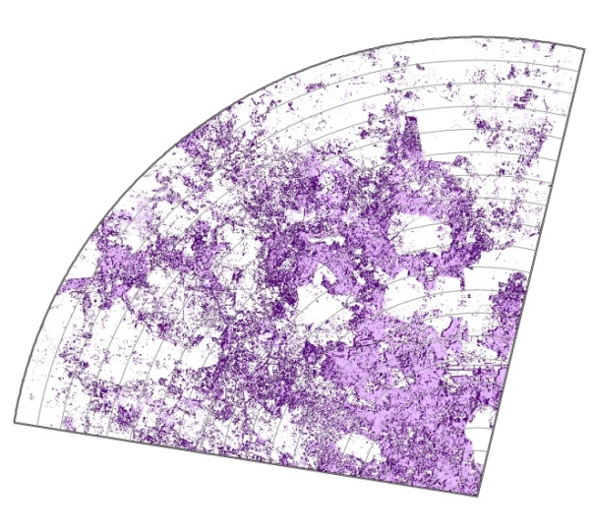
Comparison HCMC - Hyderabad
20 km
20 km

Slide 24
Inter urban comparisons - Concept
eGeopolis/Indiapolis – Digitization of Indian urban agglomerations – Author: French Insitute of Pondicherry
Digitization on basis of Google Earth satellite image data
The second step (2010-2012) consists of the exhaustive cartography of all Indian
settlements (>5000 inhabitants) and agglomerations, and in preparing the update of the census of 2011
Inde_1872_2001.gif
Notes:
24

Slide 25
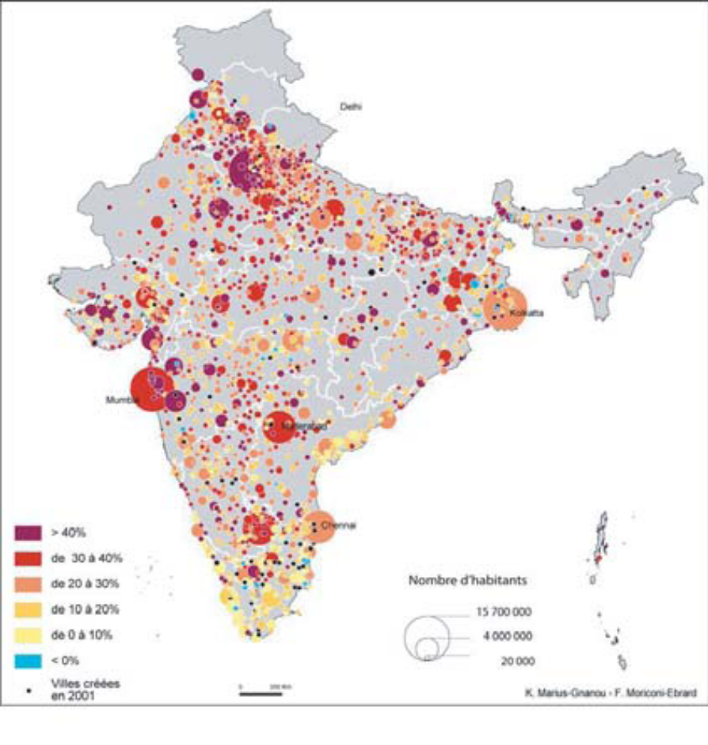
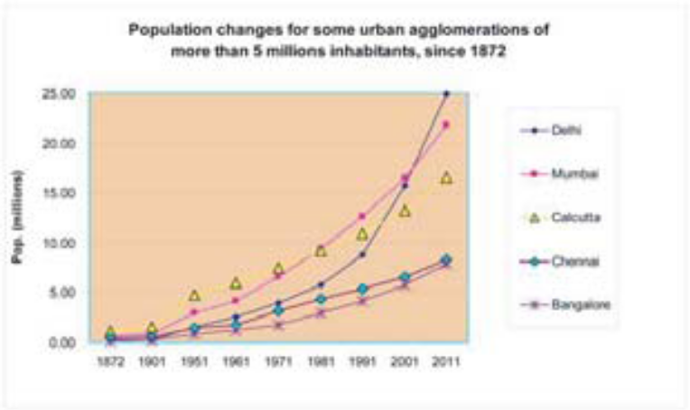
Variation 1991 - 2001
Agglomerations of more than 20,000 inhabitants

Slide 26
Inter urban comparisons - Methodology
Creation of a raster grid of 5*5 km
Delineation of rectangular ring zones with raster grid elements in 5km distances starting from a defined center grid element
Calculation of digitized urban ‚footprint‘ within the grid elements
Statistical Analysis of urban agglomerations
Notes:
26

Slide 27
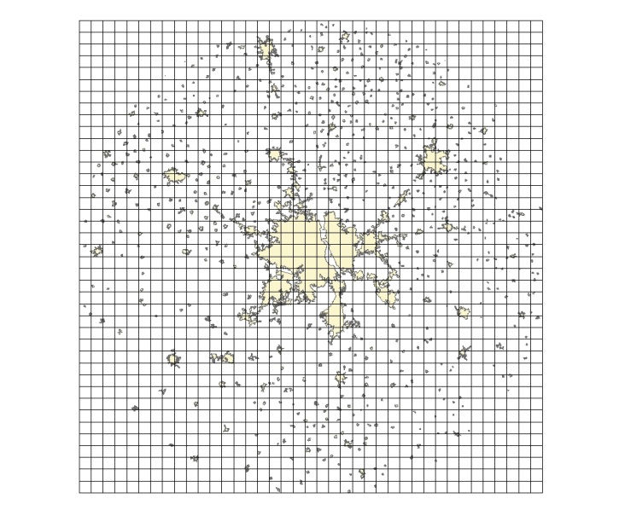
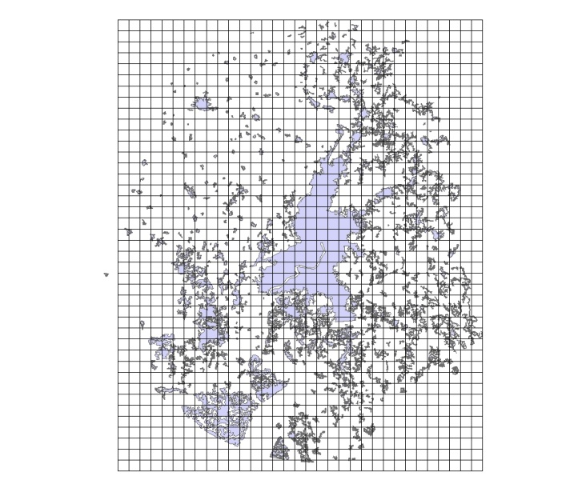
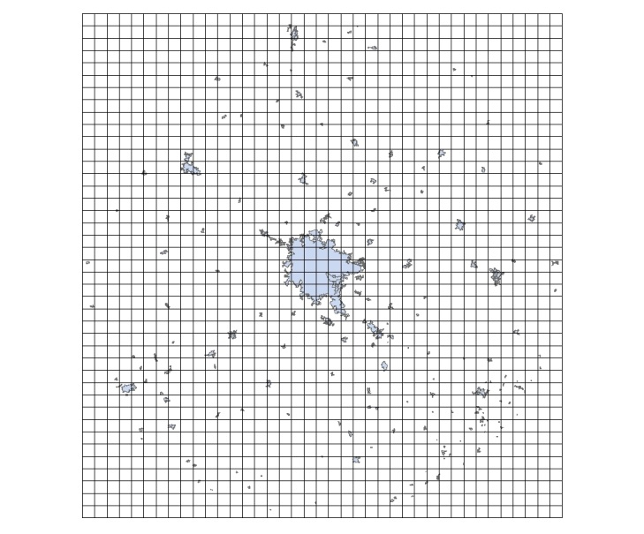
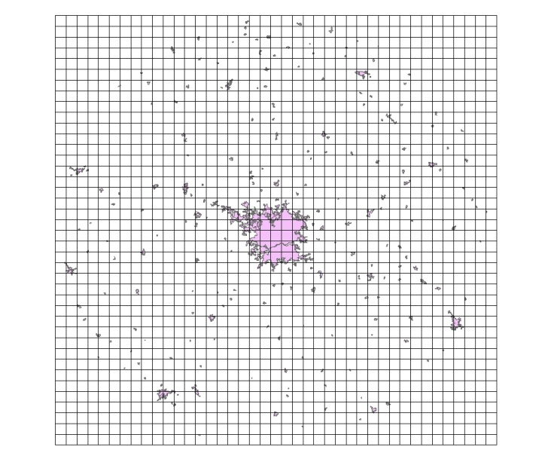
eGeopolis/Indiapolis – Test areas with 5km grid
Delhi
Kolkata
Hyderabad
Bangalore

Slide 28
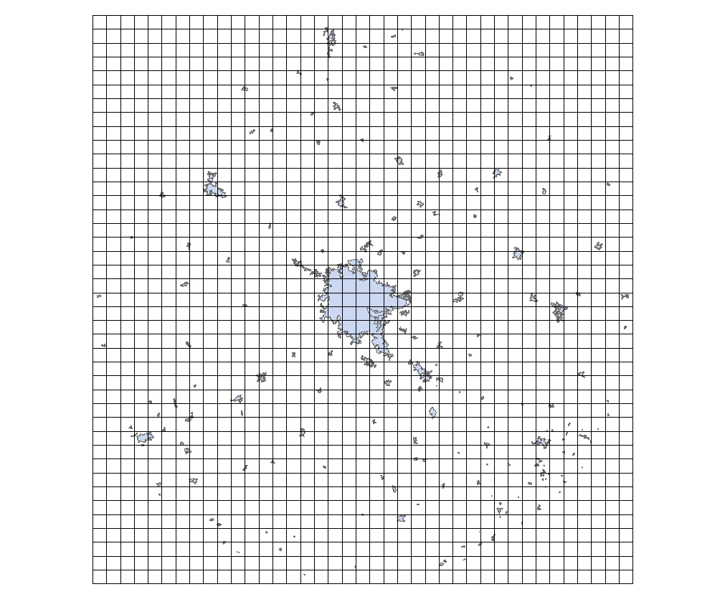

eGeopolis/Indiapolis - Bangalore and Kolkata with 5km grid

Slide 29
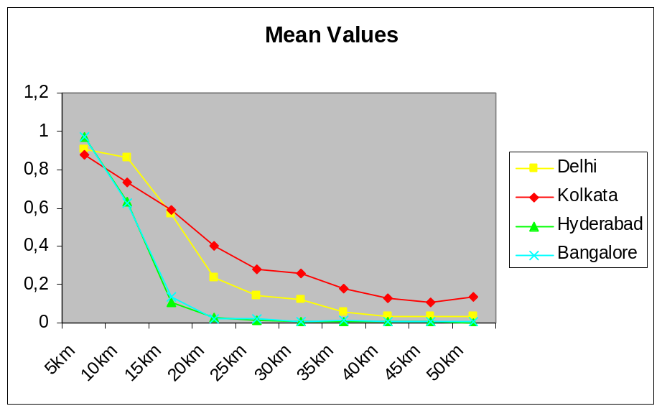

Inter Urban Comparisons - Results
All start at similar high density level
MC Delhi and Kolkata show higher values in increasing distance and slower decrease, higher variation (SD) than emerging MC Hyderabad and Bangalore
Notes:
29

Slide 30


Inter urban comparisons – Results (cont.)
MC higher Majority values overall
Minority varies a lot in the closer fringe areas, ‚stabilize‘ in the outer areas with higher values for the MC, lower for the EMC
Notes:
30

Slide 31

Recent Research Activities on Urbanization in India
Comparative study of ten biggest indian urban agglomerations:
  3 Megacities: Delhi, Mumbai and Kolkata
  Incipient mega cities (5-7 mill. inh.: Chennai, Bengaluru, Hyderabad and Ahmadabad
  Urban agglomerations 2.5 and 5 mill. Inh.: Poona, Surat, Kanpur, Jaipur and Lucknow
Population data vs. Satellite based LC/LU classification (H. Taubenböck et al. / Computers, Environment and Urban Systems 33 (2009) 179–188
Notes:
31
31

Slide 32

Spider charts characterising spatiotemporal urban development
Megacities show consistent similarities: extensive LSI to TE axis and a graph development giving the net an Area, BD and LSI leaning shape.
consist of disaggregated patches and parallel a high built-up density
Incipient mega cities: Chennai, Hyderabad, Bengaluru show very similar shapes
Gradients from various parameter axes, as well as the enclosed areas, almost consistently correspond
Notes:
32
32

Slide 33
Physical expansion of Hyderabad
Conclusions and Outlook
Remote Sensing and Landscape Metrics widely used during the last decade for evaluating spatio-temporal dynamics in urban regions
Need to standardize/harmonize methods for a real evaluation, especially for inter-urban comparisons, LU/LC budgets and prognosis
How can we integrate case studies into a common and widely accepted framework?
Notes:
33

Slide 34
Thanks for your attention !
Notes:
34

Slide 35
Shannon Entropy value Calculation
  Degree of spatial concentration and dispersion exhibited by a geographical variable in a specified area
  For all 35 wards and also for four fringe zones i.e. SE, NE, NW and SW
  Results: urban sprawl has occurred in all the wards of twin city but not at the same rate.
  Sprawl has been expected more in the fringe wards but the wards, which are in the city centre, have also experienced development i.e. vertical expansion - some open/vacant lands are now occupied with high rising buildings.
Notes:
35

Slide 36


Urban growth of Hanoi: 2000 (yellow), 2002 (orange), 2011 (red)

Slide 37






Comparison of Spatial Metrics across Regions (Huang et al., 2010)

Slide 38




Correlations between spatial variables (Huang et al., 2010)

