Slide 1

Towards a real-time landslide early warning strategy in Hong Kong
Qiming Zhou and Junyi Huang
CENTRE FOR GEO-COMPUTATION STUDIES
HONG KONG

Slide 2
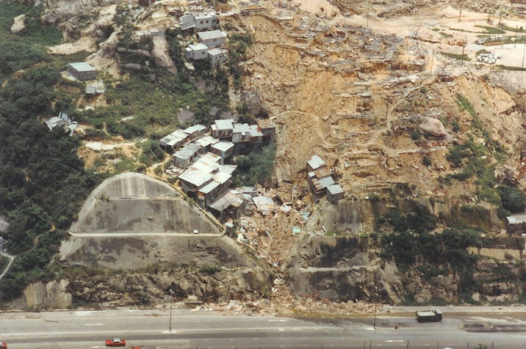
Landslide Hazard in Hong Kong
Mass movement of rock, debris or earth down a slope, which can be triggered by various external stimuli, considered as one of the most damaging disaster in the world.
Lam Tin, Kowloon (1982)

Slide 3
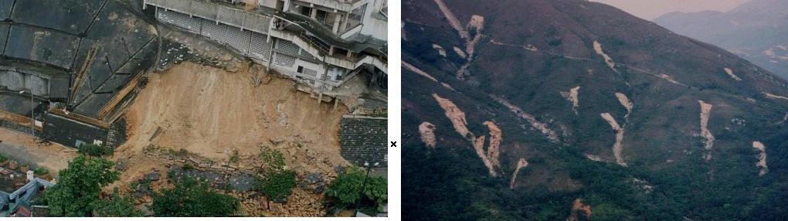
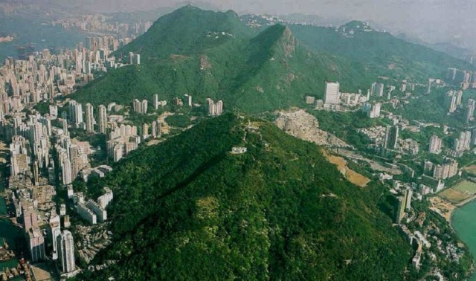
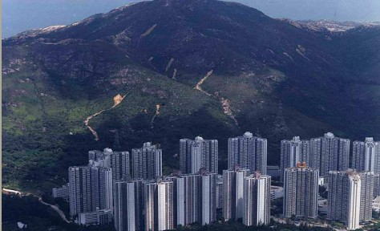
Landslide Hazard in Hong Kong
Man-made slope failure
Natural terrain slope failure
Encroachment of built environment and increasing risk of landslide

Slide 4
Methodology
Landslide susceptibility mapping:
  A quantitative or qualitative assessment of the classification, volume (or area), and spatial distribution of landslides which may potentially occur in an area.
Influence from
environmental variables
rainfall-runoff process
Real-time early warning system
Geotechnical/
statistical model
scale-adaptive physical/empirical model

Slide 5
Research Framework
Study site selection and reconnaissance field investigation
Spatial data acquisition and specification
Hydrological ground data collection and rainfall/runoff analysis
Surface/sub-surface water discharge analysis
The development of landslide susceptibility and risk analysis model
Field tests and rainfall-runoff simulation experiment
Computer platform implementation
System calibration and evaluation

Slide 6
Landslide Susceptibility Analysis
Historical landslide inventory (ENTLI database from CEDD)
Environmental parameters
  Elevation (terrain slope and aspect, etc.)
  Vegetation Index (NDVI)
  Lithology (1:20,000 geology map)
  Distance to fault line
  Distance to major stream
  Land cover
Landslide triggering factors and its consequence
  Rainfall gauge data (archive, real time and forecast)
  Service run-off
  Soil hydorlogy
Risk analysis
  Tertiary Planning Unit (TPU) census data 2011
  Transportation network
  Tracts in conservation parks

Slide 7
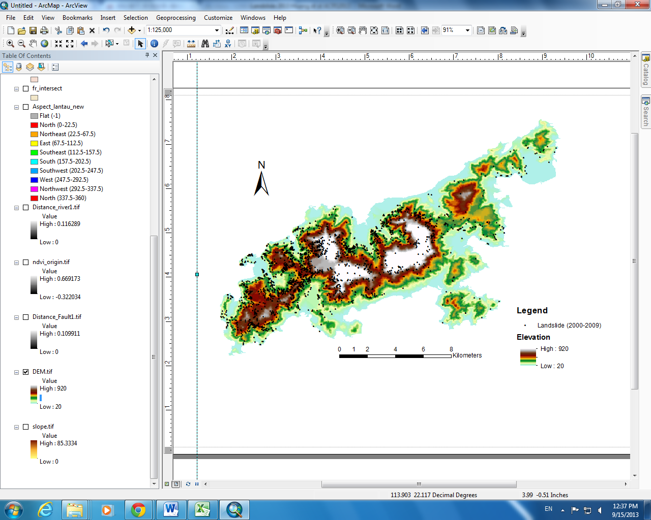
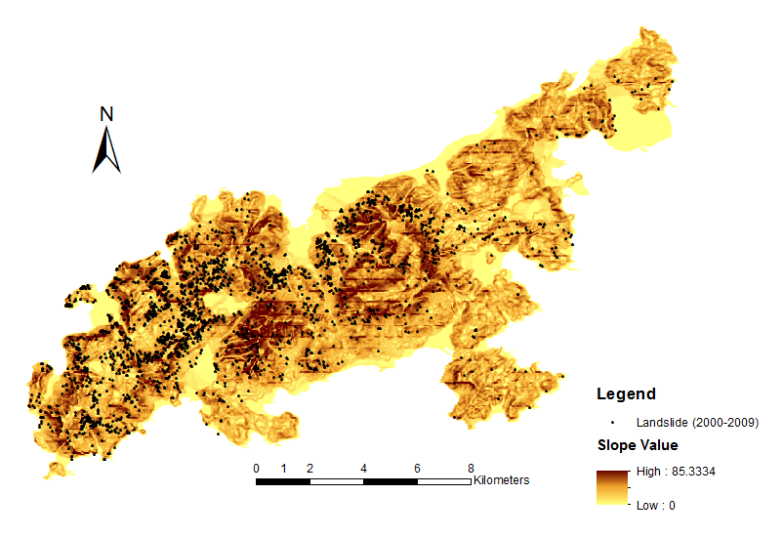
Landslide susceptibility Analysis
Digital Elevation Model (DEM) and its derivatives (slope, aspect, curvature, etc.)
Landslide occurrence record (2000-2008), elevation and slope of Lantau Island, Hong Kong

Slide 8
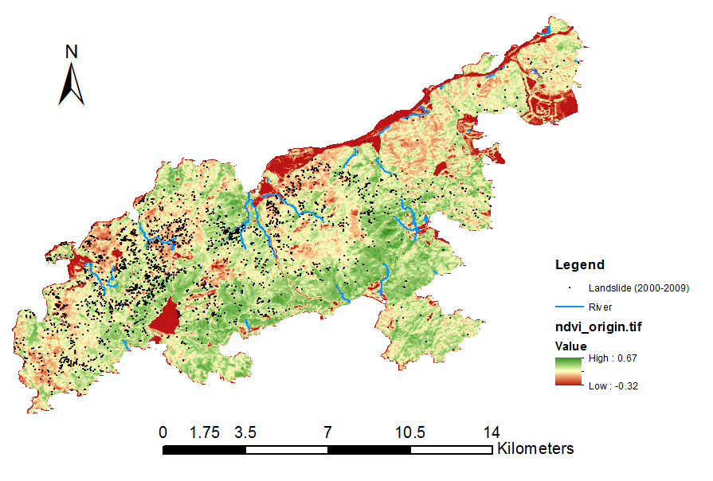
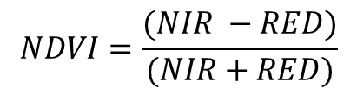
Landslide Susceptibility Analysis
Vegetation cover rate
$$NDVI=\frac{(NIR −RED)}{(NIR+RED)}$$
Normalized Difference Vegetation Index (NDVI) and Major River
in Lantau Island, Hong Kong

Slide 9
Landslide Susceptibility Analysis
Frequency ratio model analysis
LSI = Fr_{elevation} + Fr_{NDVI} + Fr_{slope} + Fr_{aspect} + Fr_{fault distance} + Fr_{river distance} + Fr_{lithology}
LSI: Landslide Susceptibility Index
Fr: Frequency ratio of each causative factors
Variables | Class | Value | Type | Pixels in domain | Pixel % | Landslide occurrence points | Landslide occurrence points% | Frequency ratio (Fr)
Elevation (m) | 1 | 20 - 69 | Continuous | 46,050 | 30.12 | 224 | 8.43 | 0.28
 | 2 | 69 - 143 |  | 31,089 | 20.33 | 428 | 16.11 | 0.79
 | 3 | 143 - 220 |  | 25,387 | 16.60 | 607 | 22.85 | 1.38
 | 4 | 220 - 297 |  | 17,750 | 11.61 | 634 | 23.86 | 2.06
 | 5 | 297 - 382 |  | 13,267 | 8.68 | 418 | 15.73 | 1.81
 | 6 | 382 - 477 |  | 9,207 | 6.02 | 192 | 7.23 | 1.20
 | 7 | 477 -582 |  | 5,225 | 3.42 | 124 | 4.67 | 1.37
 | 8 | 582 - 702 |  | 3,451 | 2.26 | 27 | 1.02 | 0.45
 | 9 | 702 - 920 |  | 1,479 | 0.97 | 3 | 0.11 | 0.12
Variables | Class | Value | Type | Pixels in domain | Pixel % | Landslide occurrence points | Landslide occurrence points% | Frequency ratio (Fr)
Distance to fault (km) | 1 | 0 - 0.62 | Continuous | 18,332 | 31.06 | 1,548 | 58.17 | 1.87
 | 2 | 0.62 - 1.20 |  | 12,478 | 21.14 | 853 | 32.06 | 1.52
 | 3 | 1.20 -1.78 |  | 8,118 | 13.75 | 218 | 8.19 | 0.60
 | 4 | 1.78 - 2.36 |  | 6,240 | 10.57 | 36 | 1.35 | 0.13
 | 5 | 2.36 - 2.95 |  | 5,015 | 8.50 | 6 | 0.23 | 0.03
 | 6 | 2.95-3.52 |  | 4,588 | 7.77 | 0 | 0.00 | 0.00
 | 7 | 3.52-3.83 |  | 4,251 | 7.20 | 0 | 0.00 | 0.00
Classification
Pixel in each category and percentage

Slide 10
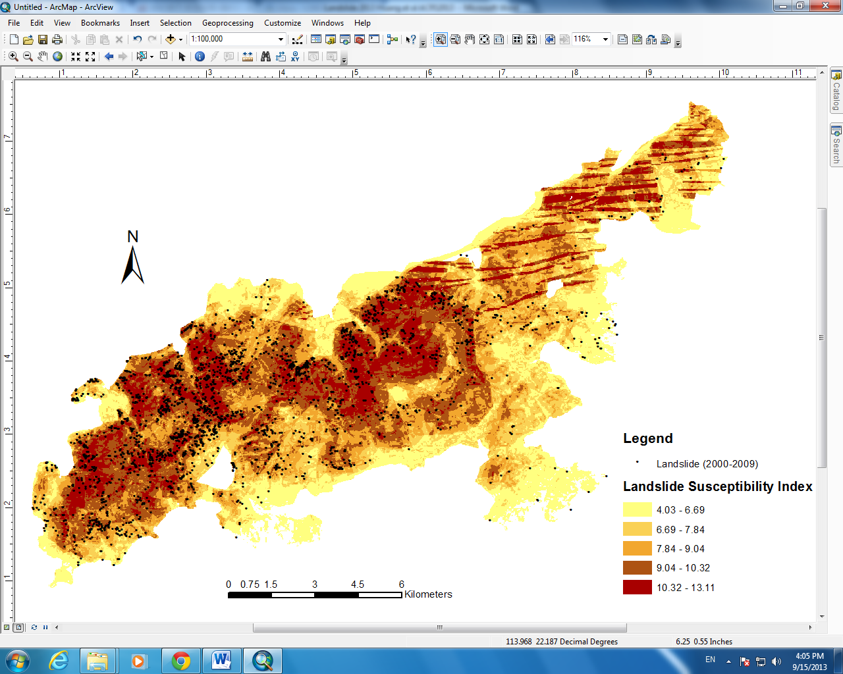
Landslide Susceptibility Analysis
Landslide susceptibility mapping result based on frequency ratio method

Slide 11
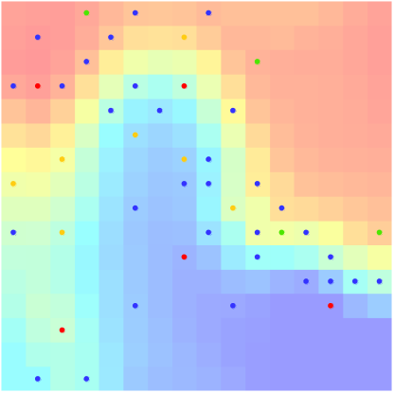
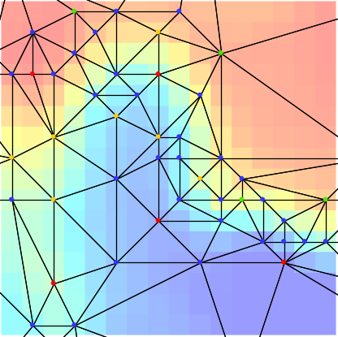
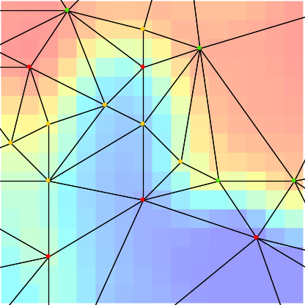
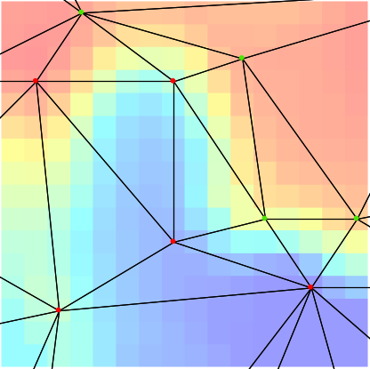
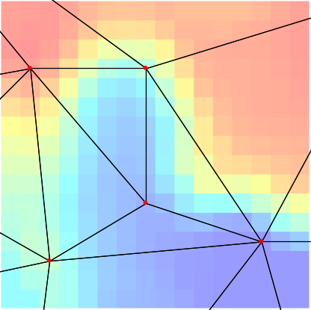
Multi-scale DEM
(a)
(b)
(c)
Degree of Importance
m
30
50
90
125
(d)
(e)

Slide 12
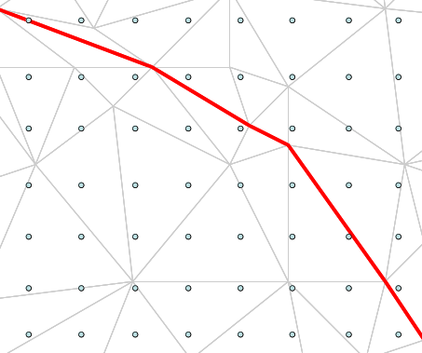
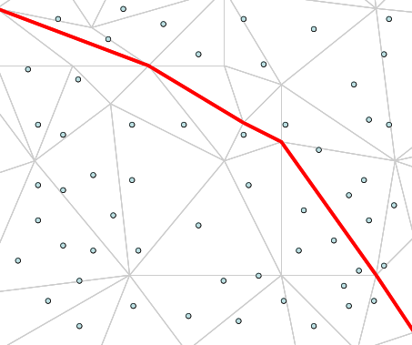
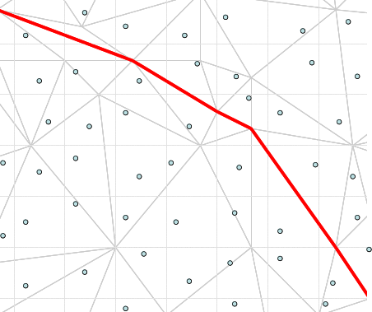
The separation of DEM and hydrologic model
Source sampling schema
Systematic
Random
Stratified random

Slide 13
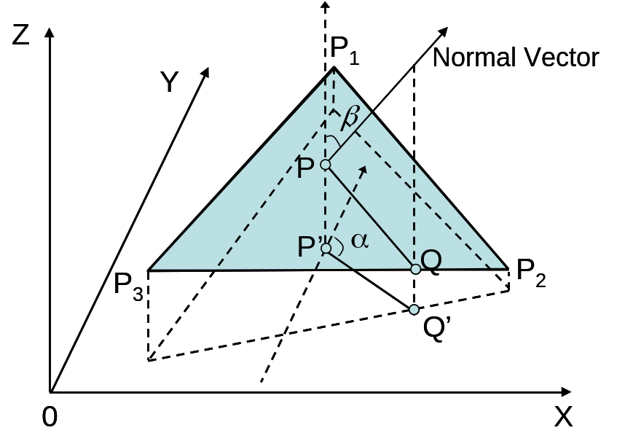
The flow vector on a triangular facet

Slide 14

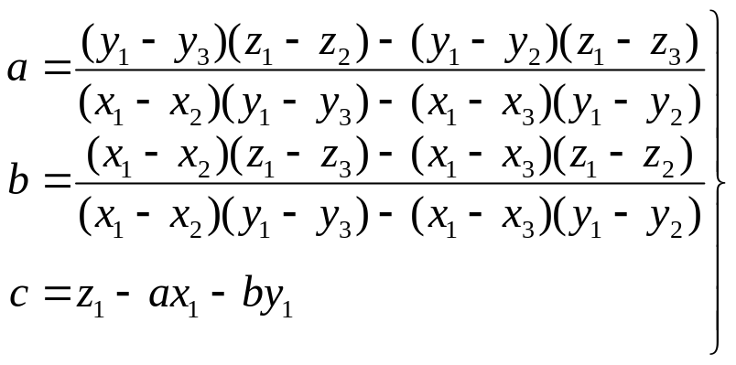
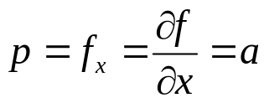
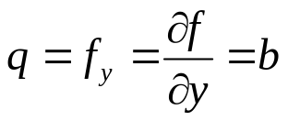
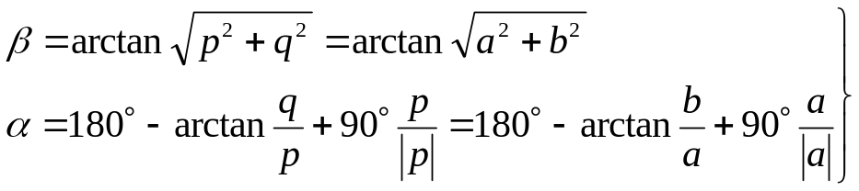
The slope and aspect of a triangular facet
P₁(x₁, y₁, z₁)
P₃(x₃, y₃, z₃)
P₂(x₂, y₂, z₂)

Slide 15
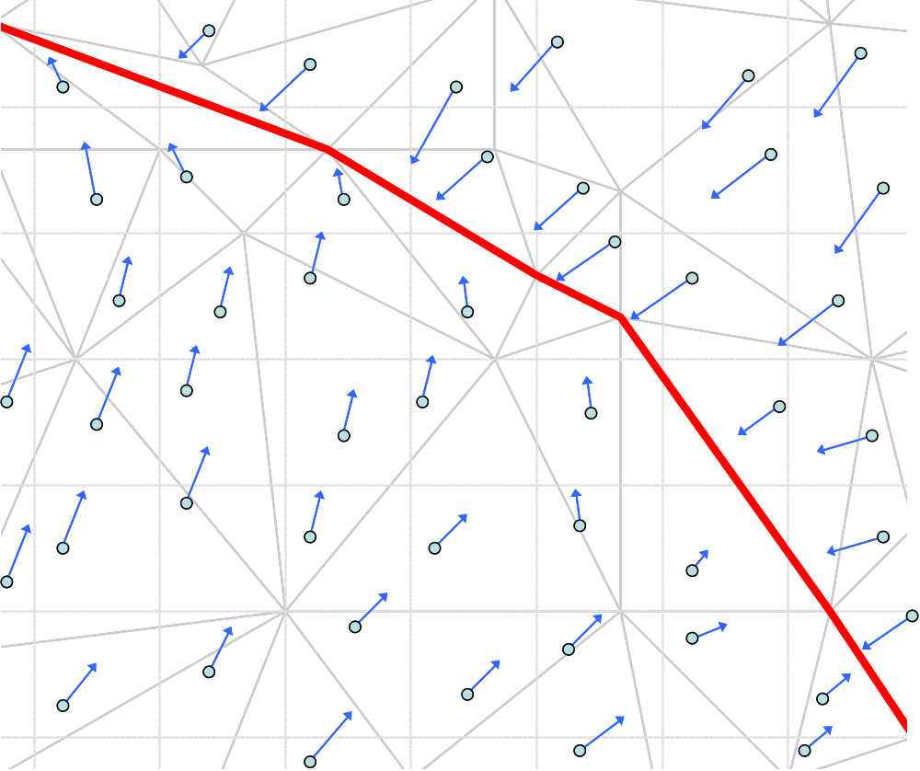
The flow direction of each source point

Slide 16
Flow path tracking

Slide 17
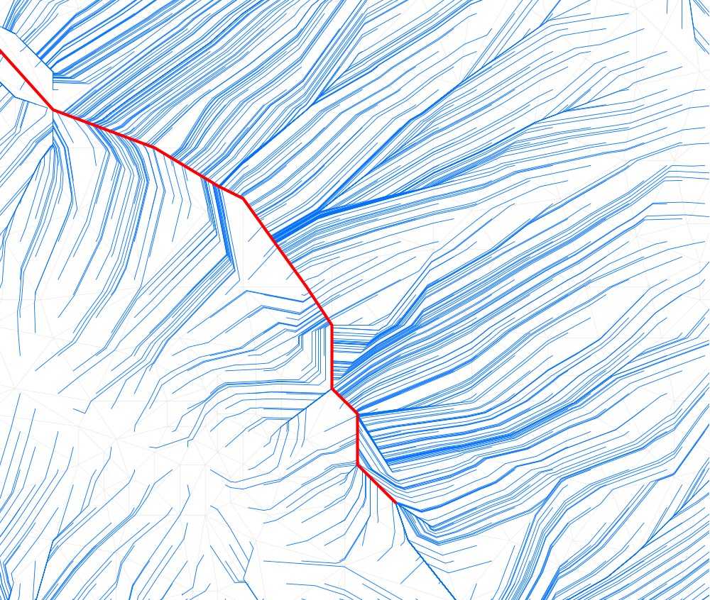
The flow path set

Slide 18
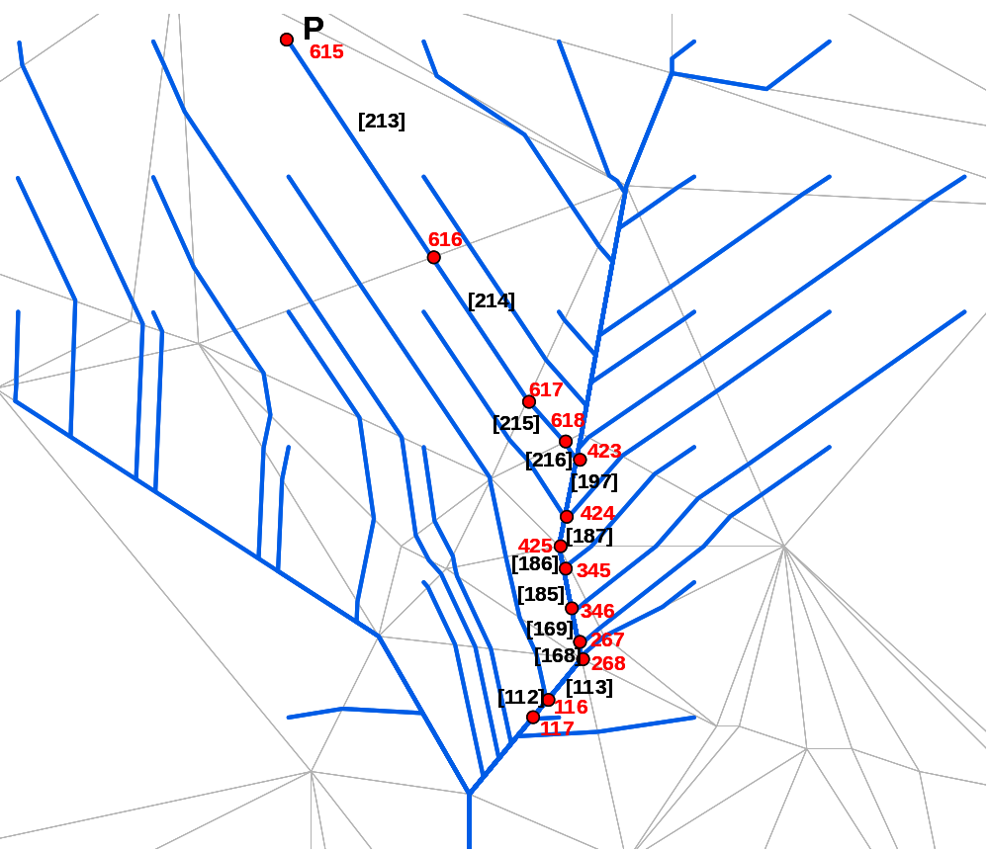
The topology of the flow path network
Node table
Node ID | X (m) | Y (m) | Z (m) | …
615 | 402306 | 4072762 | 1169.52 | …
616 | 402338 | 4072715 | 1129.89 | …
617 | 402359 | 4072683 | 1115.94 | …
… | … | … | … | …
Line table
Line ID | Start node | End node | Slope | length (m) | velocity (m/s) | …
213 | 615 | 616 | 20 | 217.5 | = v(…)
214 | 616 | 617 | 15 | 135.1 | = v(…)
215 | 617 | 618 | 10 | 32.4 | = v(…)
… | … | … | … | … | … | …
v = f(r, s, n)

Slide 19
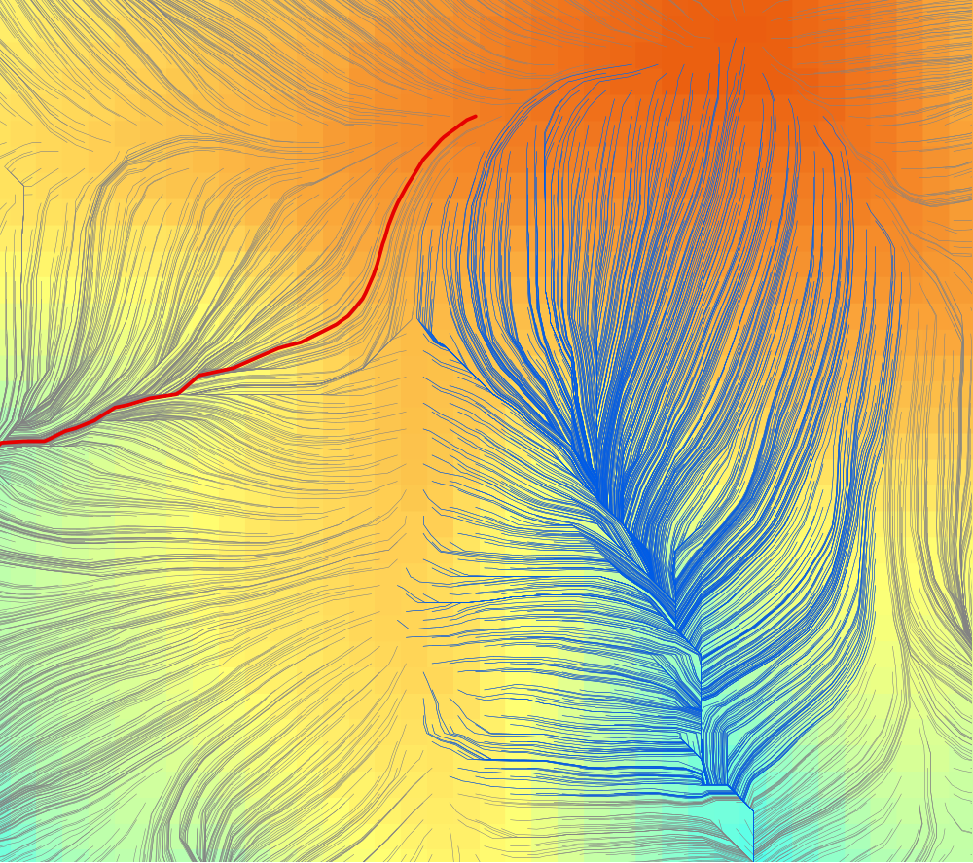
The flow path network
B
A

Slide 20
Digital terrain model

Slide 21
Rainfall simulator
Spatial-temporal rainfall interpolation
Stratified Random Sampling
t
P
t
P
t
P
x
y
t

Slide 22






Rainfall event simulation
t = 9s
t = 127s
t = 402s
t = 734s
t = 938s
t = 1120s

Slide 23
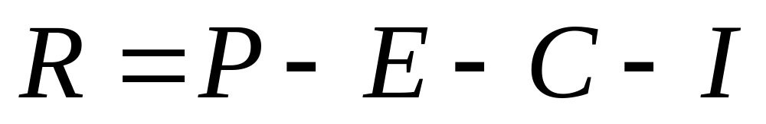
The flow generation at the source
Ground observation
Remote sensing
Ground observation
Soil and infiltration
R = runoff; P = rainfall; E = evaporation; C = interception; I = infiltration

Slide 24
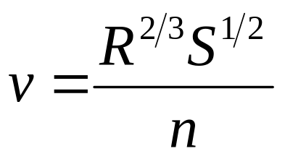
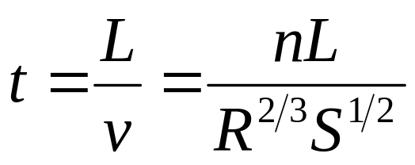
Velocity and time
From Manning Fomular:
v = velocity (m/s)
R = hydraulic radius (m)
S = hydraulic slope
n = Manning roughness coefficient
L = flow path length (m)
We have:

Slide 25
Runoff generation and flow simulation
DTM: Based on S-DEM method to generate dynamic TIN
Simulated rainfall event: 20 minutes 12mm uneven rainfall event
Other environmental factors were not considered.

Slide 26
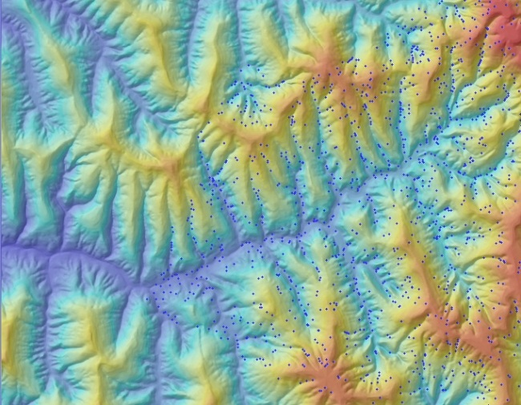
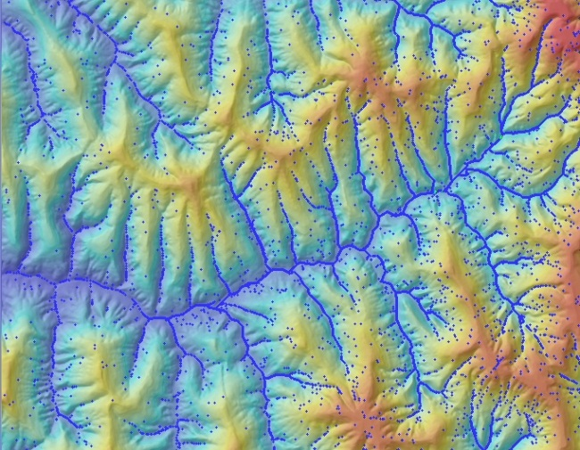
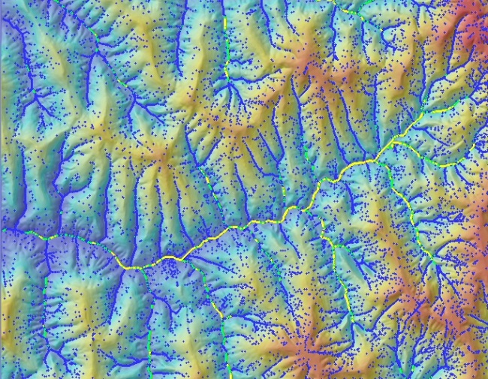
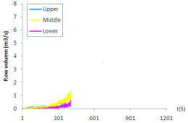
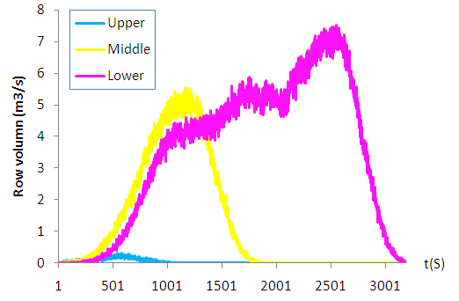
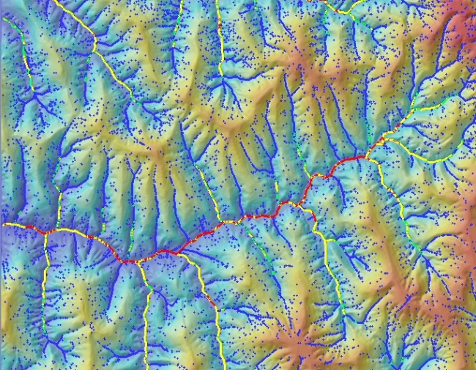
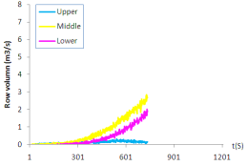
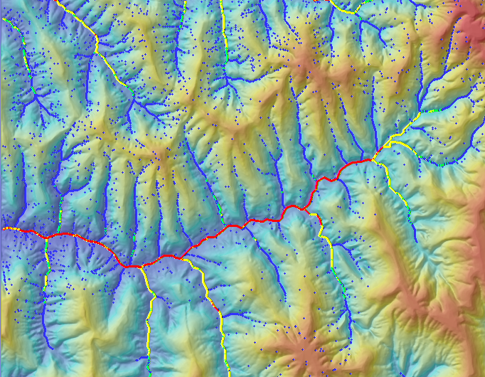
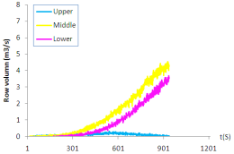
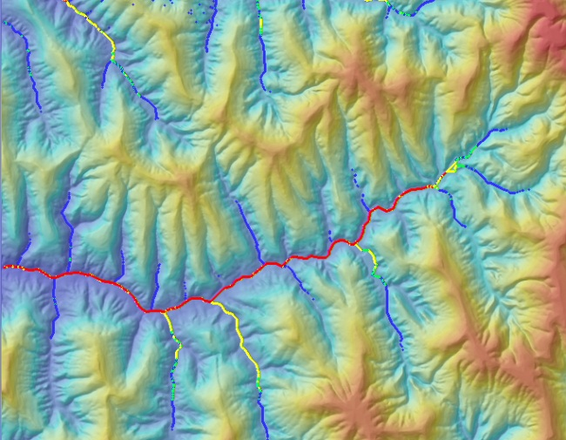
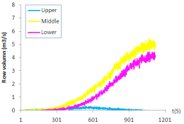
Rainfall-runoff modelling
t = 9s
t = 127s
t = 402s
t = 734s
t = 938s
t = 1120s
0 - 0.27 m³/s
0.27 – 0.54 m³/s
0.54 – 2.7 m³/s
> 2.7 m³/s

Slide 27
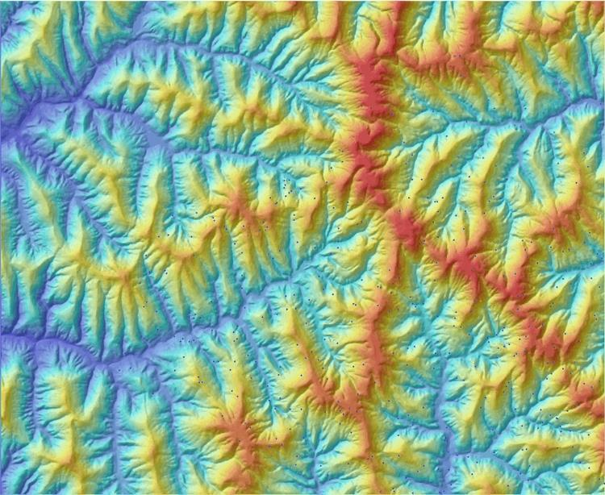
Rainfall-runoff modelling

Slide 28
Research significance
Mapping the detail areas potentially affected by or susceptible to landslides in a timely manner in order to mitigate/prevent the related risk, and compare with/improves the previous model(s)
Integration of an interdisciplinary approach by integrating the geotechnical statistic methods and hydrological physical/empirical rainfall-runoff models
Big data geography with time-critical natural disaster monitoring or forecasting

Slide 29
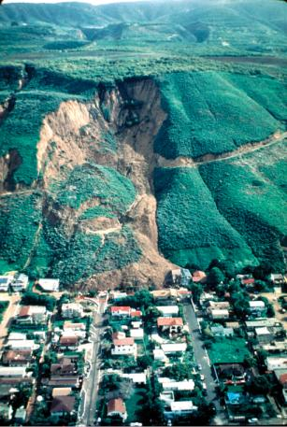
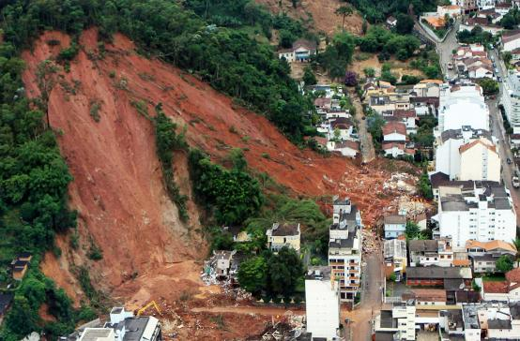
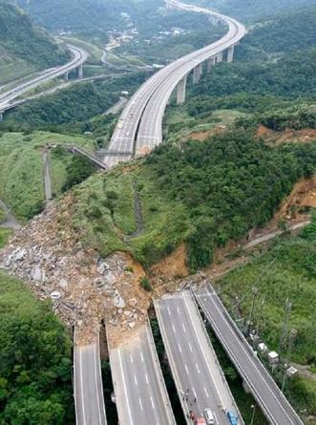
Thanks you for listening!
Interested in studying in Hong Kong or China?
Contact us!
qiming@hkbu.edu.hk

